Slide 1
Current Achievements of ESA CCI Land Cover and Sentinel-2 for Agriculture projects
F. Waldner and P. Defourny
MuSLI Working Session – 2017/04/14

Slide 2












Large Scale decametric Cropland Mapping from Sentinel-2 : Lessons Learned from 2016 nationwide Demonstration for three Countries
Defourny P., Bontemps S., Bellemans N., Cara C., Dedieu G., Grosu A., Guzzonato E., Hagolle O., Inglada J., Laurentiu N., Rabaute T., Savinaud M., Udroiu C., S. Valero, D. Morin and Koetz B.
In close collaboration with national partners in Ukraine (N. Kussul),
in Mali (P.S. Traoré) and in South-Africa (G. Chirma, T. Newby)
2

Slide 3

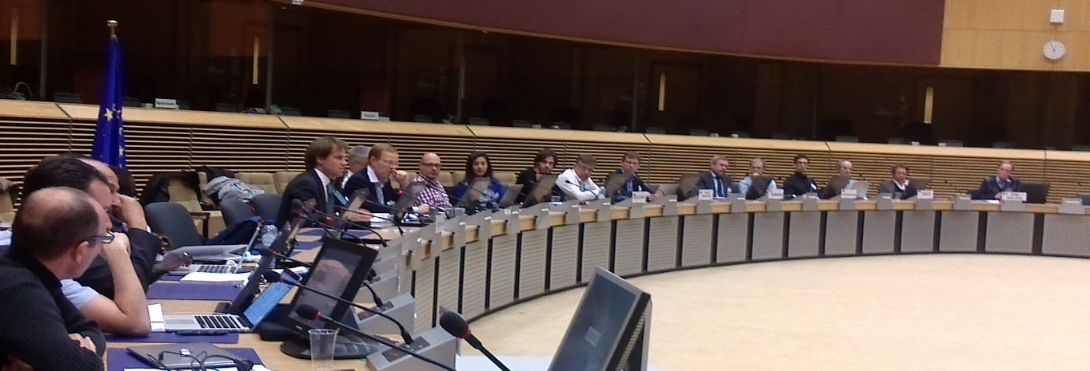
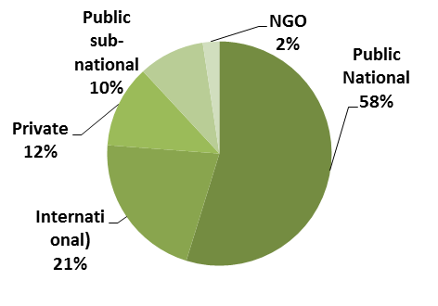
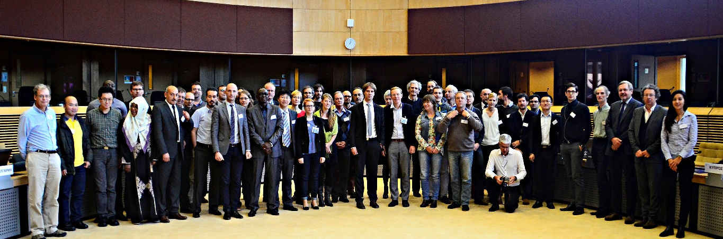
Sentinel-2 for Agriculture system
User-driven approach to define the requirements
Consortium
Support &
data provider
Champion Users
1st User Consultation organized by ESA in 2012
2nd User Consultation through surveys in 2014
Survey filed up by 42 institutions
1st Sen2-Agri Users Workshop – FAO May 2014
2nd Sen2-Agri Users Workshop – EU Nov. 2015
Notes:
Introduce consortium partners and their respective role

Slide 4
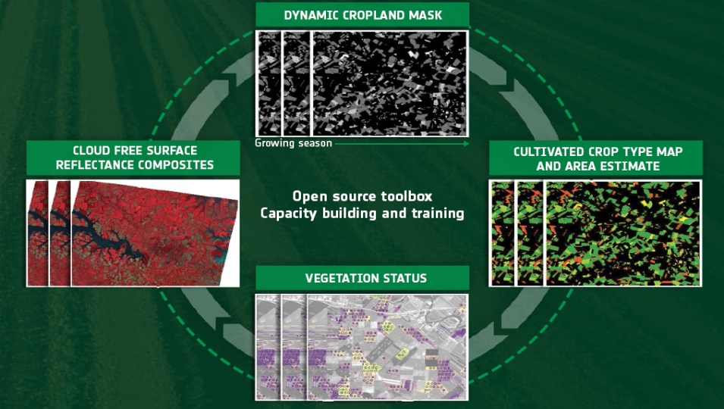
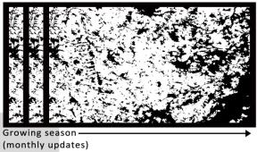
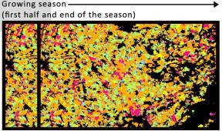
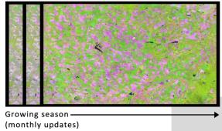
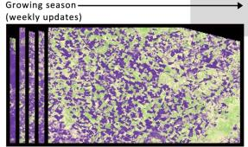
Top priority : open source system to deliver
4 Sen2-Agri products along the season
in line with the GEOGLAM core products
Binary map identifying annually cultivated land at 10m updated every month
Monthly cloud free surface reflectance composite at 10-20 m
EARLY AREA INDICATOR
EARLY AREA INDICATOR
Crop type map at 10 m for the main regional crops including irrigated/rainfed discrimination
Vegetation status map at 10 m delivered every week (NDVI, LAI, pheno index)

Slide 5
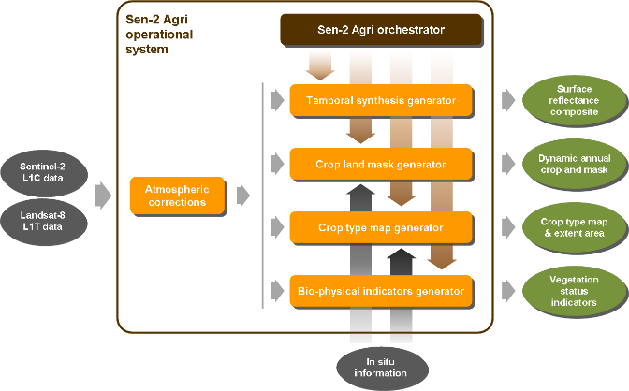
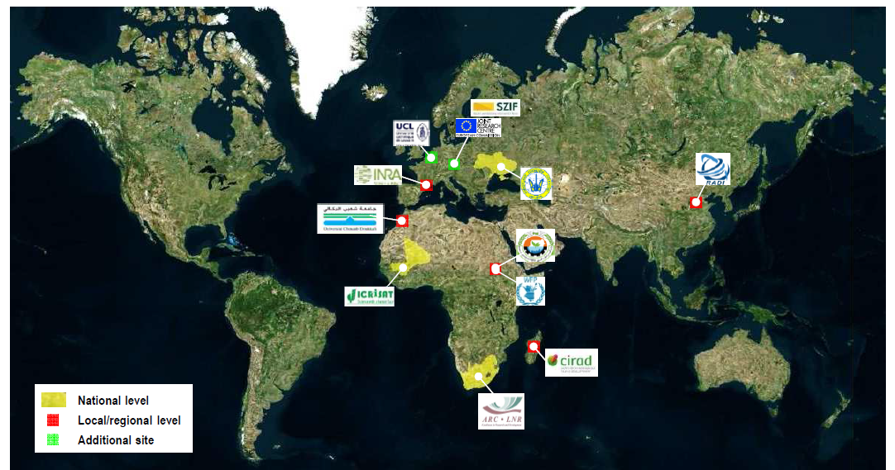
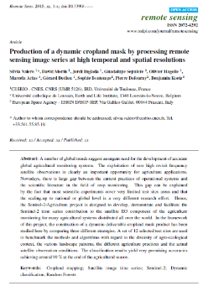
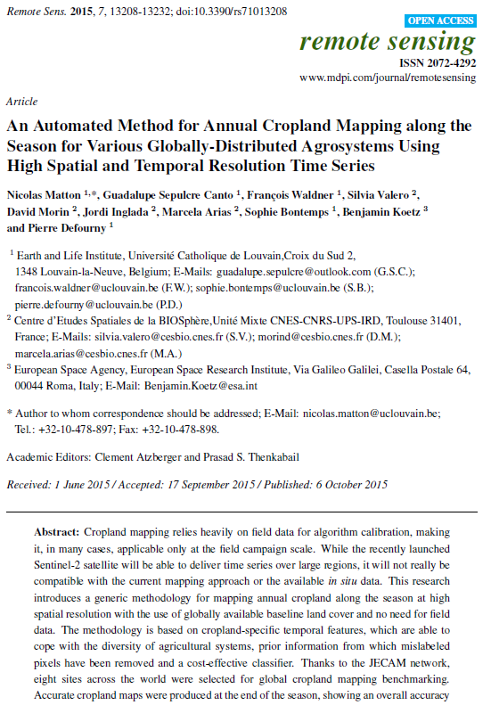
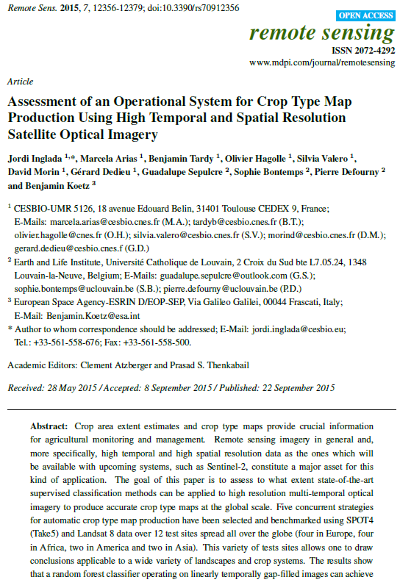
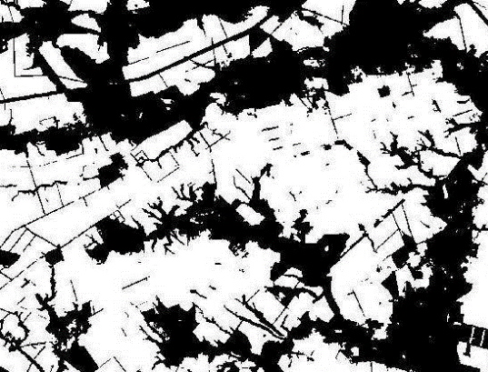
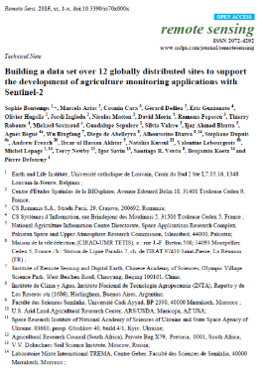
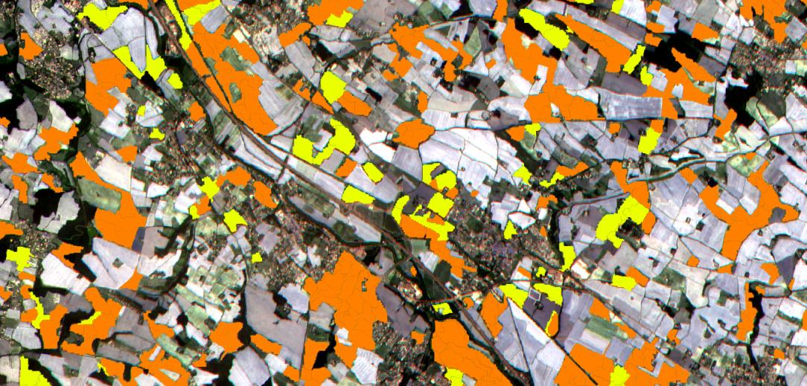
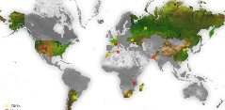
Phase 3 Sen2-Agri system demonstration
Demonstration & Validation
2016-2017
Prototypes of EO products
2015
Algorithm Development
2014
National use cases
Local use cases
Capacity building
Training activities
Fitness-to-use assessment
System qualification
Users Products specifications
Benchmarked Methods (4 pub.)
System ready in April 2016
Products prototype SPOT5-T5

Slide 6
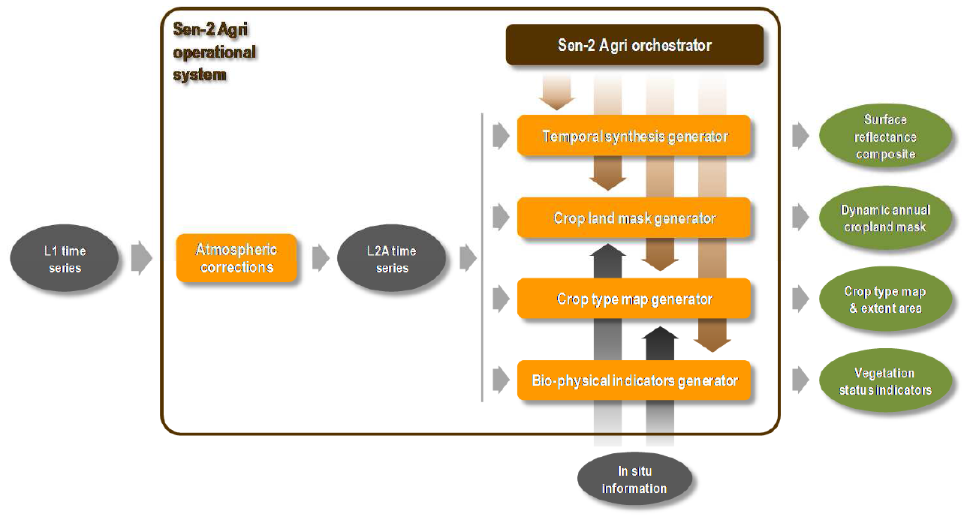
Phase 2 Sen2-Agri system development
A system designed to run in an automated near real time (and off line) mode to deliver agric. products as satellite images are ingested
=> Orchestrator concept

Slide 7
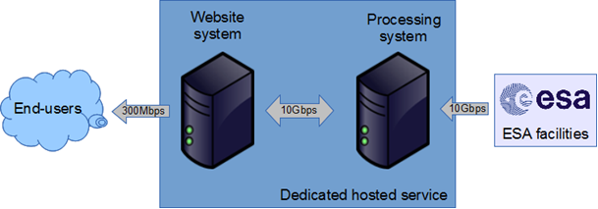
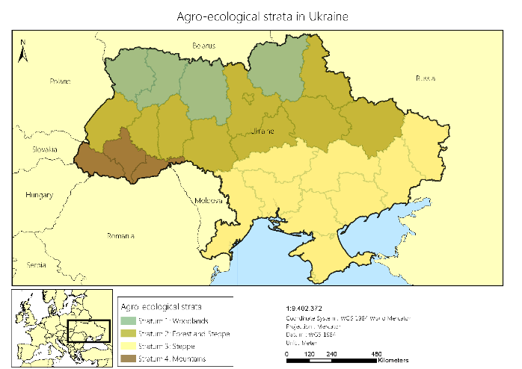

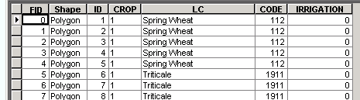
Sen2-Agri system : parametrization field data collection planning
Before the monitoring period
Monitoring period
System initialization
SoS
EoS
Sen2-Agri system : parameters settings
Area of Interest | Shapefile to be uploaded
Monitoring period | Start and end dates to be defined
S2 or S2 + L8 | To be selected
Other parameters | …
Sen2-Agri system : field campaigns
Sampling design | Stratification and sampling
Field visit | In situ data collection – early survey
 | In situ data collection – mid-season survey
Data upload | Field data quality control

Slide 8
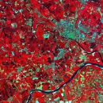


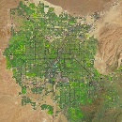


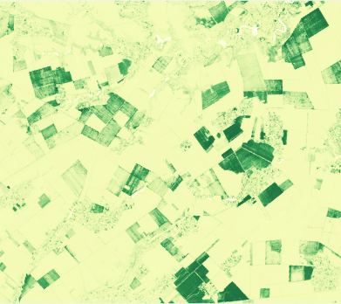
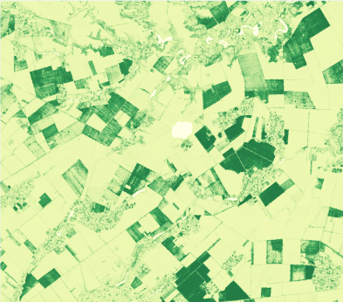
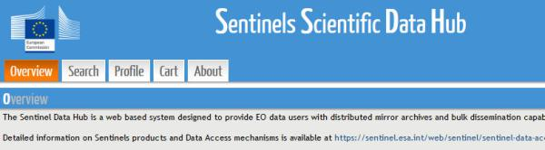
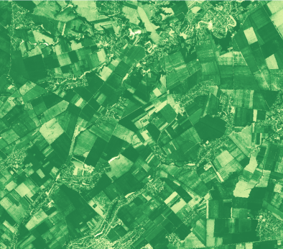
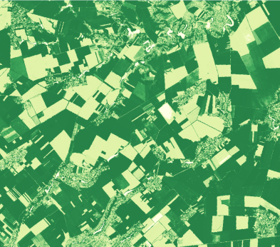
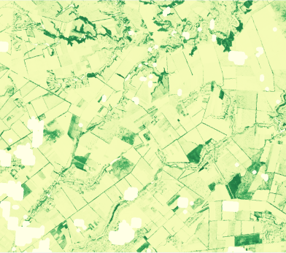
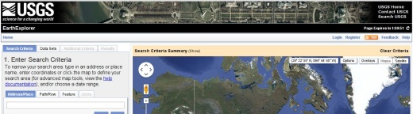
System operation for crop growth monitoring :
Leaf Area Index (LAI) product
Before the monitoring period
Monitoring period
t₀
t₅
t₁₀
t₁₅
System initialization
t₂
t₁₈
SoS
EoS
SoS
Automatic EO data download
from EO data providers
t₀
t₂
t₁₀
t₁₅
t₁₈
Notes:
This system is designed to process on the fly all the Sentinel-2 and Landsat-8 acquisition along the season to derive in automated way four different products
Benchmarking conclusions
Non-linear regression model
Reflectance are simuated using the ProSail model
2 reprocessing options :
Weighted average using the n last LAI value
Fitting a phenological model on the full time series

Slide 9
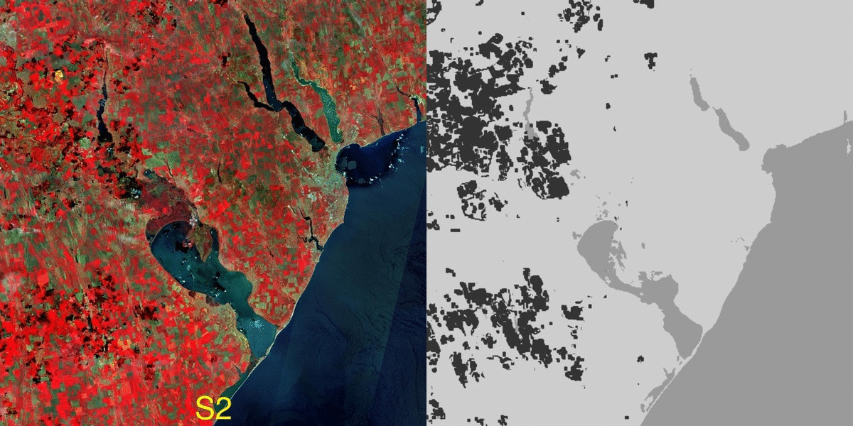
Cloud-free temporal synthesis over South of France, combining S2 andL8

Slide 10
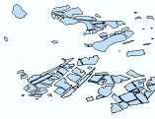
System operation for crop type
Before the start of
the monitoring period
Automatic EO data download
Manual in situ data upload
Monitoring period
System initialization
SoS
6M
EoS
SoS
EO data providers
Operators
Notes:
Based on the crop mask previously generated
Random forest classifier
Classifier applied on features :
Surface reflectance
NDVI
NDWI
Brightness

Slide 11
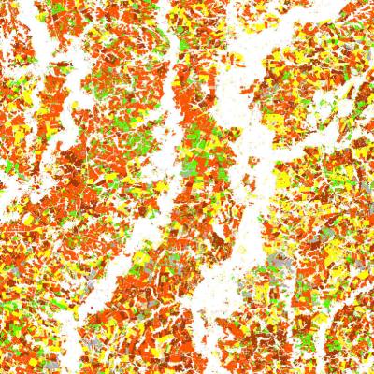
System operation for crop type
Before the start of
the monitoring period
Automatic EO data download
Manual in situ data upload
Monitoring period
System initialization
SoS
6M
EoS
SoS
Mid-season crop type
EO data providers
Operators

Slide 12

System operation for crop type
Before the start of
the monitoring period
Automatic EO data download
Manual in situ data upload
Monitoring period
System initialization
SoS
6M
SoS
EoS
Mid-season crop type
EO data providers
Operators

Slide 13
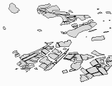
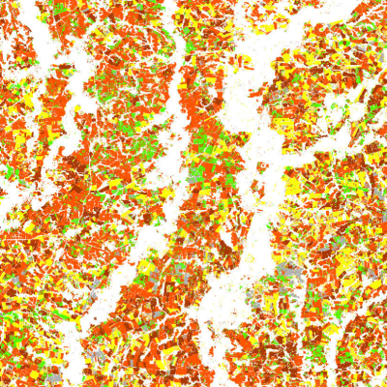
System operation for crop type
Before the start of
the monitoring period
Automatic EO data download
Manual in situ data upload
Monitoring period
System initialization
SoS
6M
EoS
SoS
EoS
Mid-season crop type
EO data providers
End of season
crop type
Operators

Slide 14
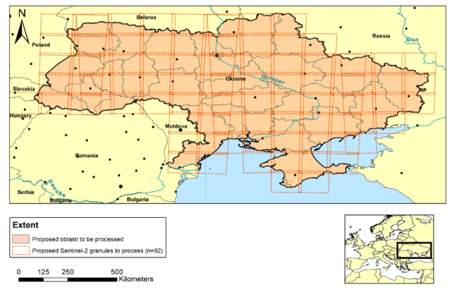
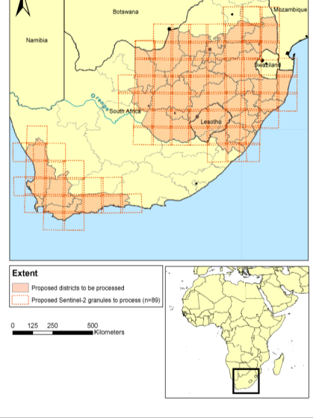
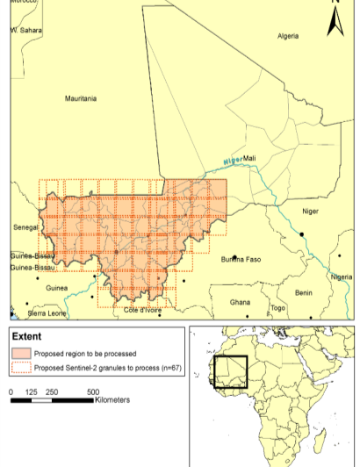
Phase 3 Sen2-Agri system demonstration
3 national sites
To demonstrate the Sen2-Agri system and NRT products using Sentinel-2a & Landsat 8 (but without Sentinel-2b) at national scale with in situ system implementation
Ukraine (SRI)
South Africa (ARC)
Mali (ICRISAT & IER)

Slide 15
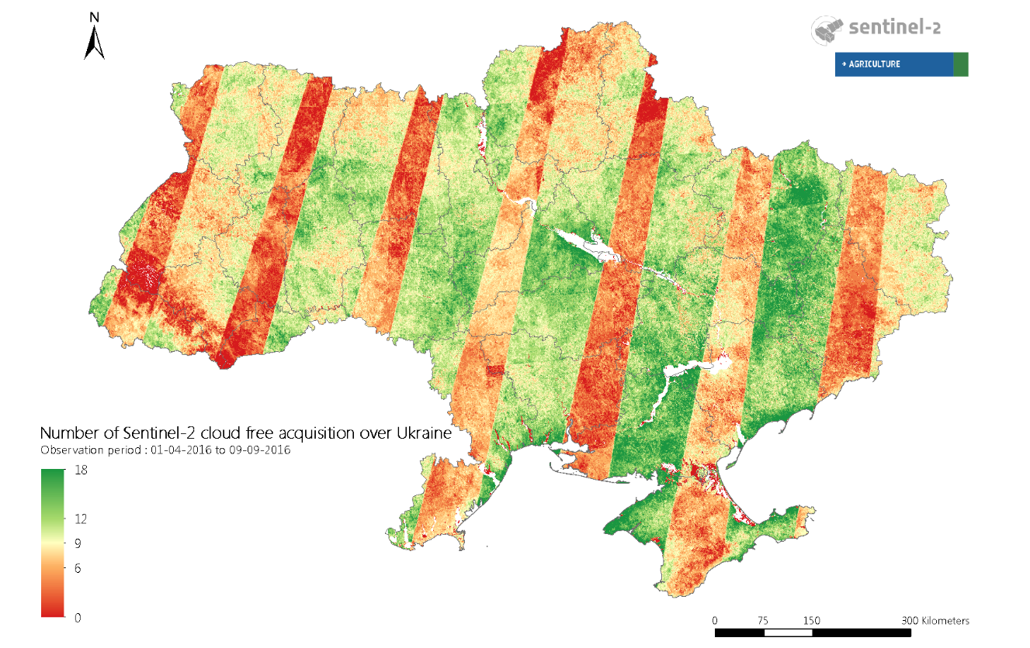
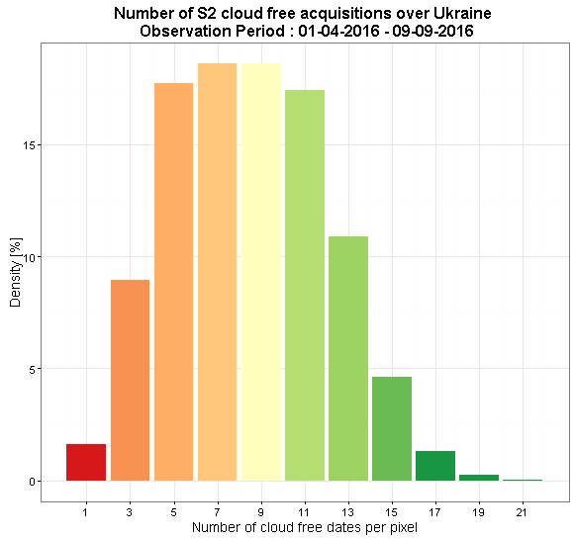
Ukraine 2016 : Sentinel-2 coverage

Slide 16
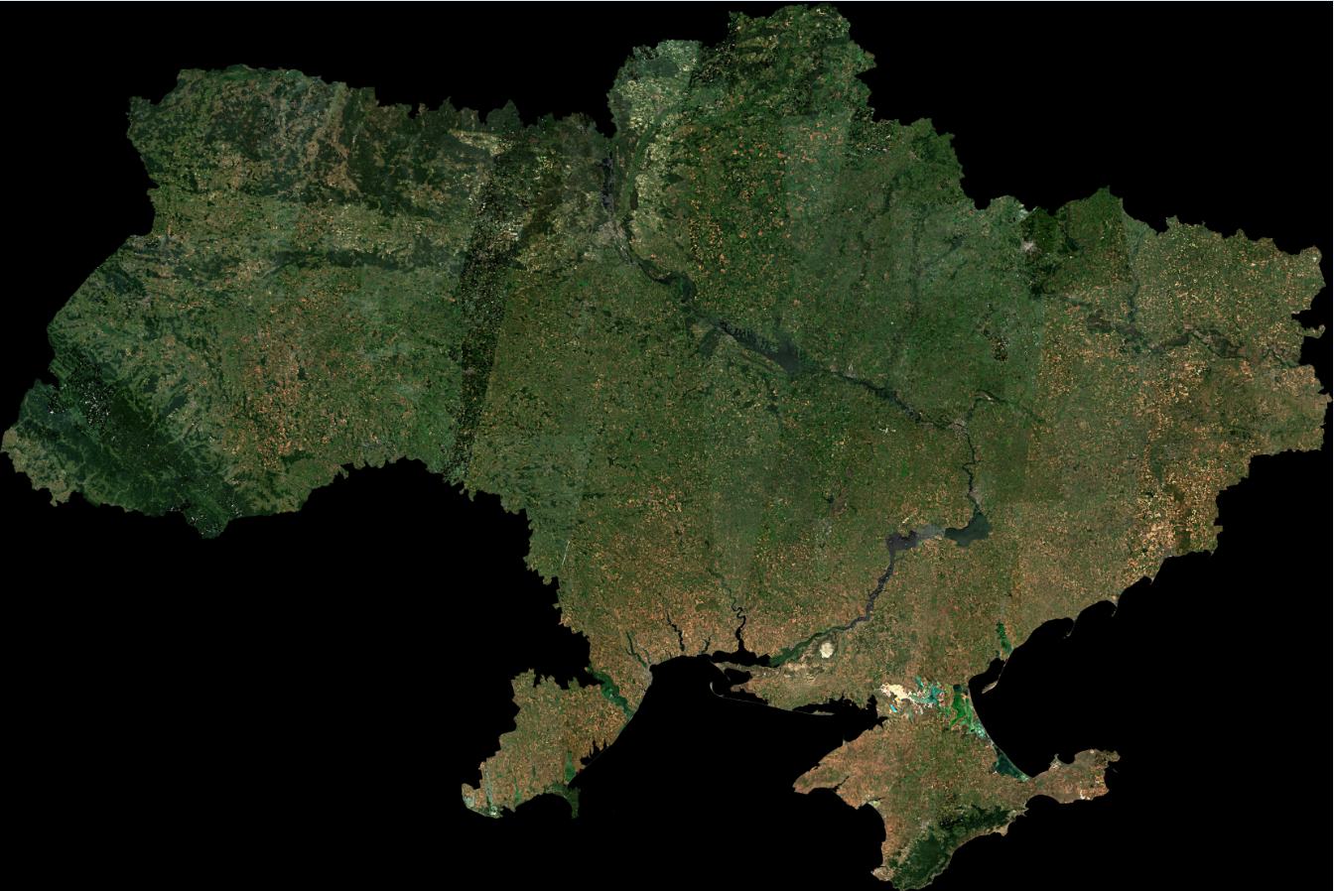
Sentinel-2 10 m cloud free composite (July 2016)

Slide 17
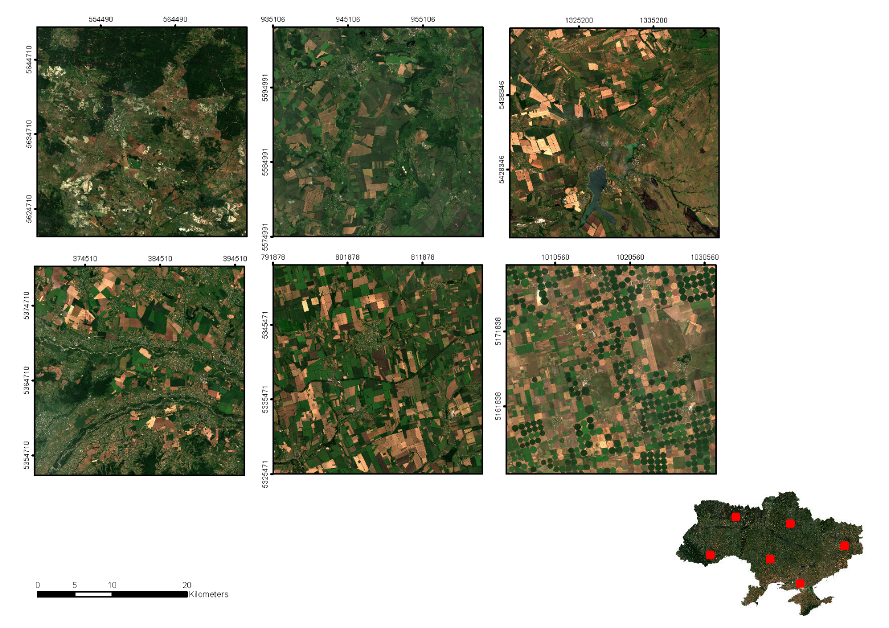
Sentinel-2 10 m cloud free composite (July 2016)

Slide 18
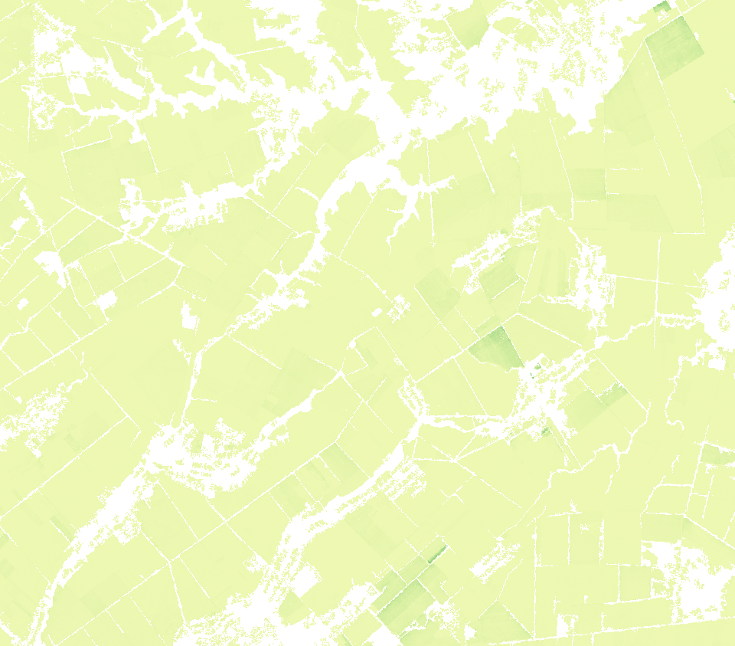
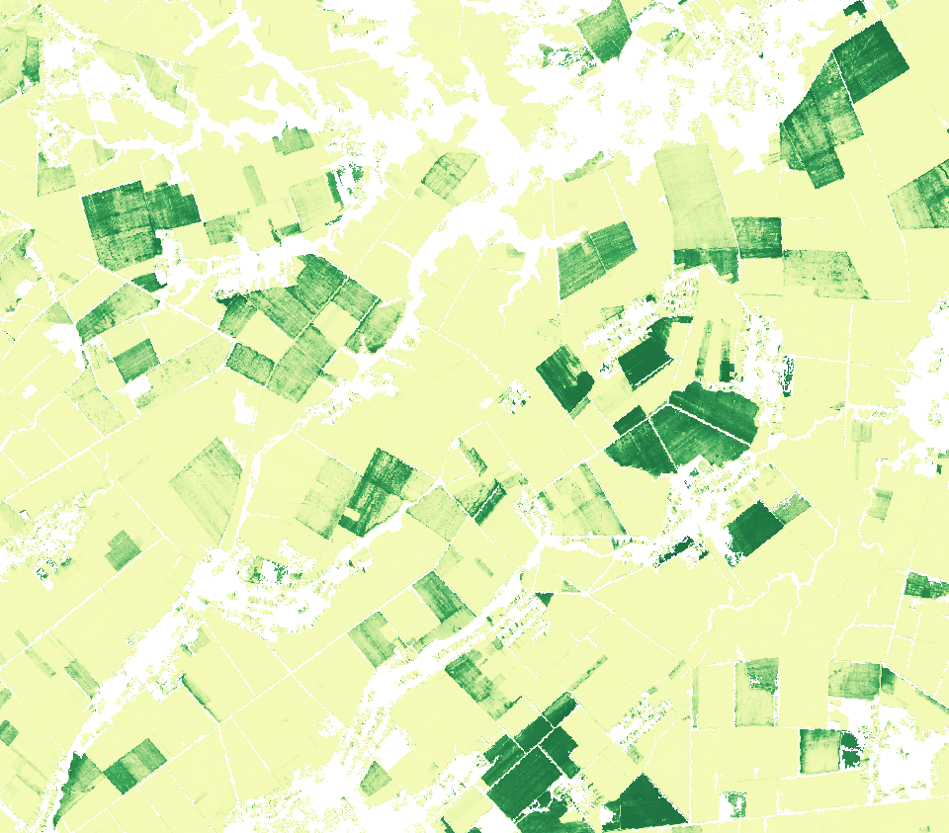
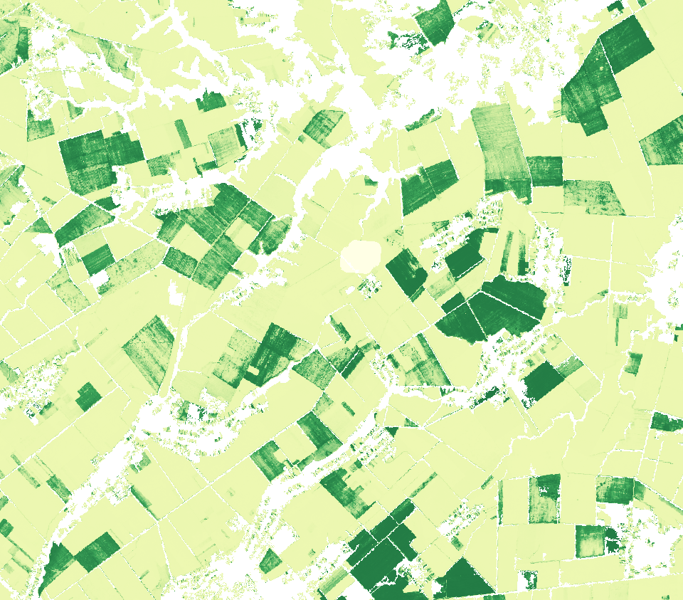
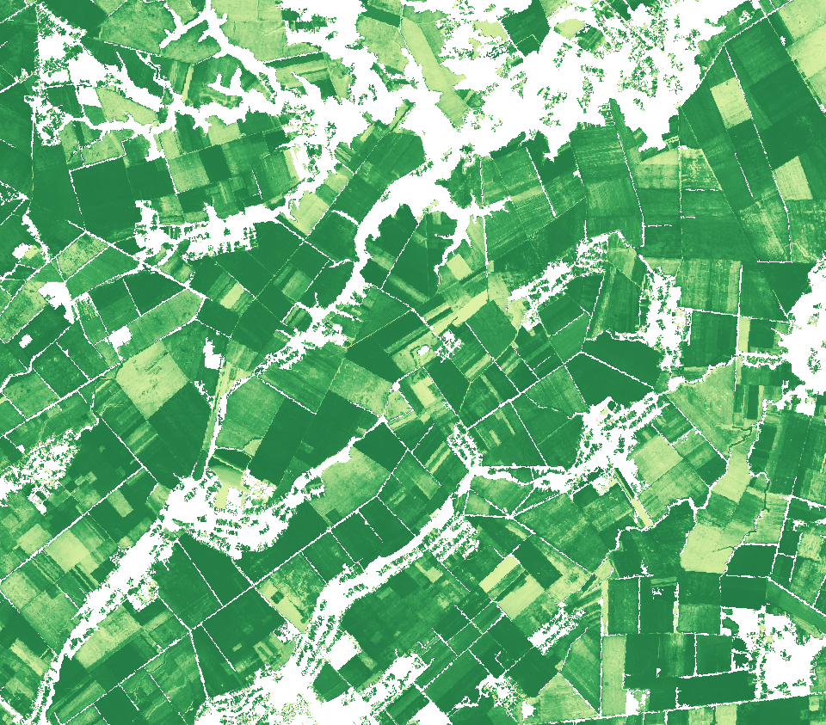
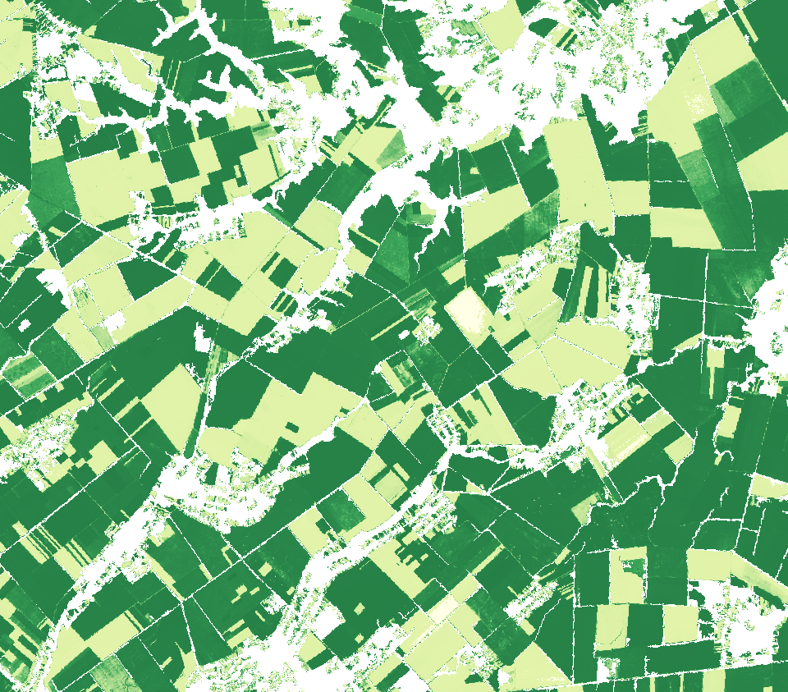
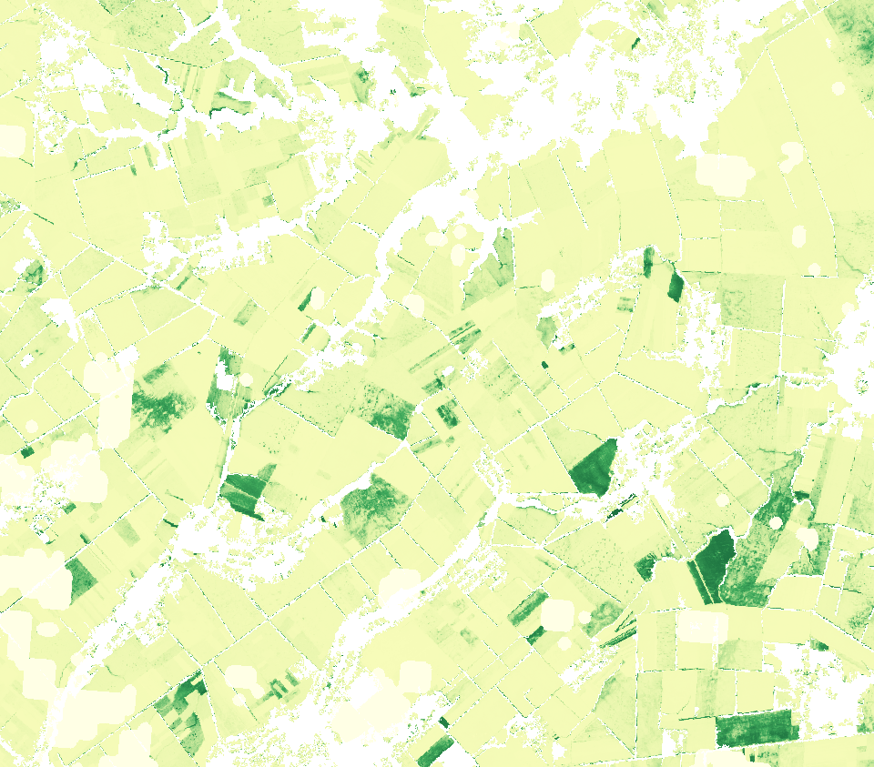
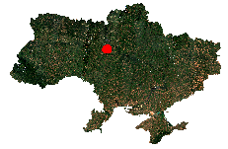
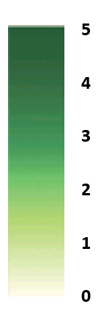
Sen2-Agri crop growth monitoring :
2016 Leaf Area Index (LAI) time series for cropland
18 Feb. 16
18 Apr. 16
28 Apr. 16
17 Jun. 16
17 Jul. 16
8 Sept. 16
Leaf Area Index
values

Slide 19



Slide 20


Sen2-Agri 10 m cropland map for Ukraine (July 2016)
Cropland
Non-Cropland
Overall accuracy : 96 %
F-score cropland : 97 %

Slide 21
Crop Area Early Indicator for 2016 versus
Cultivated Area Statistics per Oblast for 2015

Slide 22

Training set – 5536 parcels
Validation set – 2153 parcels

Slide 23



Sen2-Agri 10 m main crop types map for Ukraine (July 2016)
Overall accuracy : 81 %
    Winter wheat and sunflower quite interesting performances
    Winter barley accuracy required further investigation (nbr of samples, distribution )

Slide 24


Sen2-Agri 10 m products : field level

Slide 25

Sen2-Agri 10 m products : field level

Slide 26



Phase 3 Sen2-Agri system demonstration
in Mali (447 948 sq. km)

Slide 27





First cloud free composite series over Mali
at 10m resolution from Sentinel-2 and Landsat 8
July 2016
August 2016
September 2016
October 2016

Slide 28


First cropland mask at 10m resolution from Sentinel-2 and Landsat-8 over South of Mali
1st system validation:
Overall accuracy: 0,96
F-score cropland: 0,81

Slide 29

The decametric resolution is a game changer for area estimation

Slide 30
Early lessons learnt from national demonstration of decametric land mapping
Decametric time series availability allows to proceed to full scale experiment on annual basis – Sentinel-2b still much needed and Sentinel-1 integration would much enhance the robustness
Nationwide operation is challenging for the processing but even more for the in situ data collection in a quality control and timely manner (logistics matter a lot + flooding in Sudan, unrest in Madagascar, etc.)
Turn-key system like Sen2Agri system should actually be able to evolve based on capitalization of full scale experiences
Partnerships with national stakeholders is key to insure outcome relevance, ownership and the « last mile » – joint multi-year experience needed !
Very fast learning curve thanks to standardisation of full scale experiments for different countries

Slide 31










ESA Climate Change Initiative - Land Cover component
A consistent 1992 - 2015 global land cover time series at 300 thanks to a state-of-the-art reprocessing of multi-mission archives
Defourny P. (1), Brockmann C. (3), Lamarche C. (1), Bontemps S. (1), Achard F. (2), Boettcher M. (3), De Maet T. (1), Gamba P. (4), Hagemann S. (5), Hartley A. (6) , Hoffman L., (11), Georgievski G. (5), Kirches G. (3), Lisini G. (4), MacBean N. (7), Mallick K. (11), Mayaux P. (2), Moreau I. (1), Pathe C. (8), Peylin P. (7), Radoux J. (1), Ramoino F. (10), Riedel T. (8), Santoro M. (9), Schmullius C. (8), Smollich S. (4), Van Bogaert E. (1), Vittek M.(1), Wegmüller U. (9), Zuehlke M. (3), Ramoino F. (10), Arino O. (10) m
(1) UCLouvain-Geomatics, Belgium; (2) JRC, Italy; (3) Brockmann Consult GmbH, Germany;
(4) University of Pavia, Italy; (5) Max Plank Institute for Meteorology, Germany;
(6) MET Office, United Kingdom; (7) LSCE, France; (8) University of Jena, Germany;
(9) GAMMA Remote Sensing, Switzerland; (11) LIST, Lux. (10) ESA-ESRIN, Italy

Slide 32

Status of the global land cover at the start of the ESA-CCI programme
Single sensor - single year land cover products (except MODIS et MERIS)
No compatibility between existing products and between typologies
Continuous but not cumulative improvement from 1°to 300 m in 20 years
Land surface not so consistently described over years even from daily obs. time series

Slide 33





CCI Land Cover concept land cover + land surface seasonality + land cover change
Three basic principles
1. Characterizing three components : LC, seasonality and LC change
2. Decoupling LC and LC change in terms of EO sources and methods
3. Multi-mission approach with reprocessing of full mission archives
Mapping land cover and land surface seasonality
Mapping land cover change from trajectory analysis
Burnt Areas
Occurrence
probability
Snow
Occurrence
probability
NDVI
Average &
Inter-annual variability
  Climatology of 3 variables over 12 y.
(Defourny et al., 2013)
Notes:
Learning from GlobCover experience we know land cover which seems common sens is not so easy to get consistently over space and time !
In the context of CCI, we had to adress the request from the climate modeling community but we knew that by adressing their needs we will also serve other users communities.
Therefore, we decide since 6 years ago to take up the challenge.
Threebasic principles were decided :
This should leads to 3 types of products…
This was a long way but today the very good news for those who heard about it since a while as well as for those who just heard about it today : the very good news is that this is now completed !
Therefore today, on behalf of our CCI LC consortium, I have the pleasure to announce the public release of the CCI Land Cover dataset available on-line and covering the period from 1992 to 2015. Ramp up phase Today the viewer with all the products and download of the most recent one 2015 !

Slide 34


CCI Land cover challenge : consistency and change detection over time
STABILITY
CONSISTENCY
over years
CHANGE
Stratification in 22
equal-reasoning reg.
MERIS full archive
(2003-2012)
AVHRR
(1992-1999)
SPOT-VGT full archive
(1999-2012)
PROBA-V
(2013-2015)
Machine learning & unsupervised classification
Per-pixel LC classes trajectories for 1 km change detection using IPCC classes
…
Labeling layer
1994
1995
1998
2001
2002
2005
2006
2009
2012
1992
2013
1993
1996
1997
1999
2000
2003
2004
2007
2008
2010
2011
2014
Baseline
(2003-2012)
2015
Back- and up-dating
consolidated and delineated at 300 m using 22 LC classes
Annual 300 m LC maps
(1992-2015…)

Slide 35


Forest Loss:
Coal mines in Germany
land cover status in 1999

Slide 36


Forest Loss:
Coal mines in Germany
Post-change class: sparse vgt

Slide 37




2011
Brown coal is extracted in Jänschwalde mines
2003
Year of
change
2003
2004
2005
2006
2007
2008
2009
2010
2011
2012

Slide 38


Forest Gain:
Plantations in Sumatra
LC status in 1999

Slide 39


Forest Gain:
Plantations in Sumatra
Post-change class:
Forest

Slide 40


Forest Gain:
Plantations in Sumatra
Year of change

Slide 41


South-East Asia

Slide 42

Mato-Grosso

Slide 43




Land surface seasonality variables computed at 1km based on 12 y.+
7-day resolution for ‘climatological’ variables from data or existing dataset
(incl. quality flag)
Frequency of fire for each week
(burned areas)
Great consistency across the 3 variables
Frequency of snow for each week
NDVI average along the year and
its inter-annual variability per week

Slide 44



300 m annual global land cover time series from 1992-2015 (22 classes)
Public release last Monday !

Slide 45
Lessons learnt from CCI Land Cover
Key role of surface reflectance quality (radiometry, geometry) incl. atmospheric correction and cloud & cloud shadow screening
=> iterative reprocessing of full archives for consistent global LC maps
Multi-mission approach needed => AVHRR, SPOT-VGT, MERIS, PROBA-V
Land cover consistency in space and time is very challenging
= >LC & LCC decoupling to build in the LC consistency while capturing the land cover change detectable at 1 km
“The last mile matters !”
=> Users tool and time investment from RS teams and climate model groups to share common understanding
UN-LCCS/LCML standards to define land cover typology and scale
=> toward scalable typology from decametric to 300 m LC mapping

Slide 46
http://maps.elie.ucl.ac.be/CCI/viewer/
http://www.esa-sen2agri.org/

