Slide 1
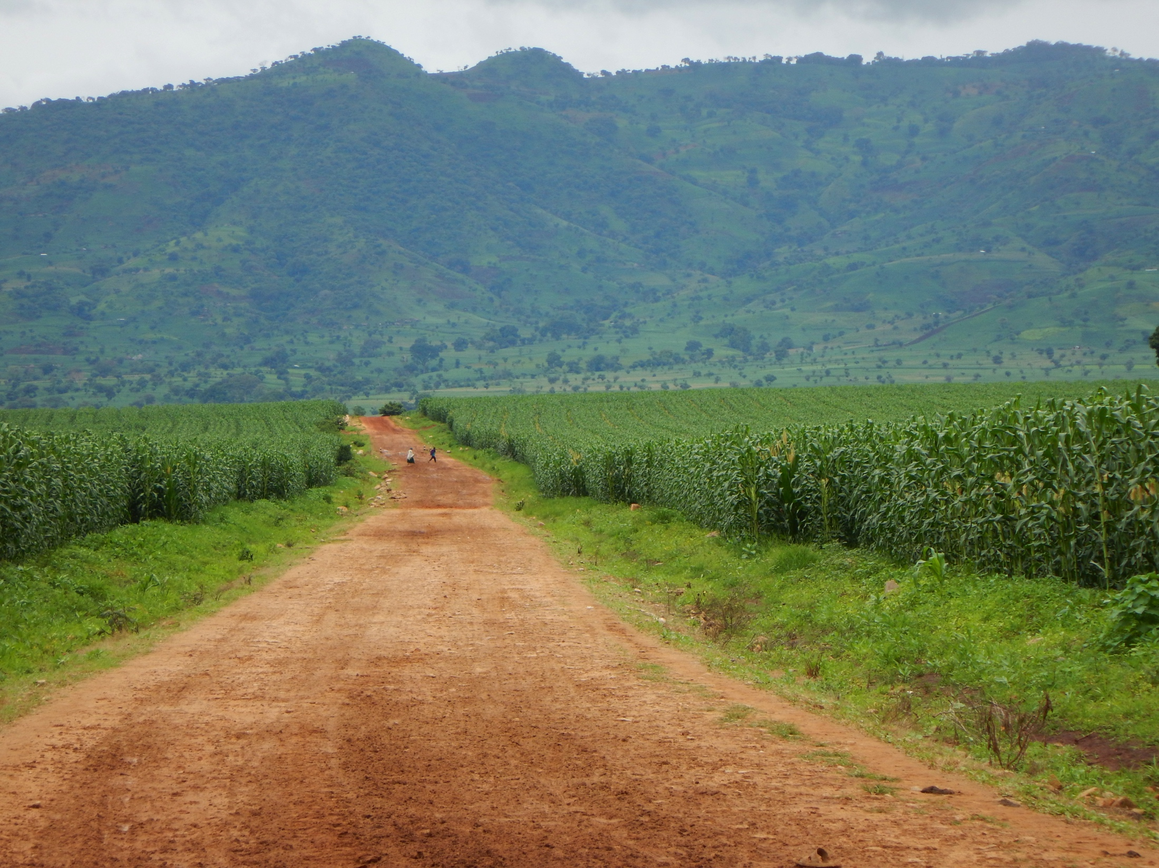



Large-Scale Land Transactions as Drivers of Land-Cover Change in Sub-Saharan Africa
Dan Brown (PI), Arun Agrawal (co-PI)
Chuan Liao (post-doc), Suhyun Jung (post-doc), Jon Sullivan (pre-doc)
Notes:
Ethiopia is particularly suited for a study of the effects of land transactions for three key reasons. First, government decision makers, keen to improve agricultural output and productivity, have sought to attract both domestic and international investments in the vast rural areas of the country (Crewett & Korf, 2008; Lavers, 2012a, 2012b). The Ethiopian government has a unique capacity to initiate large-scale land transactions and relocate existing residents because the state has controlled land rights for much of Ethiopia’s modern history. Indeed, Ethiopia has witnessed among the largest number of land transactions in sub-Saharan Africa. The actual number of transactions is far in excess of the 55 or so recorded in The Land Matrix database (Anseeuw et al., 2013; Oakland Institute, 2011). Our preliminary investigations suggest most land transactions are located in four regions of Ethiopia: Benishangul-Gumuz (BG), Gambela, Oromia, and Southern Nations, Nationalities and Peoples’ (SNNP) Region (Fig.1). Second, we have conducted substantial preparatory work in Ethiopia, through support from a NASA funded, three-country project to examine the association between land transactions, land cover change, and livelihoods. Although the research in this proposal differs substantially in its focus on modeling, feedbacks, causality, ecological processes, multiple rounds of field data collection, and linking of social, ecosystem, remote sensing, and biophysical data, the preparatory work has positioned us well for the proposed research. As a first step, we have acquired official boundary data for all transactions in three of the four regions (permission for fourth region is in process). The 737 transactions cover an area of nearly 674,000 hectares with a majority of the transactions being < 500 ha. (Table 1).
Third, Ethiopia is the second most populous African country, with households and farming present in many transacted areas (Messerli et al., 2014; Oakland Institute, 2011). Displacement in areas with farming but without land ownership for cultivators can result in greater social dissatisfaction. In less populated areas such as Gambela and BG, land tenures tend to be more uncertain (Baumgartner et al., 2015). Greater past uncertainty in rights and tenure is also associated with higher likelihood of displacement of livelihoods and households, especially agropastoral livelihoods (Butler, 2010), making a systematic investigation of the impacts of transactions all the more relevant and urgent. Finally, Ethiopia has the potential to become the breadbasket of Africa. Regions with the most transactions such as BG, Gambela and SNNP enjoy favorable conditions for agricultural development (Fig. 1). They regions are generally warm and humid with annual precipitation ranging between 1000 mm to 1500 mm, and mean temperatures of about 28 ºC. Savanna cover nearly 75% of the transacted lands, followed by forest (13.4%) and semi-desert (12.3%) vegetation. Cultivators reach attainable yield for major cereals on less than 30% of farmed areas, suggesting high potential for increased agricultural productivity (Mueller et al., 2012). Our analysis is well positioned to assess how intensification through investments influences livelihoods, ecosystems, and food-energy security.
we have identified three major pathways of land use and cover change within and around transacted lands: 1) Subsistence farming arrangements with diverse crops are being replaced by large scale, intensively cultivated farms with single crops; 2) Natural woody savanna vegetation is being converted to large-scale, intensively cultivated farms with single crops; 3) Natural vegetation is being converted to subsistence farming arrangements and human settlement as a result of displacement of farmers and farming practices in transacted areas

Slide 2
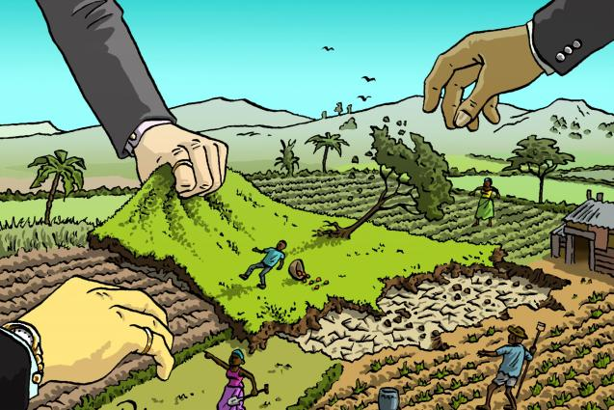
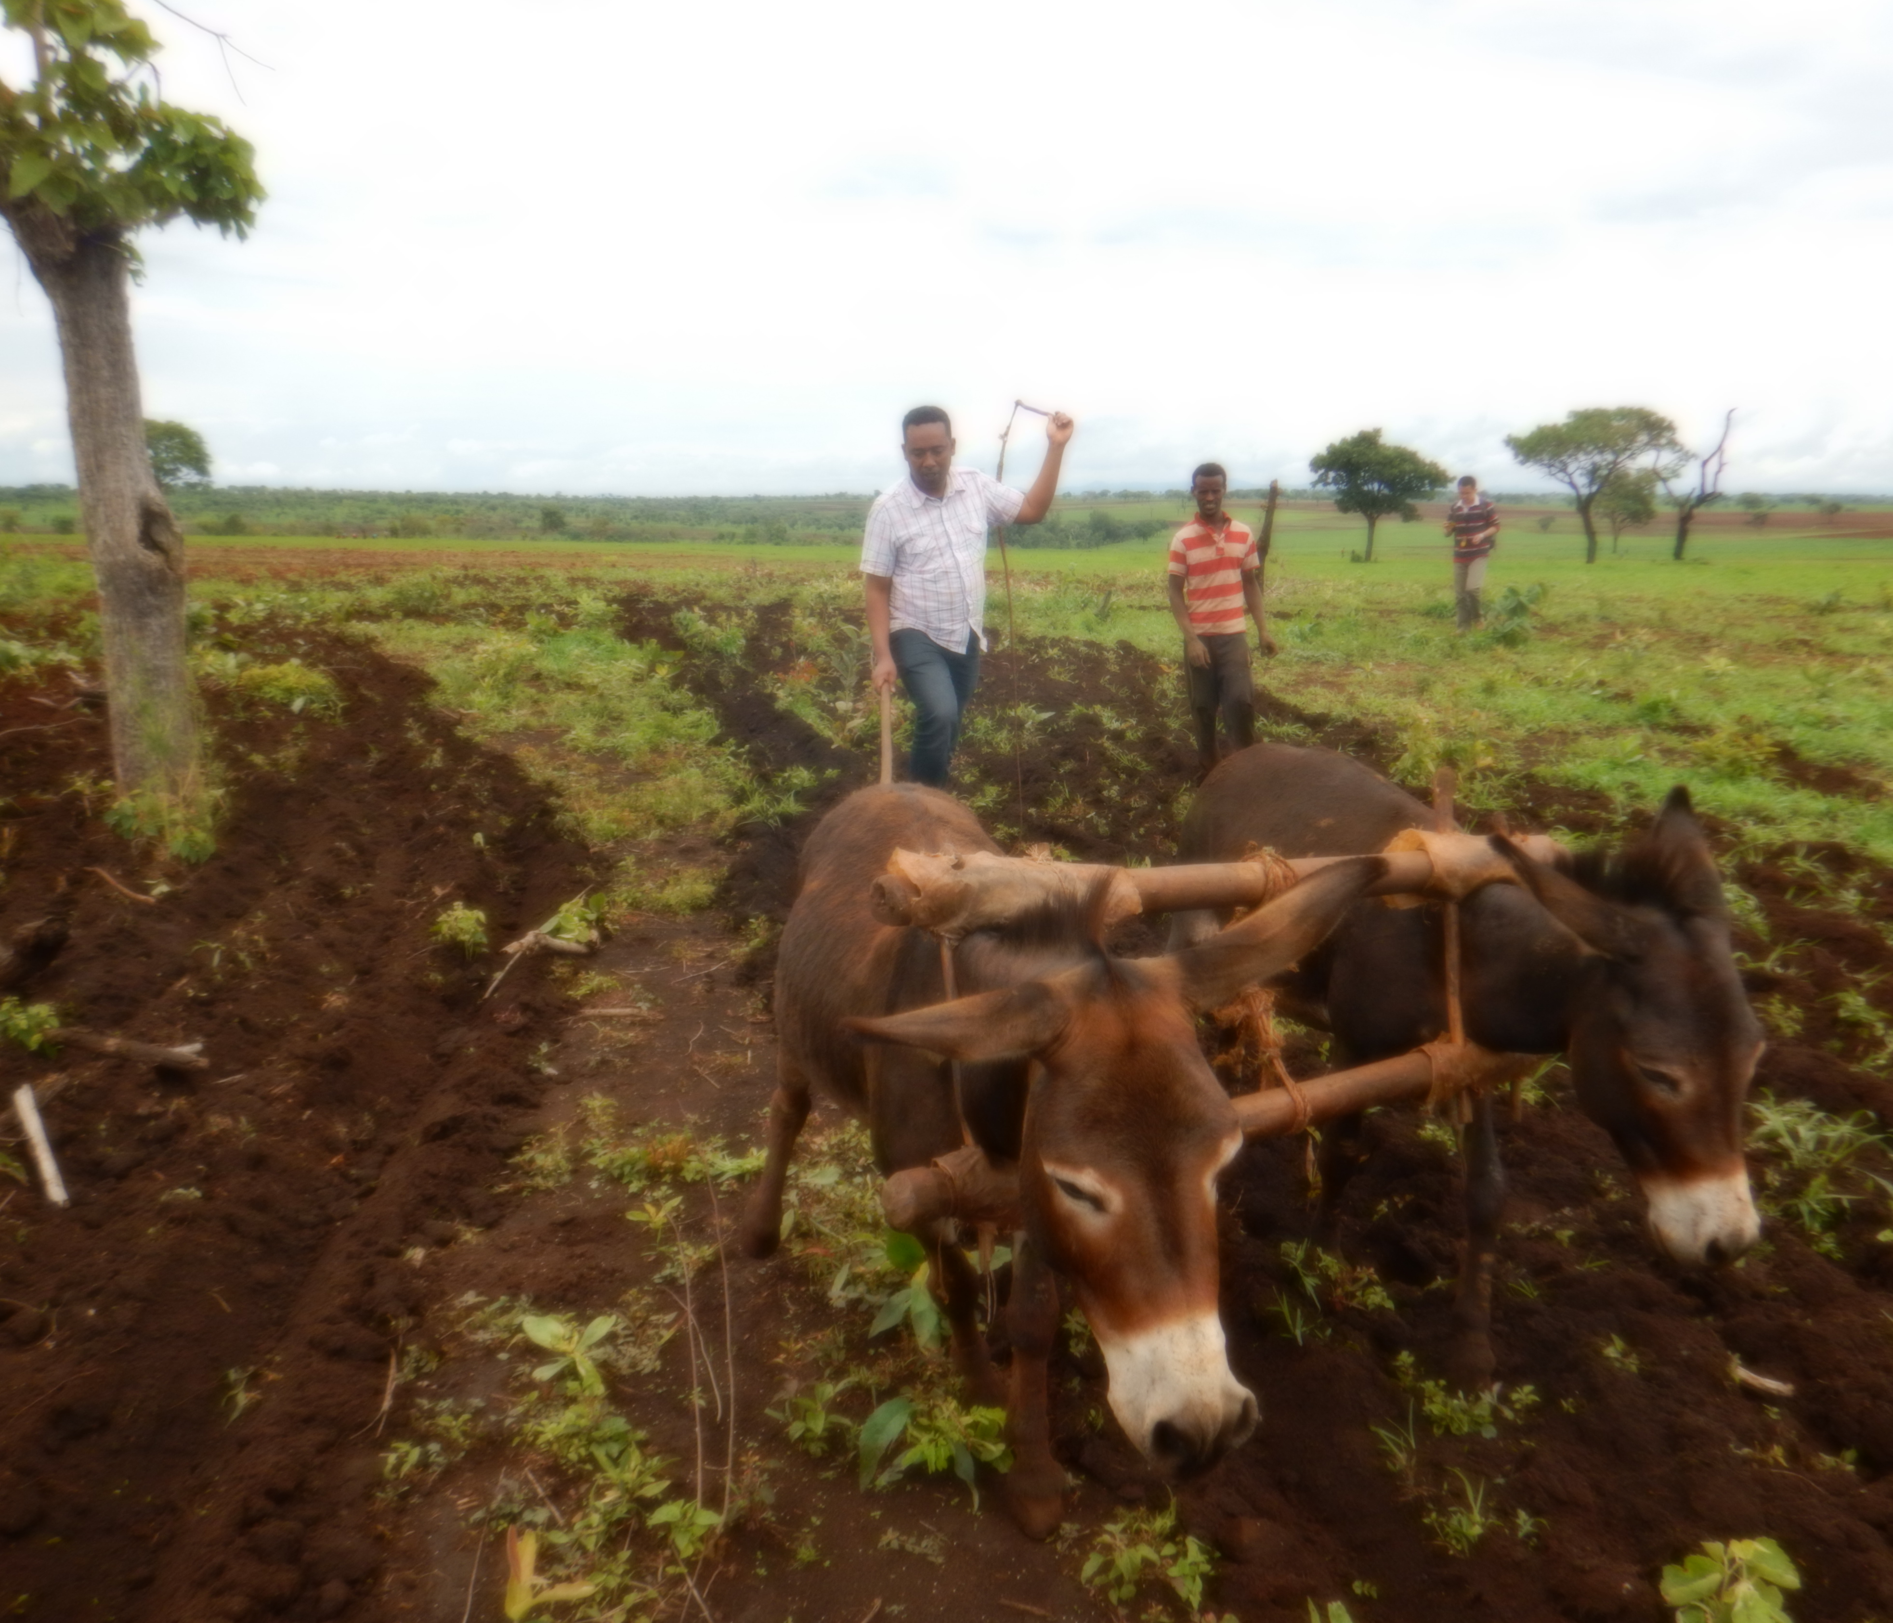
Extant Narratives
“Land Grabs”
“Agricultural Intensification”
Harvey, 2004. The “New” Imperialism: Accumulation by Dispossession.
Ittersum et. al., 2016. Can sub-Saharan Africa feed itself? PNAS, 113(52) 1–6.
Notes:
Sub-saharan Africa - population will increase 2.5 fold;
Tanzania projected to increase from 137 to 381 million by 2050;
Food demand to increase 300%;

Slide 3
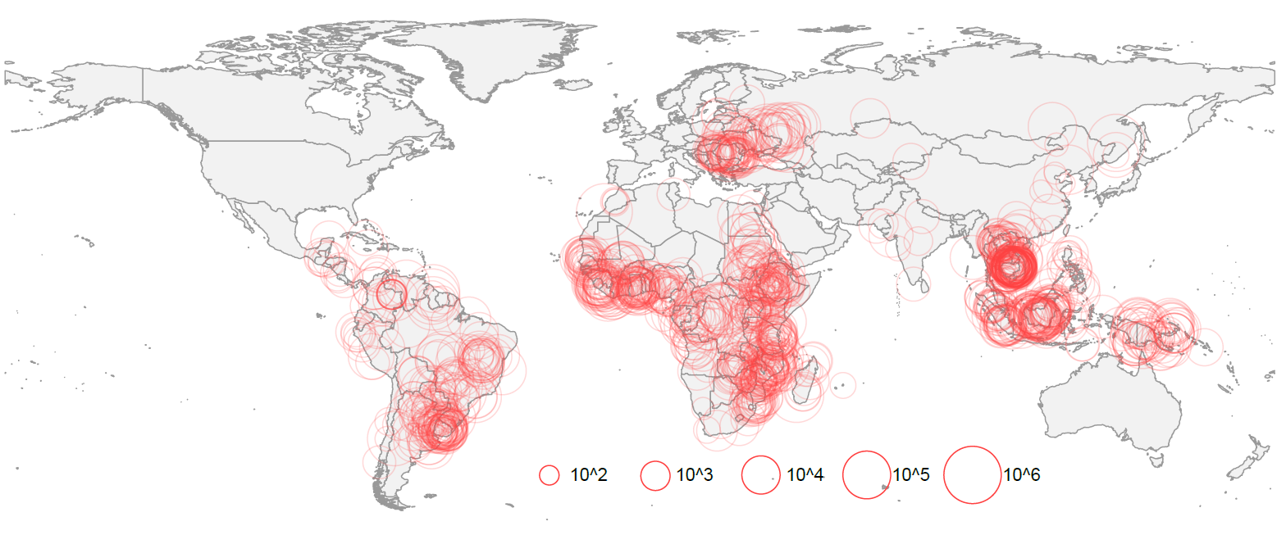
Extent of Transactions
Source: Land Matrix
ha
1162 transnational land transactions
Total transacted area = 40.6M ha

Slide 4
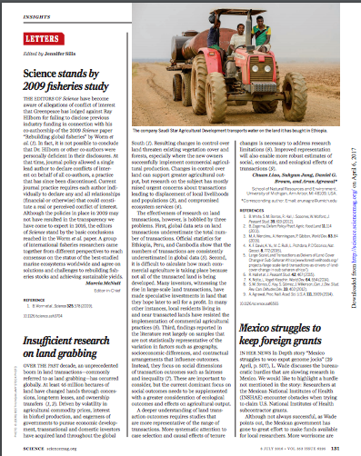
Insufficient Research on Land Grabs
Global data sets on land transactions underestimate the total number of transactions
  (e.g. LM=92, Ethiopia=833)
Not all transacted land is implemented as intensive agriculture
Non-representative samples confound conclusions about effects of geography, socioeconomic differences, and contractual arrangements
Liao, Jung, Brown, & Agrawal (2016). Science, 353(6295).

Slide 5
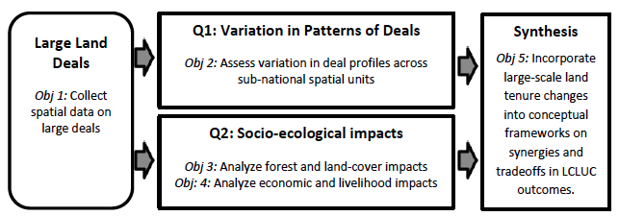
Project Objectives

Slide 6
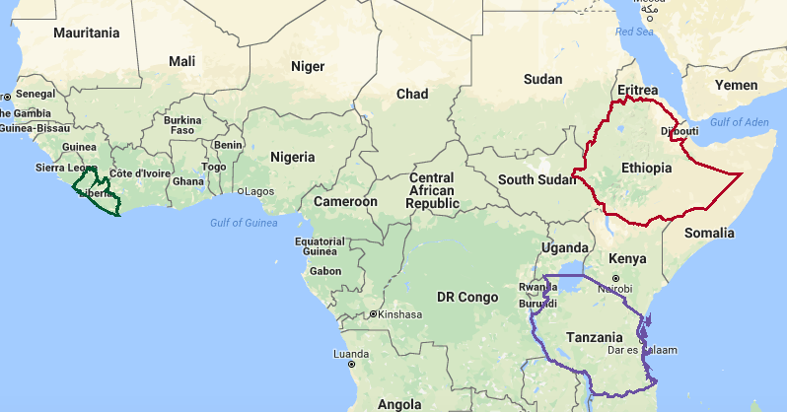
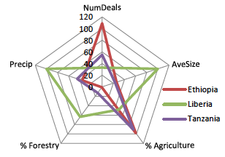
Selection of Target Countries
Lots of Transactions
Large Transactions
Ag Land Competition
http://landmatrix.org/en/
Notes:
Emphasize differences more.

Slide 7
Propensity Score Matching
Use a generalized linear model to estimate the propensity score for both treatment and control by using the matching covariates
For each treatment observation, search for an observation in the control group that has the closest propensity score

Slide 8
Propensity Score Matching
Spatial matching
Before matching
After matching
Transacted area (treatment)
Buffered area (control)
Non-matched points in control area
Systematic points in treatment area
Matched points in control area
Transacted area (treatment)
Buffered area (control)
Systematic points in control area
Systematic points in treatment area

Slide 9
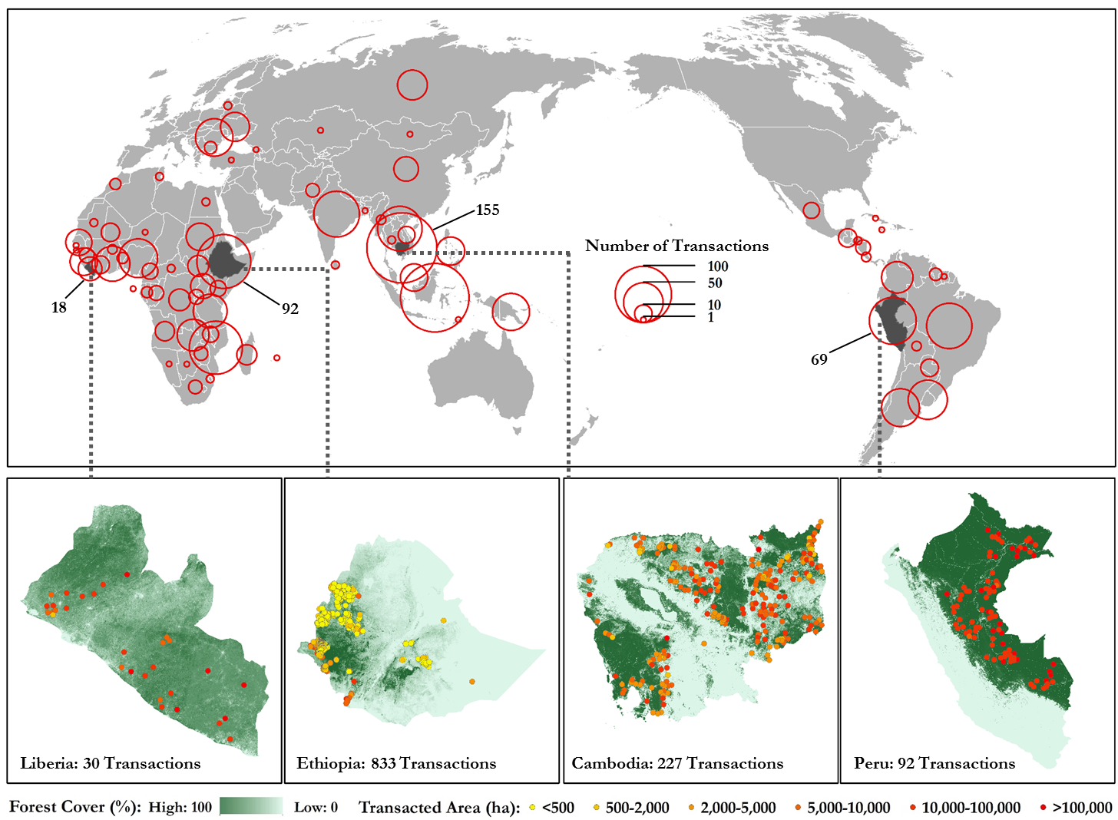
Effects on Deforestation in Four Countries
Location of land transactions in the four countries of study

Slide 10
Evaluation
Effect of land transactions on deforestation (based on Hansen et al. 2013) before and after matching on population density, night lights, and forest cover.
Cambodia
Ethiopia
Deforestation
Davis et al. (2015) Nature Geoscience
Liberia
Peru
Deforestation
unmatched control
matched control
treatment
unmatched control
matched control
treatment

Slide 11
Effects on Livelihoods in Liberia
More than 45% of total land area is under some type of concessions
Forestry concessions
  7 Forest Management Contracts (FMCs)
    larger and have not been fully implemented
  39 Private Use Permits (PUPs)
    smaller and have been fully implemented
We evaluated livelihood impacts
  DHS asset-based wealth index (electricity, tv, table, water source, floor, roof, etc)
  2007, 2009, 2011, 2013
Notes:
FMCs: 50,000 to 400,000 ha, Mean: 144,000
PUPs: 4,361 to 136,913 ha, Mean: 43,445

Slide 12
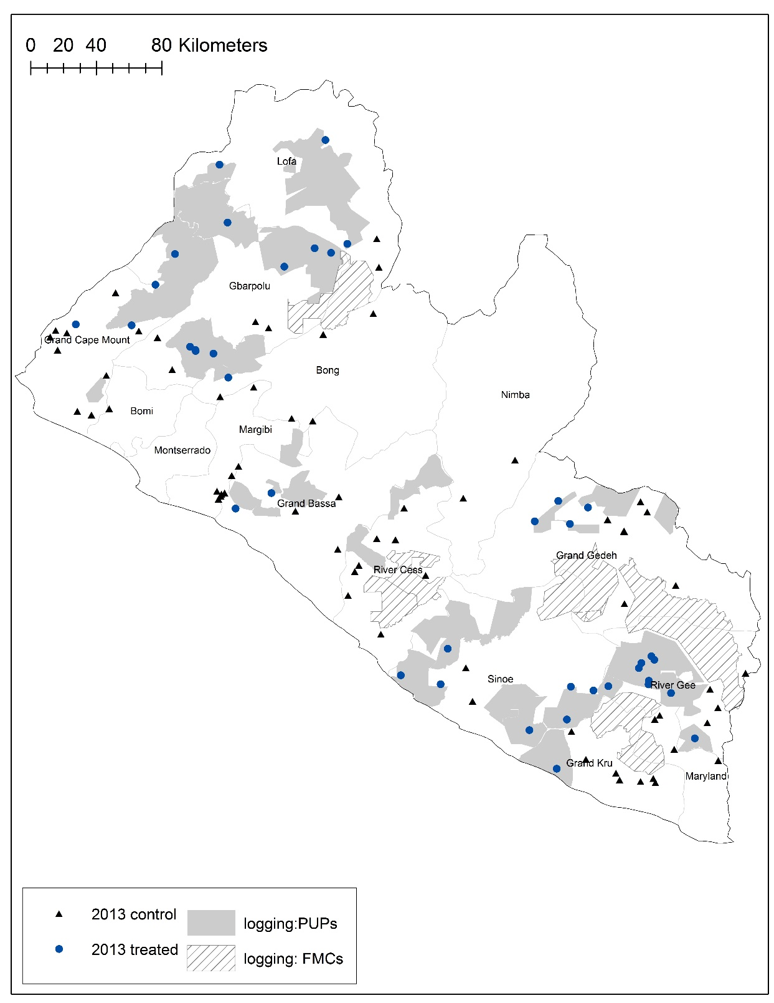
Treatment group
  Household clusters within 2km of concession boundaries
Control group
  Household clusters between 2km and 10km from concession boundaries
  Sensitivity check: up to 12, 14km
Jung et al. in prep

Slide 13
Estimation Results – Wealth index
Preliminary quantitative results show that:
Higher wealth for households living closer to active forest concessions
Notes:
Net positive impacts of active forestry concessions
Increased employment, more goods and services due to increased economic activities, development of infrastructure
Reduced access to resources due to tenure change
The difference value of 0.17 (overall) or 0.24 (PUPs)
Mean: 1.84 and S.D: 1.06
47.6% of the households in our data have the lowest wealth index value of 1 in 2013.

Slide 14
Primary Data Collection
LULC Classification
Currently implementing a “hard” manual digitization
Developing process for mapping continuous measures of tree- and house-density
Testing object-based automated classification
Testing inter-rater reliability measure
Social Surveys – Summer 2017
Collection of ~1200 household surveys in each country
Selection of control areas based on census, existing household survey data, and LULC cover datasets (coarse scale)

Slide 15
Sample Selection - Independent variables
Example from Ethiopia, based on combination of gov’t data and expert knowledge
Categorical
Existing tenure security: Low = 8; High = 7
Source of capital: Foreign = 7; Domestic = 8
Labor composition: Local-dominant = 6; Mix = 5; Migrant-dominant = 4
Continuous
Variable | Min | Median | Mean | Max
Transaction size | 516 | 1697 | 2436 | 12250
Year of implementation | 3 | 7.5 | 8.5 | 16
Elevation | 442 | 1149 | 1398 | 1730
Population density | 1.5 | 23.2 | 42.6 | 128.8
Forest cover | 0.9 | 17 | 18.21 | 35
Night light index | 3.4 | 3.85 | 4.457 | 8.8

Slide 16
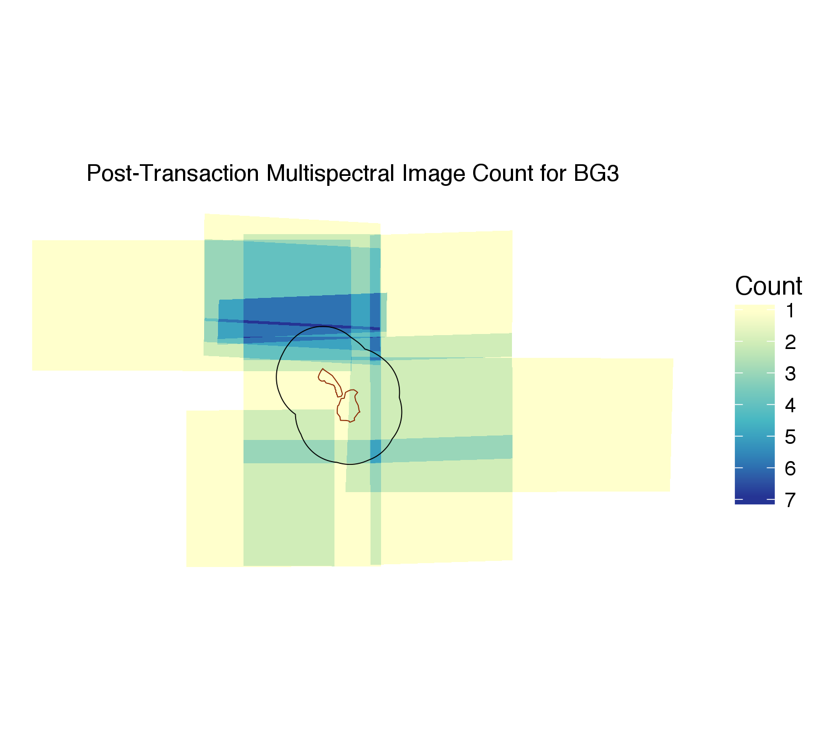
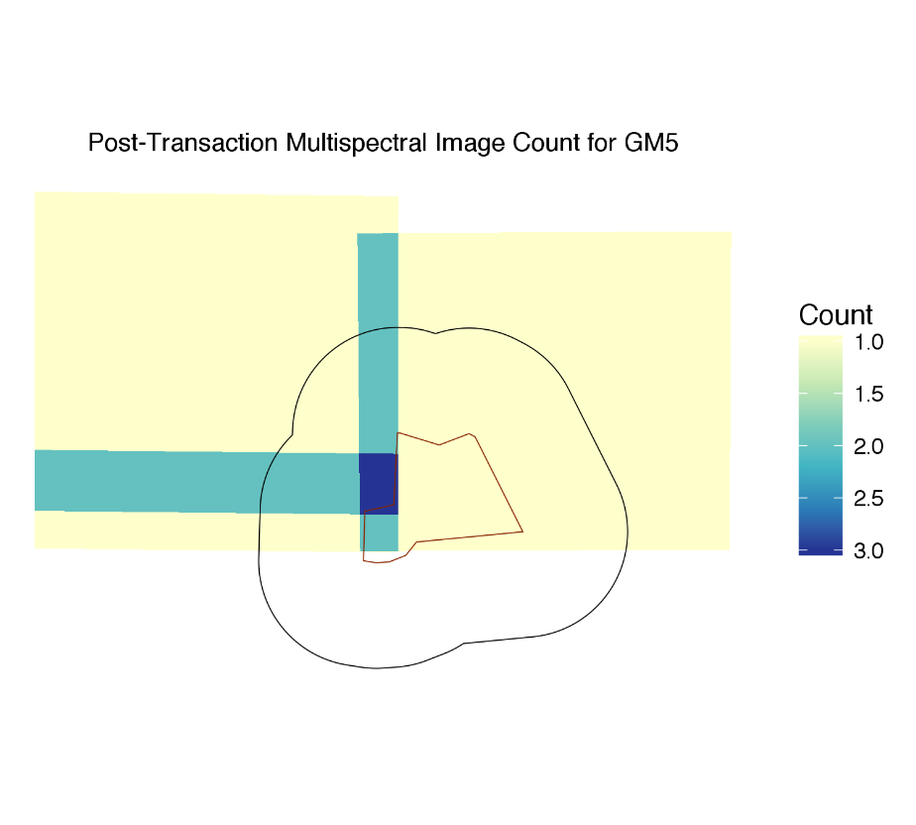
Evaluating Availability of CAD4NASA Data

Slide 17
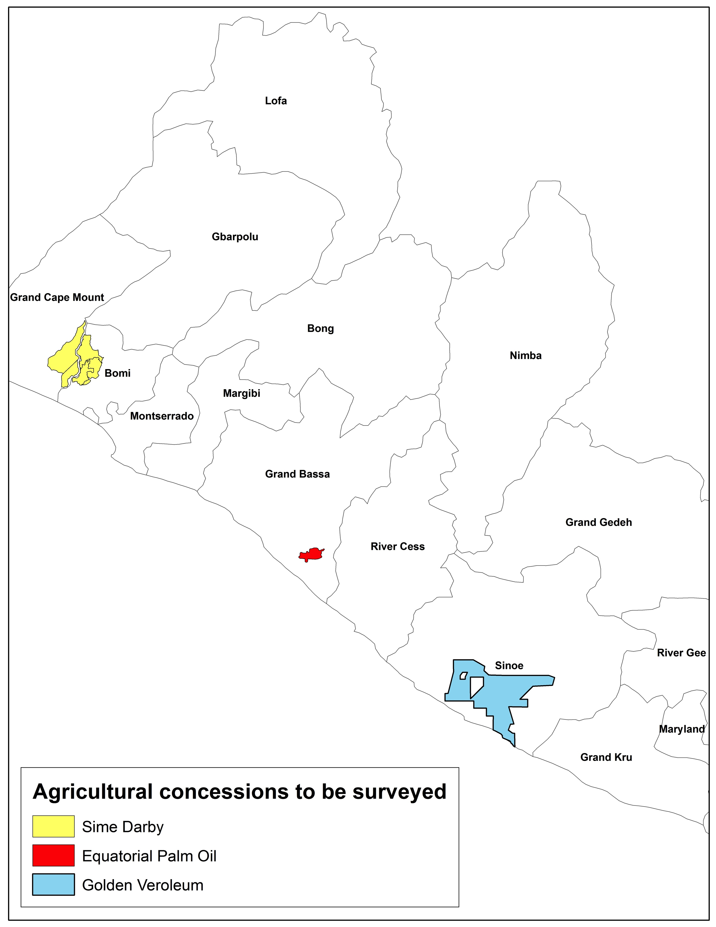
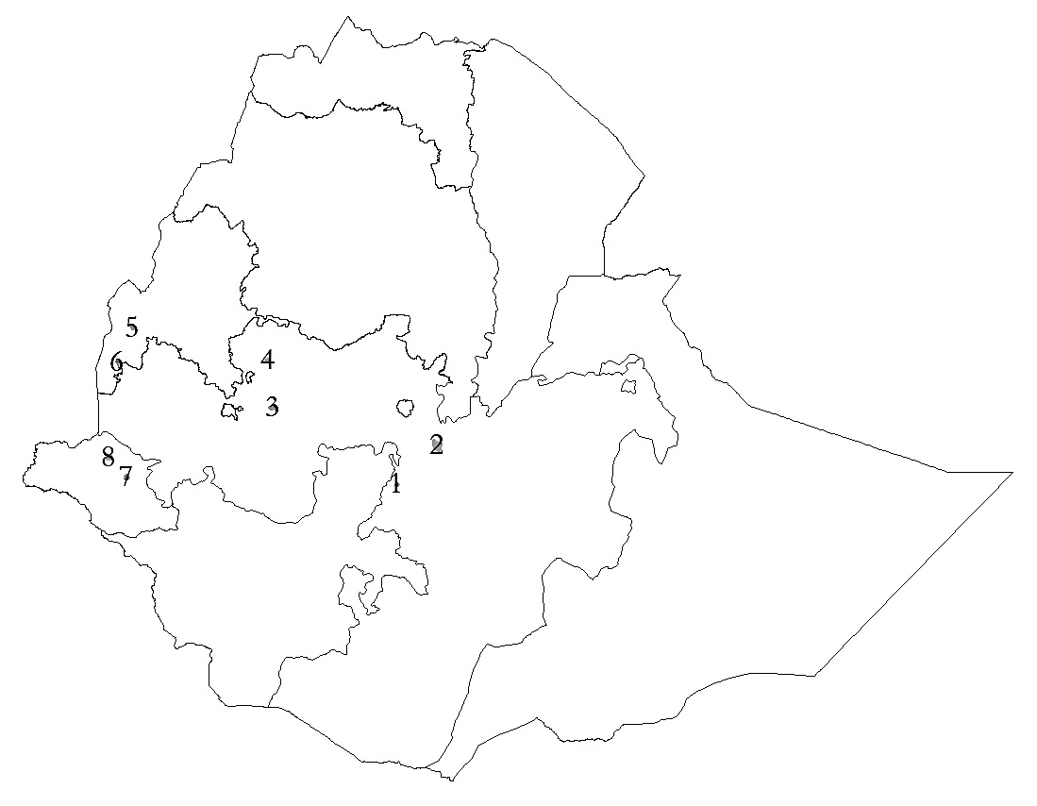
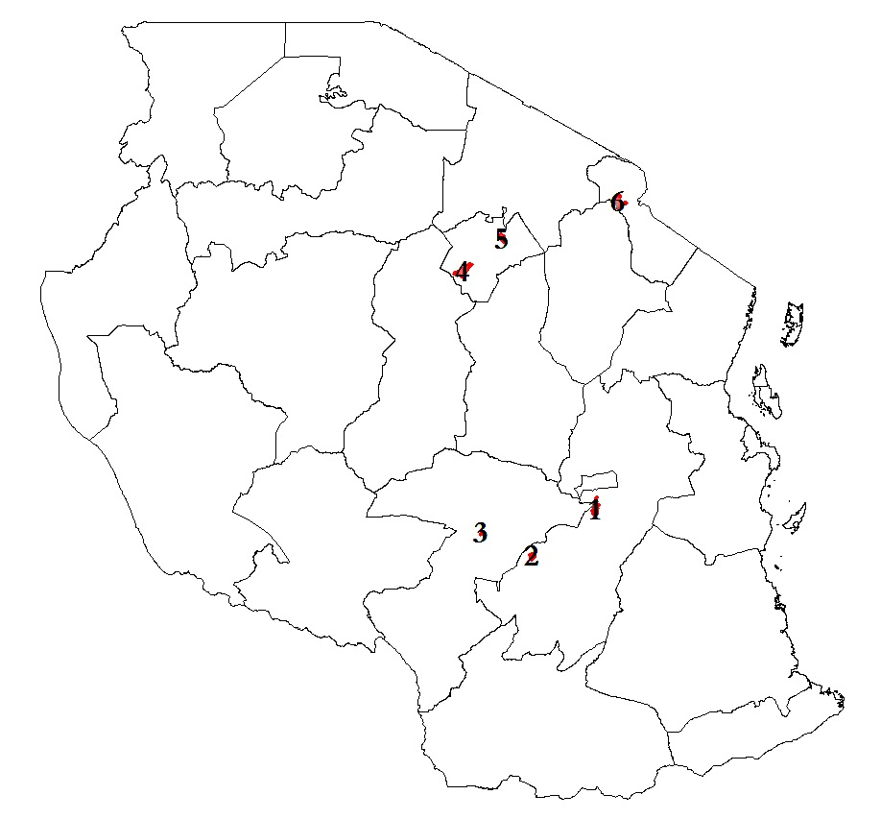
Selected Sites
Benishangul-Gumuz
Gambella
Oromia
Tanzania
Liberia
Ethiopia
Manyara
Kilimanjaro
Morogoro
Iringa

Slide 18
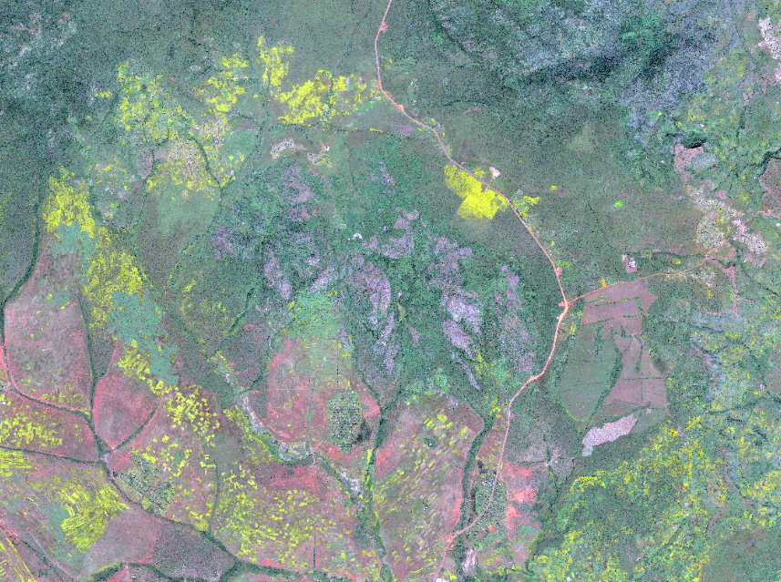
LULC Classification
Forest
Savannah-Grassland-Pasture
Settlement
Smallholder Agriculture
Intensive Agriculture (Transaction)
Notes:
True Color Image
Canola/ rapeseed is a principal crop grown in Ethiopia (yellow color)

Slide 19
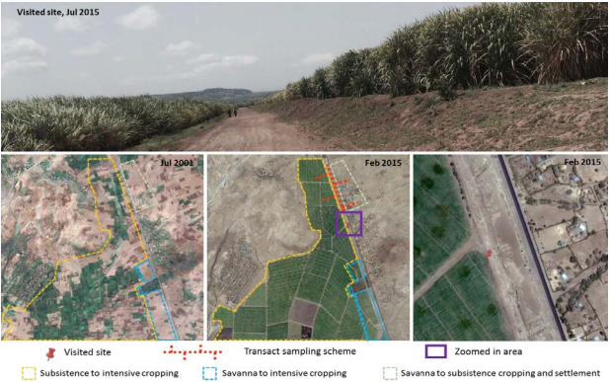
Oromia Farm

Slide 20
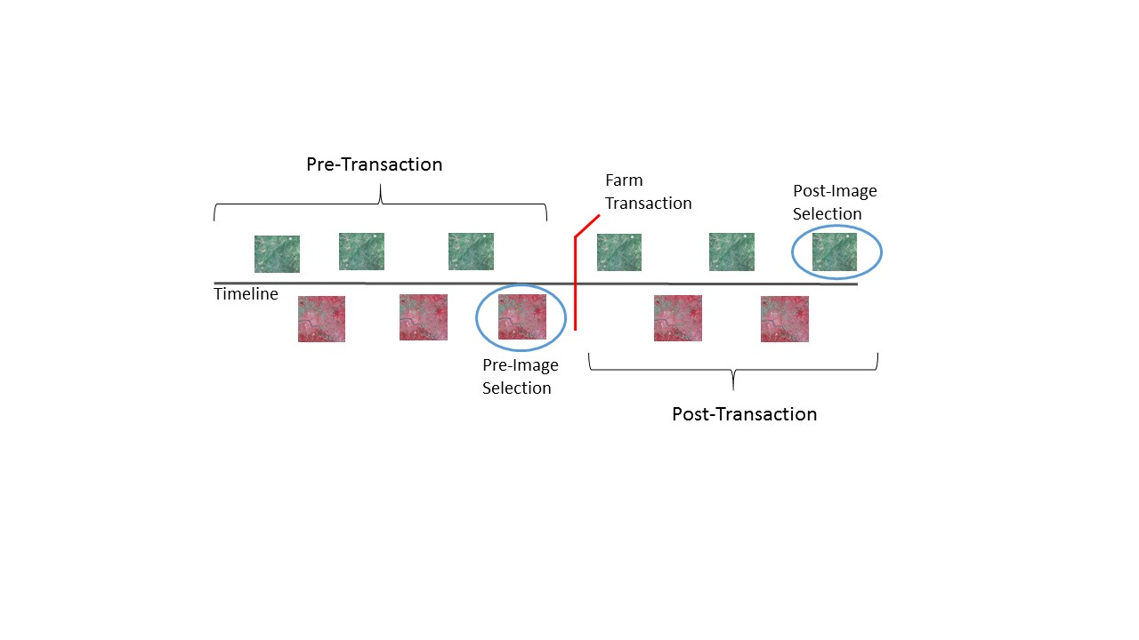
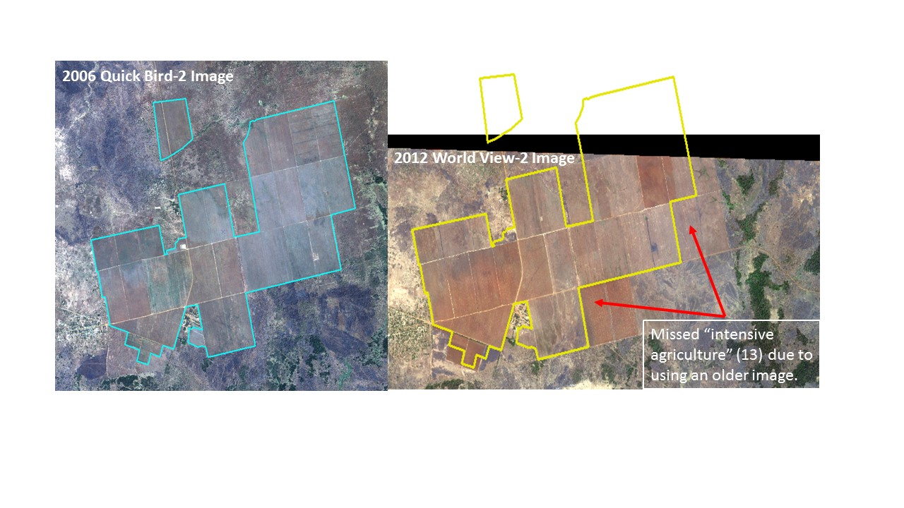
LULC Time Series

Slide 21
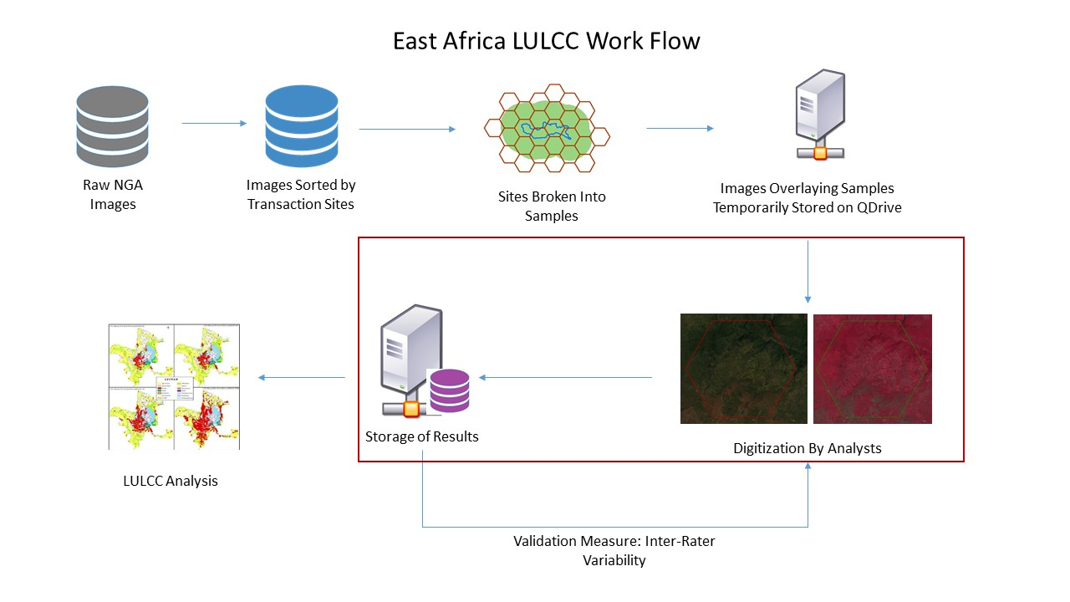
LULC Manual Digitization
Digitization of high-resolution imagery available through CAD4NASA
  Worldview
  Quickbird
  3 TB of satellite images
Trained 3 undergraduate students to carry out manual digitization

Slide 22
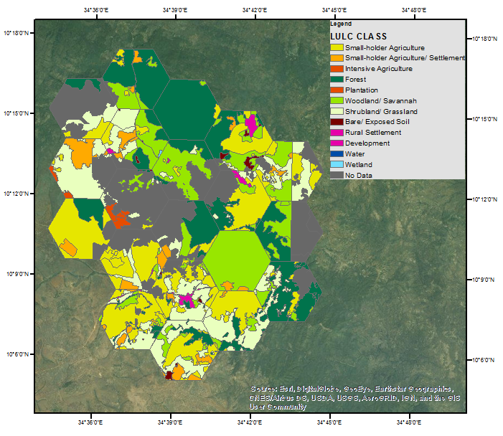
LULC Pre-Transaction

Slide 23
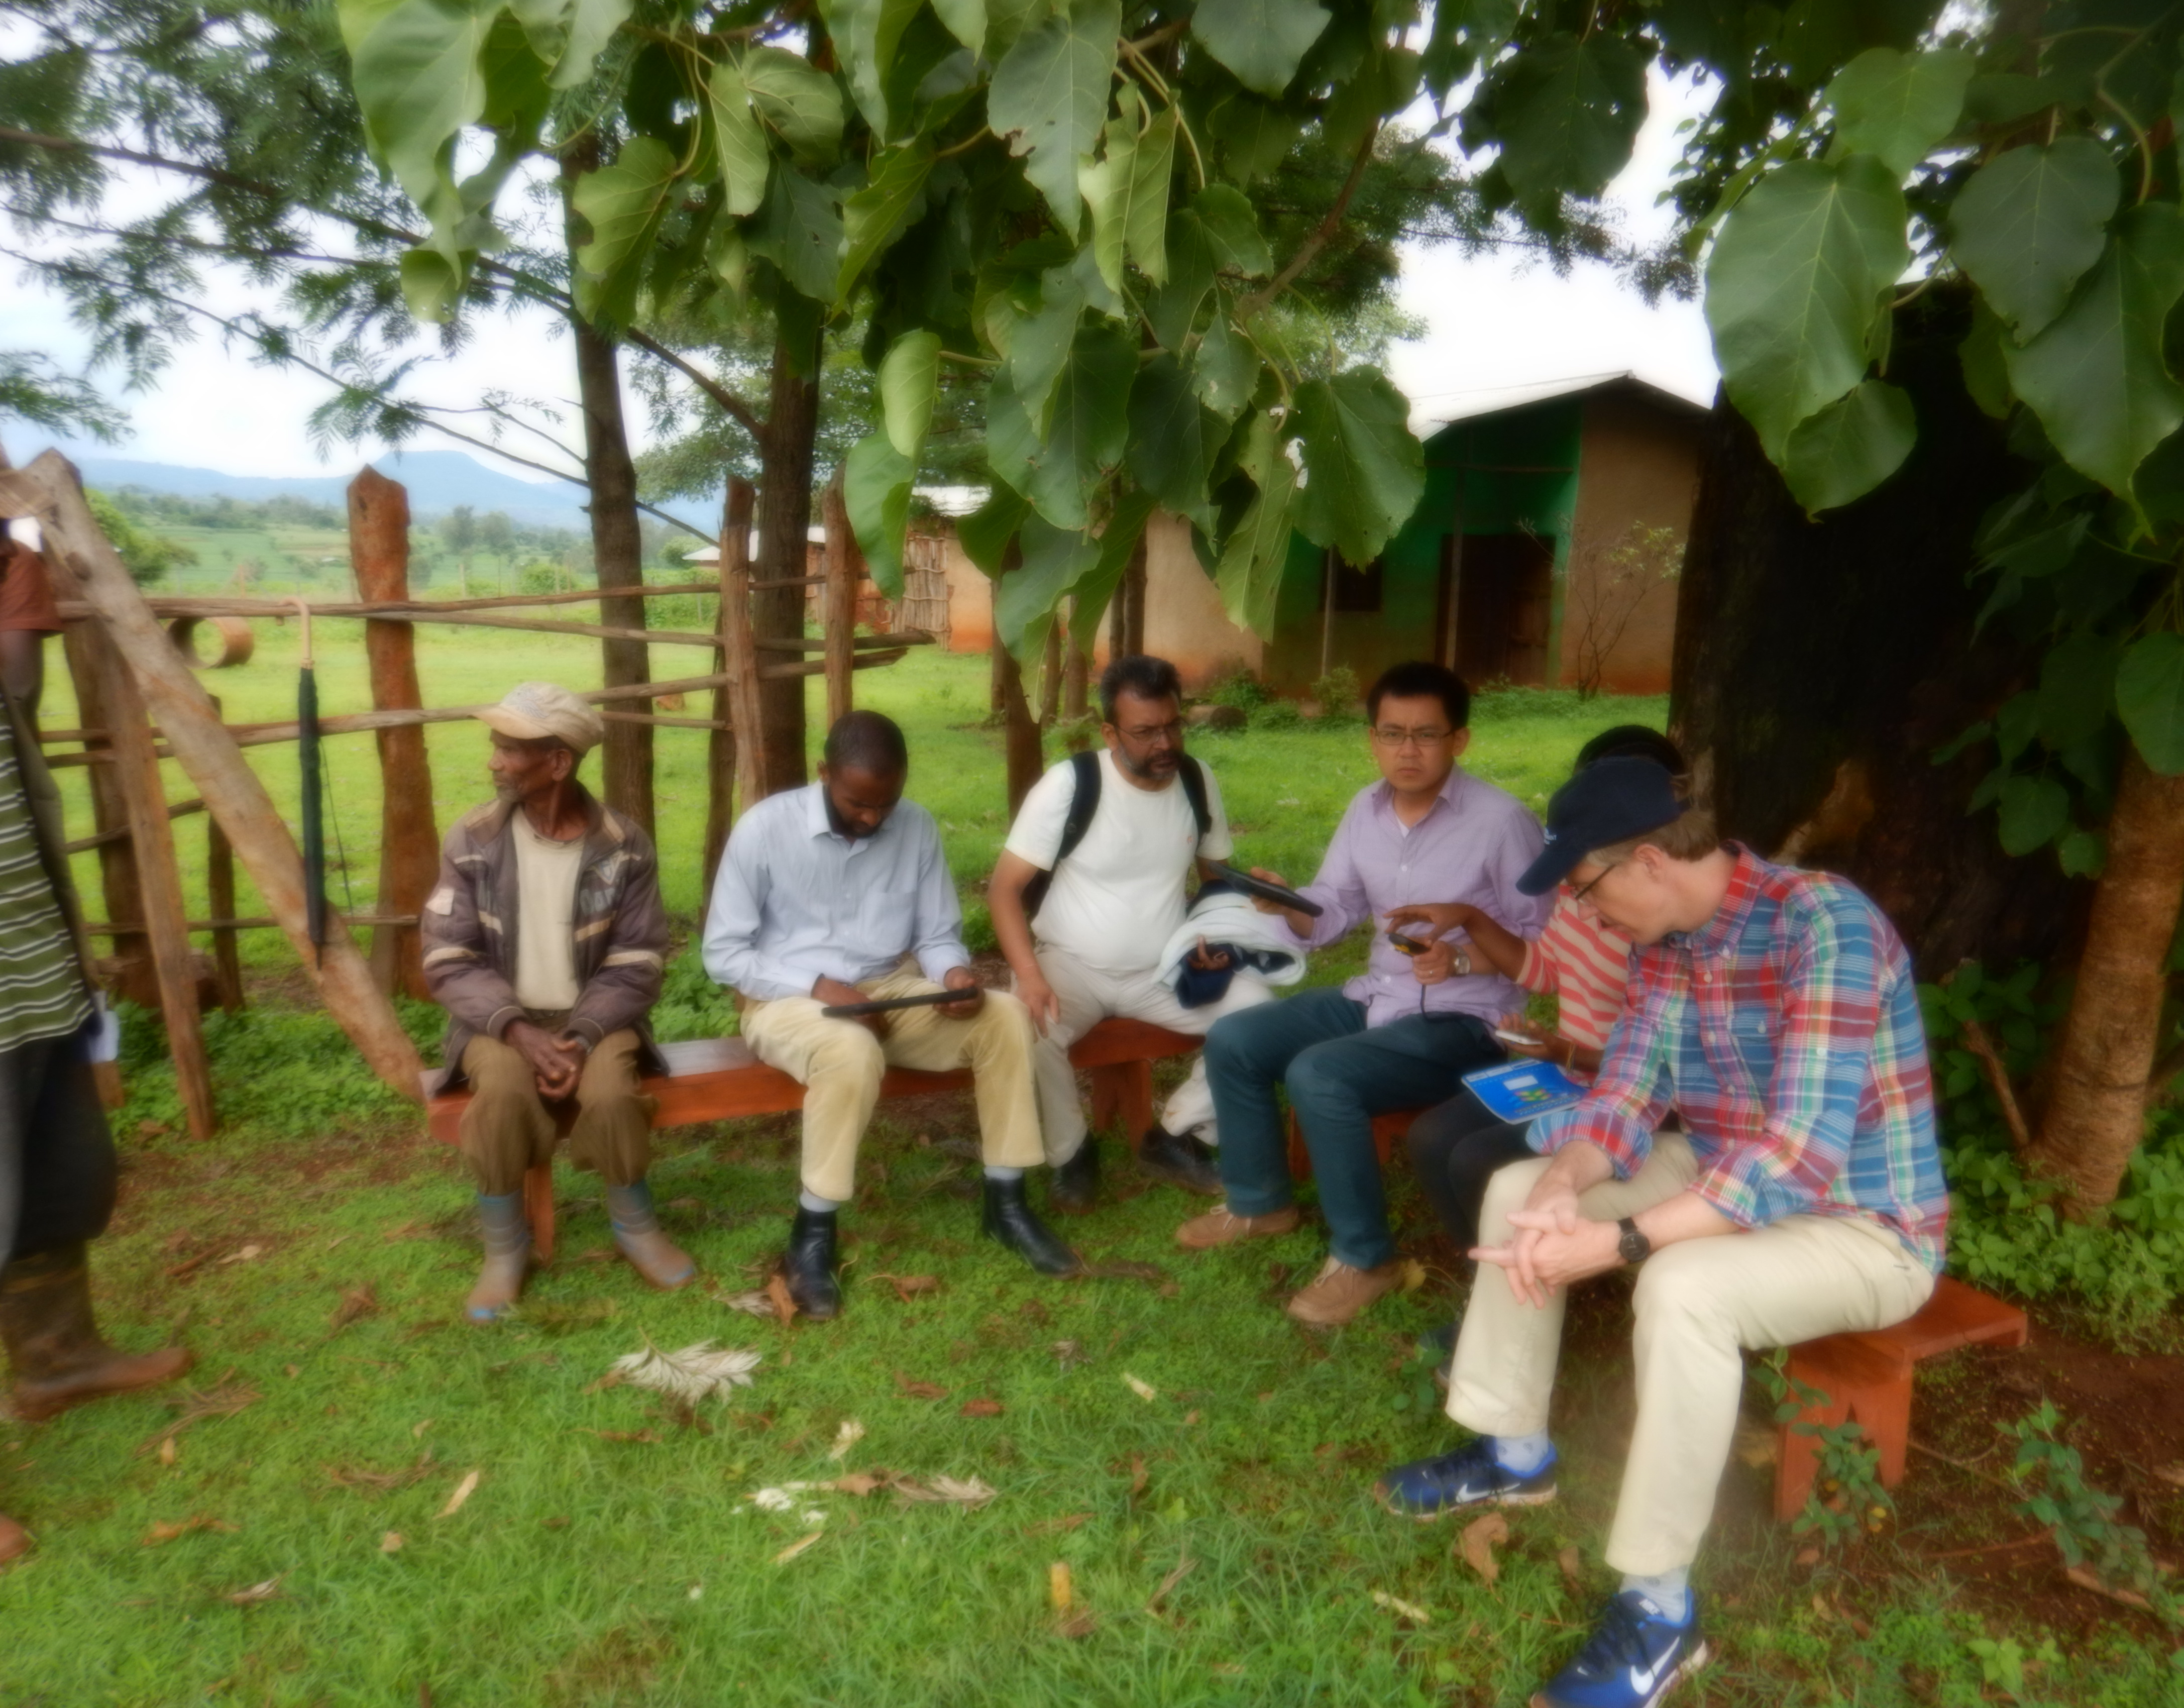
Household Surveys Piloted
On-Going this Year

Slide 24
Synthesis Activities to Date
Invited workshop on Land Transactions, Ann Arbor, April 2016
  Focus on bridging qualitative-quantitative approaches, and case studies to generalized patterns.
Organized session at AAG on Coupled Natural-Human Systems, Boston, April 2017
Planning for follow-up workshop.

Slide 25
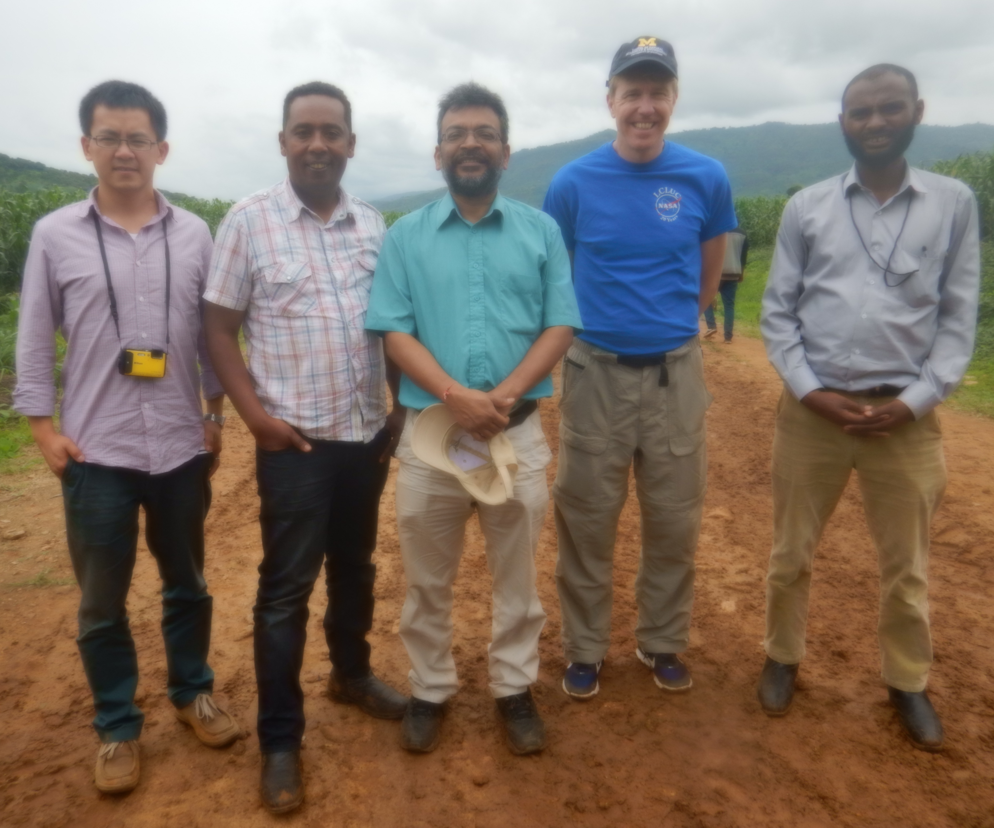
Thank You

