Slide 1
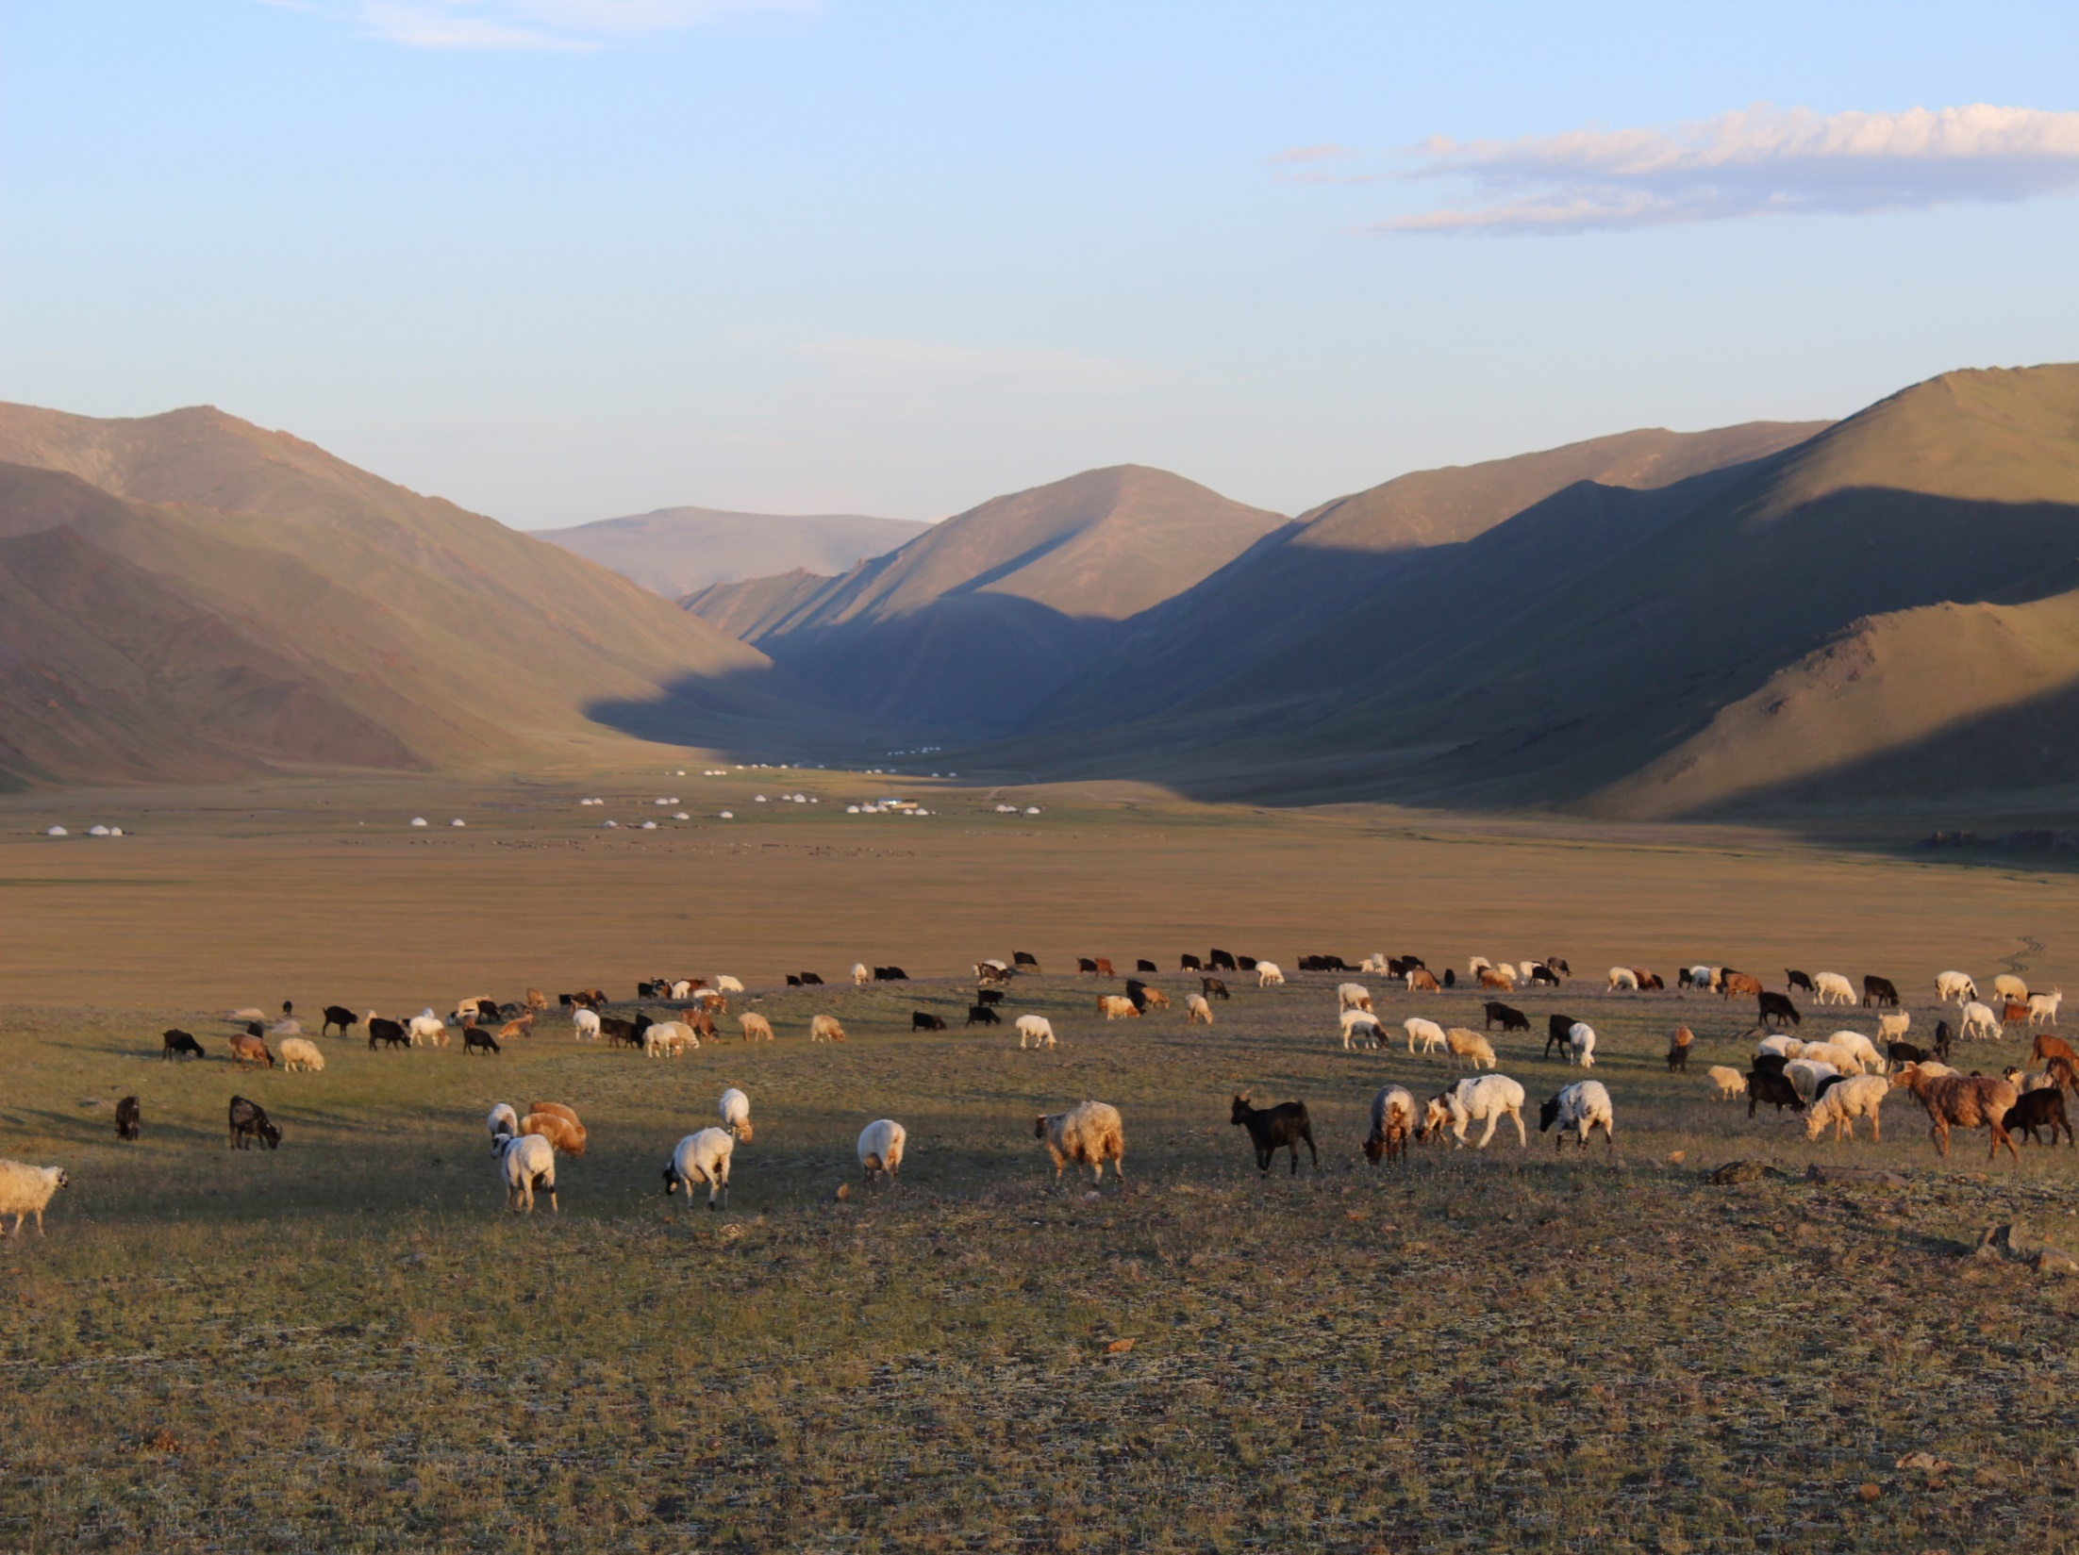
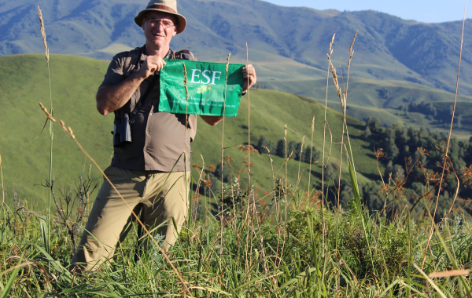
Interacting effects of socio-political and environmental factors on rangeland dynamics in the Altai Mountains in Central Asia
Giorgos Mountrakis, James Gibbs
State University of New York College of Environmental Science and Forestry
Liza Iegorova, Misha Paltsyn, Shahriar Heydari

Slide 2
Deep learning in Remote Sensing: ISPRS Journal Special issue announcement
https://www.journals.elsevier.com/isprs-journal-of-photogrammetry-and-remote-sensing/call-for-papers/deep-learning-for-remotely-sensed-data
LCLU Map
Accuracy Map
Notes:
Rangelands provide multiple ecosystem goods and services, which are critical for many people around the world. Rangelands are the main land cover type in Central Asia, and are the basis of animal production, which is the source of livelihood for numerous pastoral populations in this region. It provides people with food such as dairy products, meat, blood, etc., wool, hair, leather, manure (fertilizer and for fuel), hides, power, transportation, and cash income. Rangeland ecosystems contain great diversity of plant and wildlife species.

Slide 3
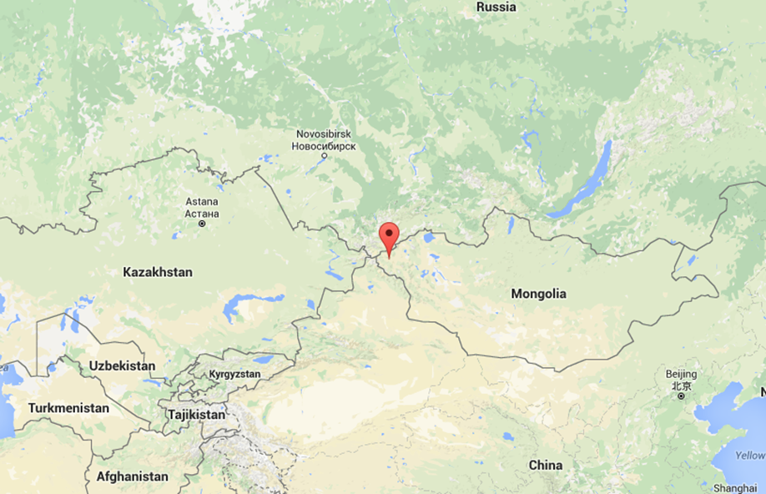
A remarkable opportunity to better understand the social and economic drivers on rangeland change because it presents a homogeneity of culture and ecology (high elevation grasslands sharing the distinctive Altai biota) intersected by a striking geopolitical overlay
Notes:
Rangelands provide multiple ecosystem goods and services, which are critical for many people around the world. Rangelands are the main land cover type in Central Asia, and are the basis of animal production, which is the source of livelihood for numerous pastoral populations in this region. It provides people with food such as dairy products, meat, blood, etc., wool, hair, leather, manure (fertilizer and for fuel), hides, power, transportation, and cash income. Rangeland ecosystems contain great diversity of plant and wildlife species.

Slide 4
Changes after the 1991 USSR Collapse:
China’s Altai Mountain area grazing systems remain similar to those in Mongolia, Kazakhstan and Russia during the Soviet era: carefully planned, heavily subsidized and intensive.
This is in stark contrast to Russia’s and Kazakhstan’s livestock industries, which have dwindled, and Mongolia’s, which have both greatly expanded and changed in herd composition.
Notes:
Rangelands provide multiple ecosystem goods and services, which are critical for many people around the world. Rangelands are the main land cover type in Central Asia, and are the basis of animal production, which is the source of livelihood for numerous pastoral populations in this region. It provides people with food such as dairy products, meat, blood, etc., wool, hair, leather, manure (fertilizer and for fuel), hides, power, transportation, and cash income. Rangeland ecosystems contain great diversity of plant and wildlife species.

Slide 5
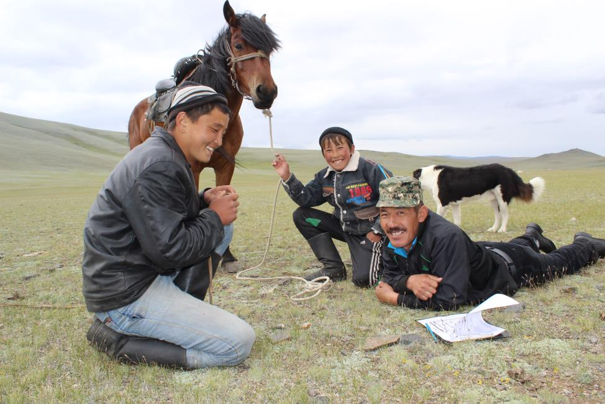
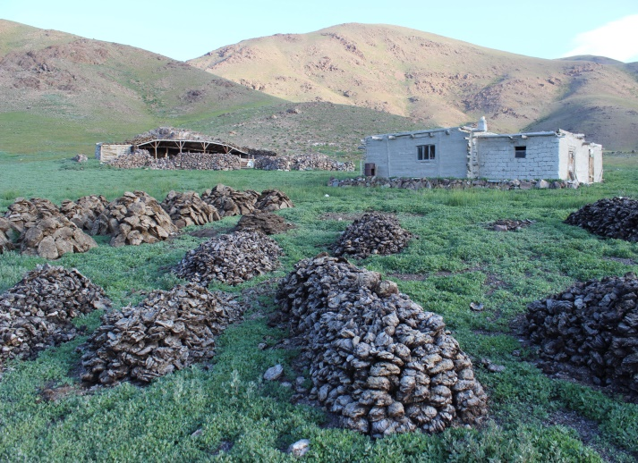
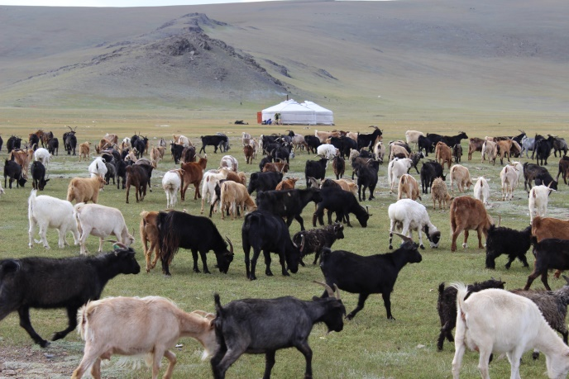
Examine land-cover change consequences of the collapse of top-down government approaches to managing grazing resources of mountain regions.
Photo credits: James Gibbs, SUNY-ESF
Notes:
Rangelands provide multiple ecosystem goods and services, which are critical for many people around the world. Rangelands are the main land cover type in Central Asia, and are the basis of animal production, which is the source of livelihood for numerous pastoral populations in this region. It provides people with food such as dairy products, meat, blood, etc., wool, hair, leather, manure (fertilizer and for fuel), hides, power, transportation, and cash income. Rangeland ecosystems contain great diversity of plant and wildlife species.

Slide 6
Q1: How accurately do satellite data capture vegetation cover in grasslands?

Slide 7
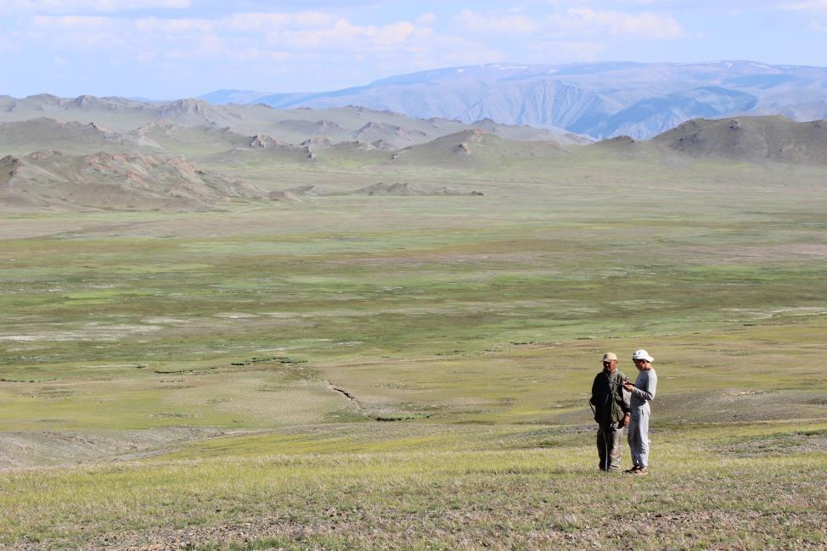
Ground Validation of NDVI-Vegetation Relationship

Slide 8
% Vegetation cover vs NDVI
Mikhail Yu. Paltsyn, James P. Gibbs, Liza Iegorova, Giorgos Mountrakis. Estimation and Prediction of Grassland Cover in Western Mongolia using MODIS-derived Vegetation Indices. 2016 (Unpublished Article)
Notes:
Here is a graph of NDVI vs actual on the ground % vegetation cover in Mongolia from a paper that we are in the process of trying to publish. It has been validated that MODIS-derived vegetation index (EVI) accurately reflects on-the-ground conditions of the Mongolian steppe ecosystem. Data on the percentage of vegetation cover were collected by James Gibbs and Mikhail Paltsyn (SUNY-ESF), and inspectors of Protected Area Administration of Mongol Altai in the Mongolian part of Sailugem and Chikhacheva Ridges in July-August 2013. A simple regression model could effectively (R² = 0.71) predict the percentage of vegetation cover based on EVI values from MODIS imagery.

Slide 9
Q1: How accurately do satellite data capture vegetation cover in grasslands?
Q2: Can we link Traditional Ecological Knowledge to satellite-derived vegetation indices?

Slide 10
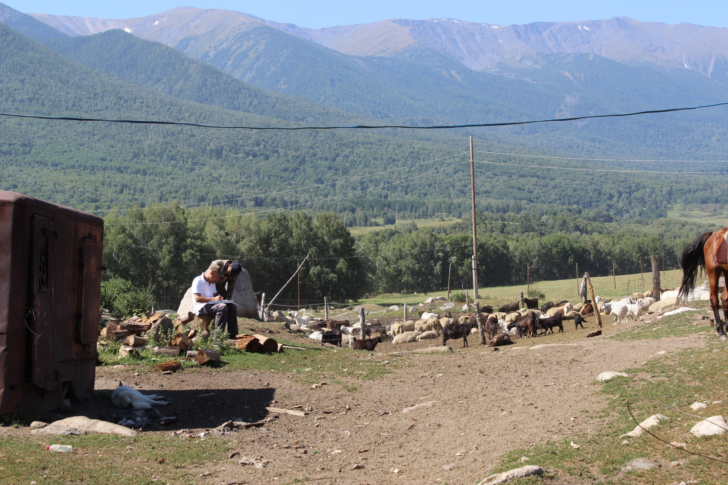
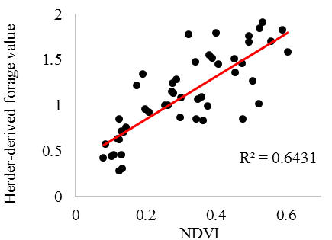
TEK in relation to NDVI
Notes:
0-2, poor medium good

Slide 11
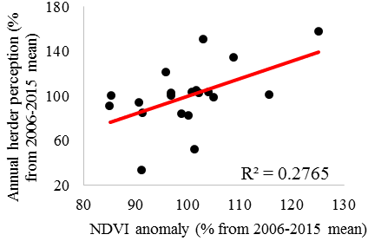
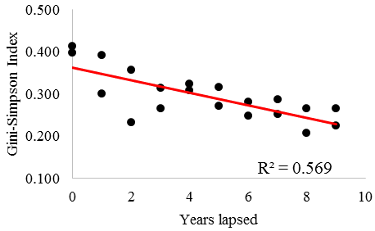
TEK in relation to NDVI

Slide 12
Q1: How accurately do satellite data capture vegetation cover in grasslands?
Q2: Can we link Traditional Ecological Knowledge to satellite-derived vegetation indices?
Q3: How has livestock changed over the three countries?

Slide 13
Russia
Kazakhstan
USSR Collapse > Elimination of state subsidies > Grain and hay too expensive > Livestock decrease
Notes:
Russia Internal local markets
After the Soviet Union collapsed, the number of livestock decreased dramatically in Russia and Kazakhstan. This is partly caused due to the remoteness of this region and the absence of trade routes to nearby markets in China and Mongolia, while the local markets for meat and wool are quite small and transport costs to larger Russian markets are very expensive. Without all the benefits and heavy subsidies provided by the Soviet system ecological factors started to play a more important role in the viability of herding. Due to the orographic effect and the prevailing west-to-east moving weather systems this territory receives a lot of snow. Thus, there is a high need for additional winter forage for the livestock, which was subsidized during the Soviet era. Imported grain and hay are now very expensive which makes livestock production for export in the area unprofitable. As a result, livestock numbers have decreased dramatically and remain low in this region during the post-Soviet era.

Slide 14
Mongolia
USSR Collapse> high unemployment rates and the sudden end of state-funded social services > Mongolians returned to herding
Livestock increases led by goats (international cashmere market)
Goats very aggressive grazing leads to significant rangeland degradation
Notes:
Cashmere to CHina
In contrast, Mongolia witnessed a dramatic rise in herd numbers, especially goats, as a response to the international market for cashmere. Among all the animals in livestock, goats are most responsible for the rangeland degradation as they destroy grass at its roots while grazing, at the same time fine wool from goats’ undercoat provides herders with a significant income. After the collapse of the Soviet Union economic pressures, particularly high unemployment rates and the sudden end of state-funded social services, many Mongolians returned to herding.

Slide 15
Q1: How accurately do satellite data capture vegetation cover in grasslands?
Q2: Can we link Traditional Ecological Knowledge to satellite-derived vegetation indices?
Q3: How has livestock changed over the three countries?
Q4: Best practices for RS classification?

Slide 16
RS Classifiers for LCLU
Edge Pixels

Slide 17
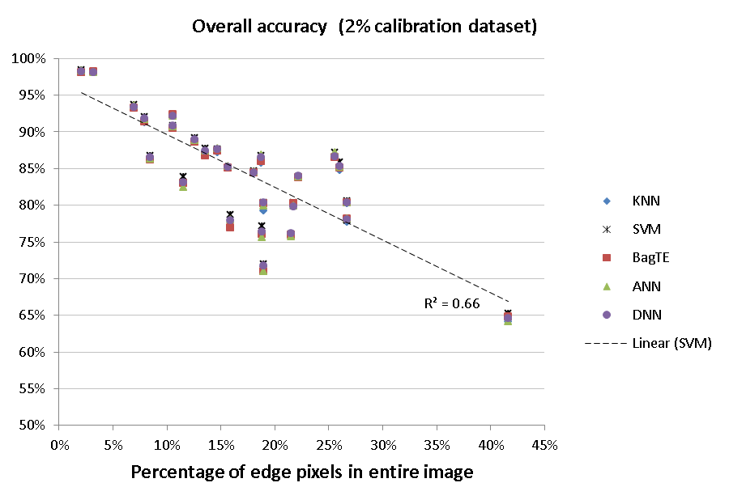
RS Classifiers for LCLU
Classification accuracy strongly linked to landscape heterogeneity

Slide 18
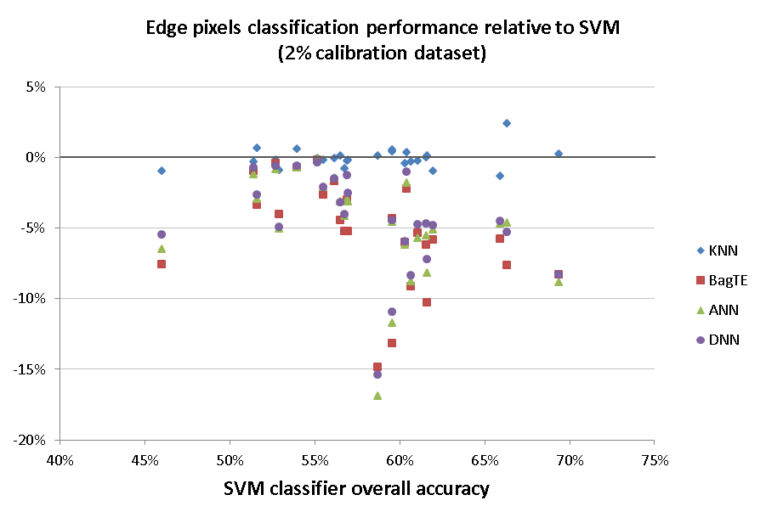
RS Classifiers for LCLU
SVM and KNN performed considerably better than other classifiers on edge pixels

Slide 19
Q1: How accurately do satellite data capture vegetation cover in grasslands?
Q2: Can we link Traditional Ecological Knowledge to satellite-derived vegetation indices?
Q3: How has livestock changed over the three countries?
Q4: Best practices for RS classification?
Q5: Can a socioecological model explain vegetation trends?

Slide 20
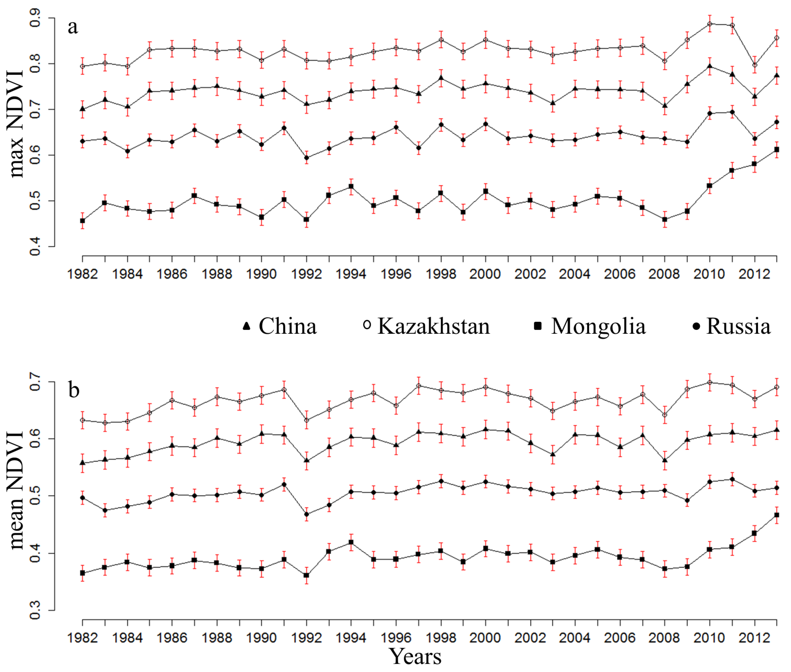
AVHRR Trends
Notes:
It is difficult to discern what influences socio-political factors had given China had a proportional rate of recovery to the three former Soviet nations after the Mt. Pinatubo eruption. Moreover, on average NDVI values are significantly higher after the Soviet Union collapse in all four countries, an effect that may be driven by climate change. Mongolia is at the upper end of the elevational gradient for the high elevation grassland ecosystems in the Altai region, the herders there have been able to increase the number of livestock without negatively impacting NDVI values. In fact, as we have shown in this study NDVI values have increased in Mongolia.

Slide 21
Synthesis in process
Interacting effects of socio-political and environmental factors on rangeland dynamics in the Altai Mountains in Central Asia
Data collection complete:
50+ herders interviewed in all four countries

Slide 22
Productivity
Publications
[1] M.Y. Paltsyn, J.P. Gibbs, L.V. Iegorova and G. Mountrakis (in revision). estimation and prediction of grassland cover in western Mongolia using MODIS-derived vegetation indices. Rangeland Ecology & Management.
[2] M.Y. Paltsyn, J.P. Gibbs, and G. Mountrakis (in preparation). Integration of traditional ecological knowledge and remote sensing for monitoring rangeland dynamics in Altai Mountains
[3] Igor E. Chestin, Mikhail Yu. Paltsyn, Olga B. Pereladova, Liza V. Iegorova, James P. Gibbs. Tiger re-establishment potential to former Caspian tiger (Panthera tigris virgata) range in Central Asia. Biological Conservation, Volume 205, January 2017, Pages 42-51.
[4] S. Heydari, G. Mountrakis, R. Khatami+ (in review). Effect of classifier selection, reference sample size and scene heterogeneity in per-pixel classification accuracy using 26 Landsat sites. Remote Sensing of Environment.
[5] L. Jian, G. Mountrakis (in revision). Vegetation phenological response under extreme temperatures using volcanic eruptions as proxies. GIScience and Remote Sensing.
[6] Interacting effects of socio-political and environmental factors on rangeland dynamics in the Altai mountains in central Asia. L.V. Iegorova, J.P. Gibbs, and G. Mountrakis (in preparation)
Deep learning in Remote Sensing: ISPRS Journal Special issue announcement
https://www.journals.elsevier.com/isprs-journal-of-photogrammetry-and-remote-sensing/call-for-papers/deep-learning-for-remotely-sensed-data

Slide 23
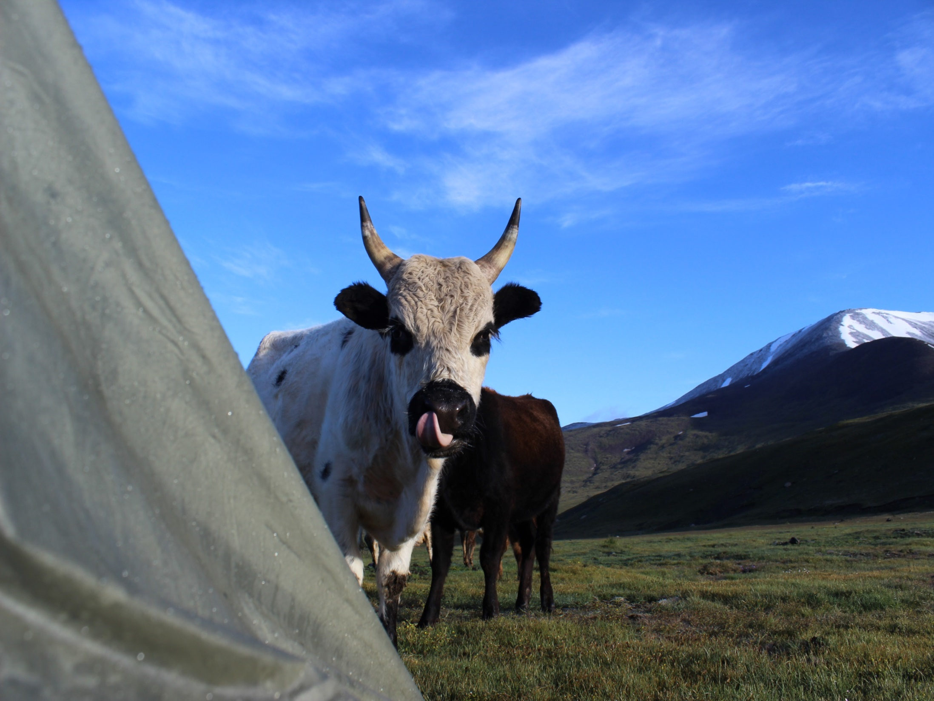
Questions
Photo credit James Gibbs

