Slide 1


Operational algorithms and products for near real time maps of rice extent and rice crop growth stage using multi-source remote sensing
N. Torbick, W. Salas; Applied Geosolutions
Thuy Le Toan; CESBIO, France
Dirk Hoekman; Wageningen University
D. Chowdhury, I. Cooke, N. Rubin, X. Huang; AGS
Spring Science Team Meeting 2017

Slide 2
Two high level truths behind this effort:
Most rice grown in S/SE Asia where/when it is cloudy
SAR has historically not been good option due to barriers
Develop integrated algorithms and operationalize multisource SAR and optical products for maps of rice agriculture to support food security / LCLUC
Rice (crop extent), calendar, cropping intensity, harvested area
Inundation, hydroperiod (duration, length, frequency)
Multi-source Land Imaging (MuSLI): SAR/SAR-optical themed
Research v operational domain and required tradeoffs

Slide 3
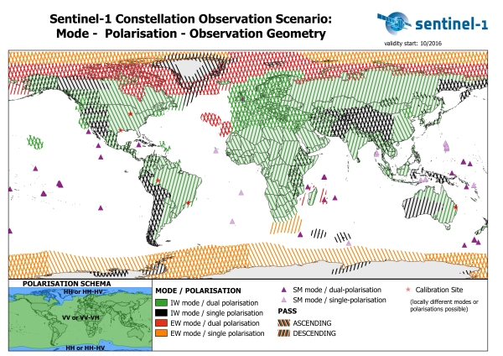
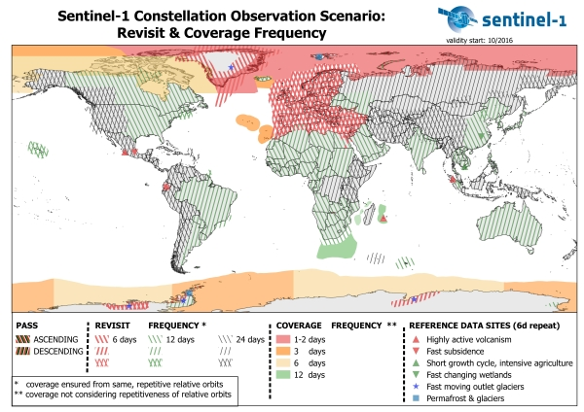
New SAR era; Sentinel-1 (A 2014 & B 2016) C-band BOS

Slide 4
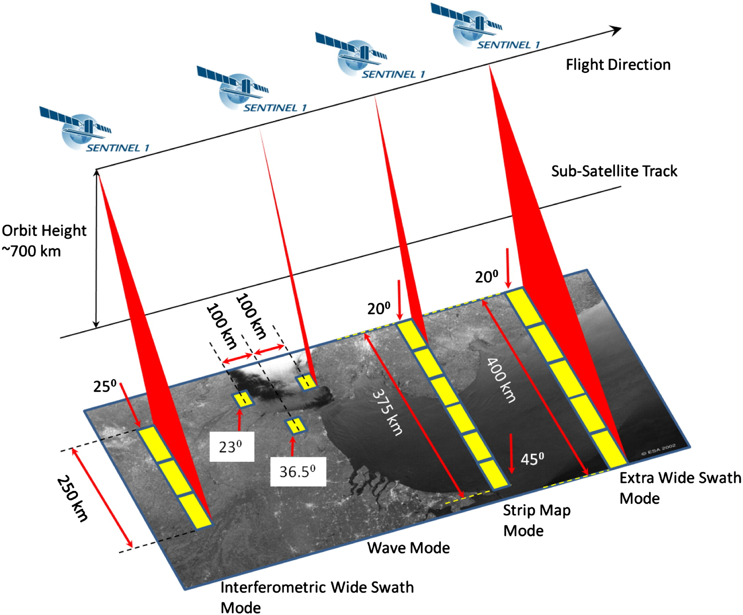
Sentinel-1 acquisition modes

Slide 5
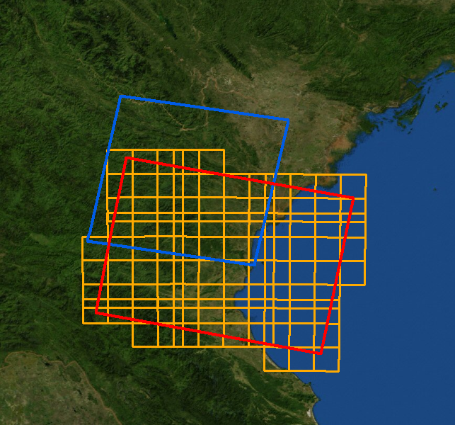
Tool development: Sentinel-1 A&B C-band driver/utility (open source: push to github)
S2L1C grid = ~5GB/tile
ESA
Staging
pre-processing
16 sub-tiles ~300 MB (dual pol)
ESA SNAP S1TBX
ASF
fetching
required tiling system
Geometry / Vector
Temporal Window
Parameter settings
Analysis Ready Data
Data Handling Platform
edge, nodata, proj, minimum tile, # cores, polarity

Slide 6
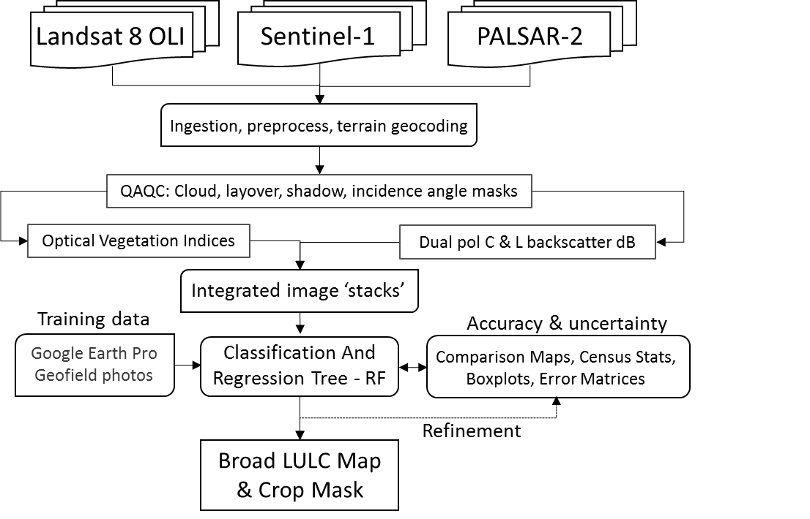
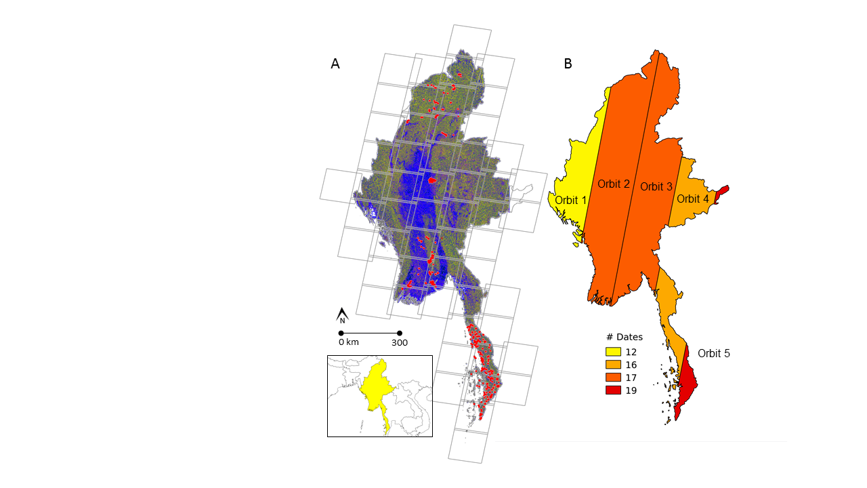
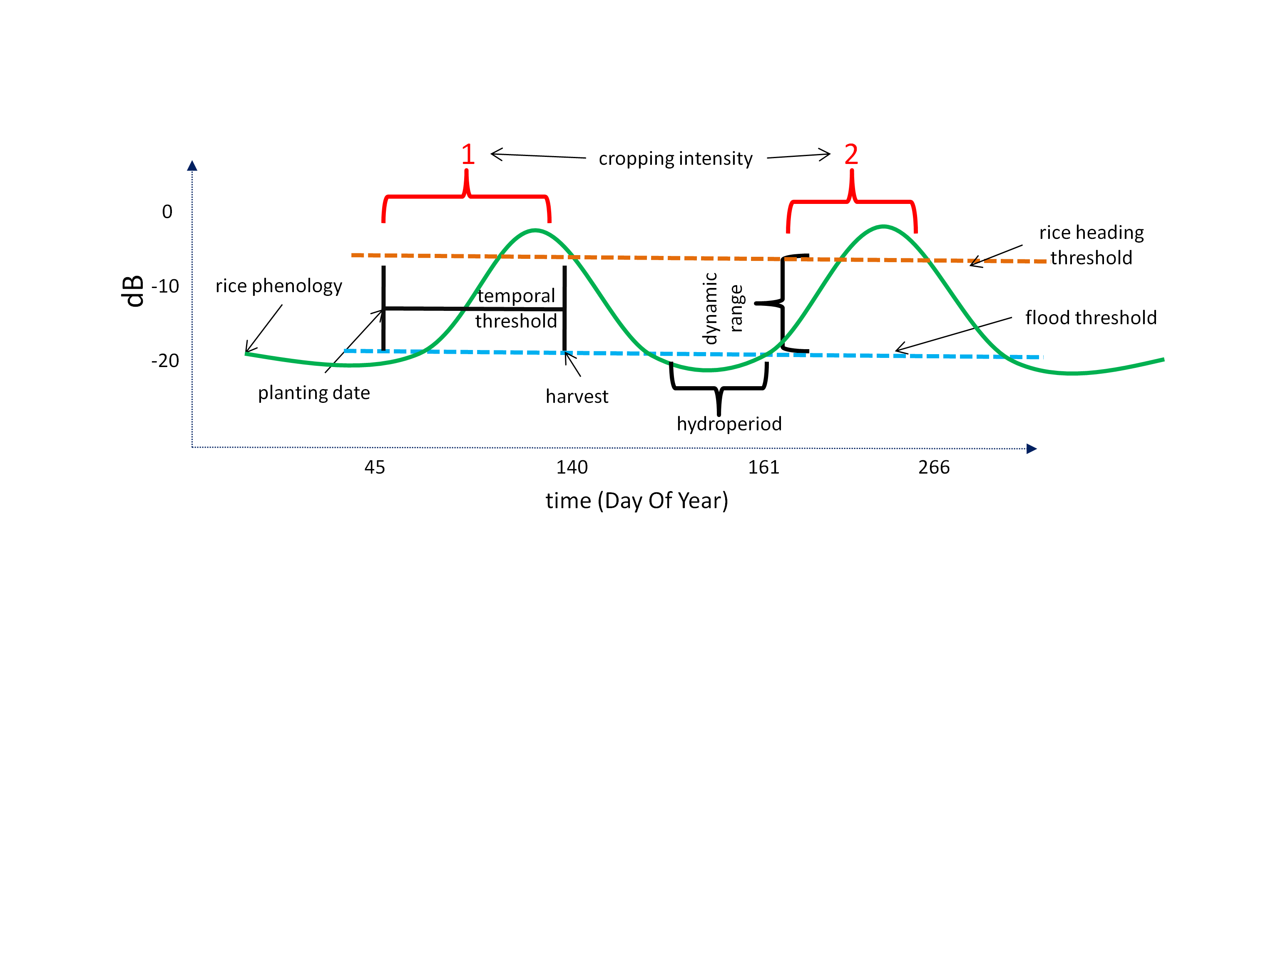
Large area rice mapping: Myanmar food insecurity
-5
-15
dB
-25
N=55
N=632
Time
Notes:
N=55 scenes

Slide 7
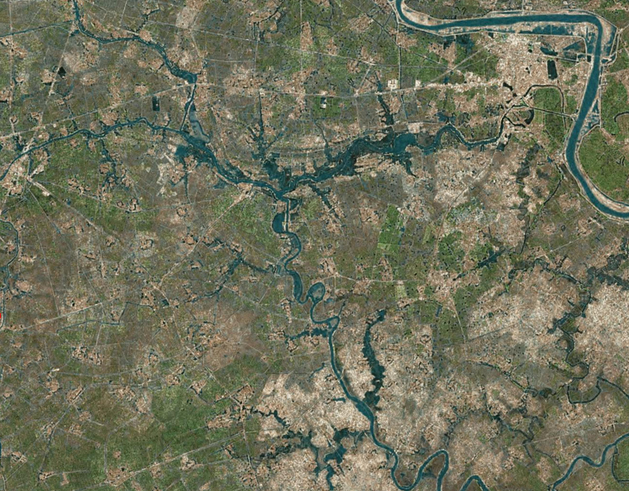
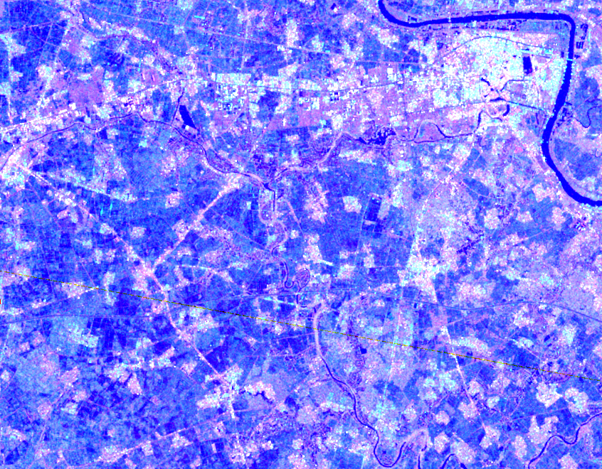
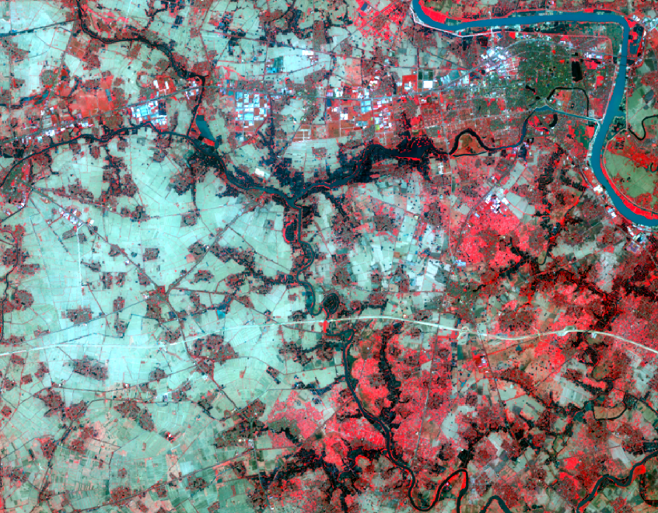
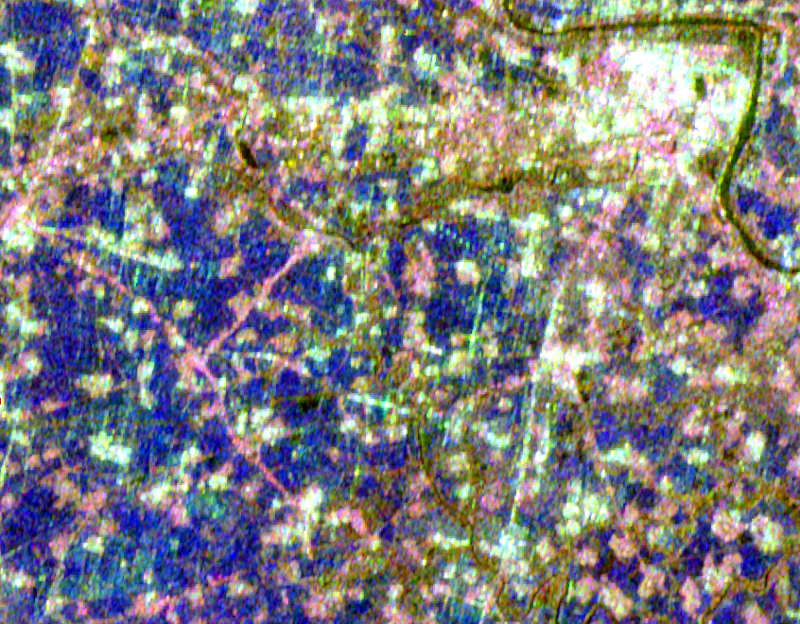
Red River Delta Multisource Imagery
HR / Google Earth
Sentinel-1 IW
Landsat 8 OLI
PALSAR-2 WB1
Notes:
Sentinel-1 VH/VV/VV for 20150304/20150304/20150608
Landsat 8 2014361 543
PALSAR-2

Slide 8
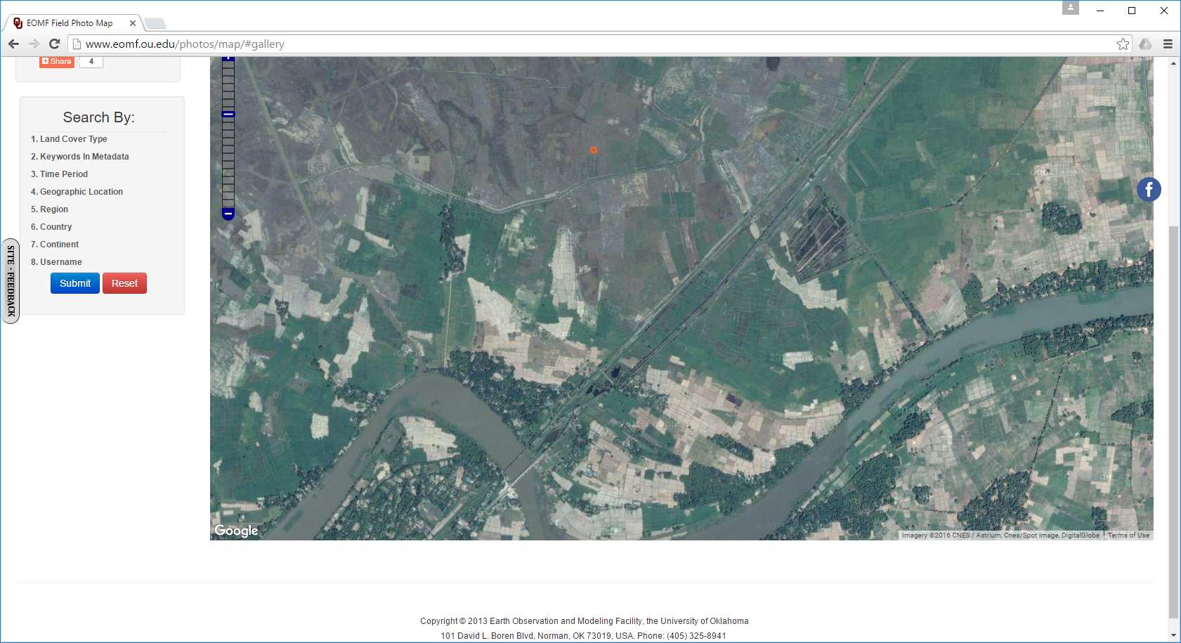
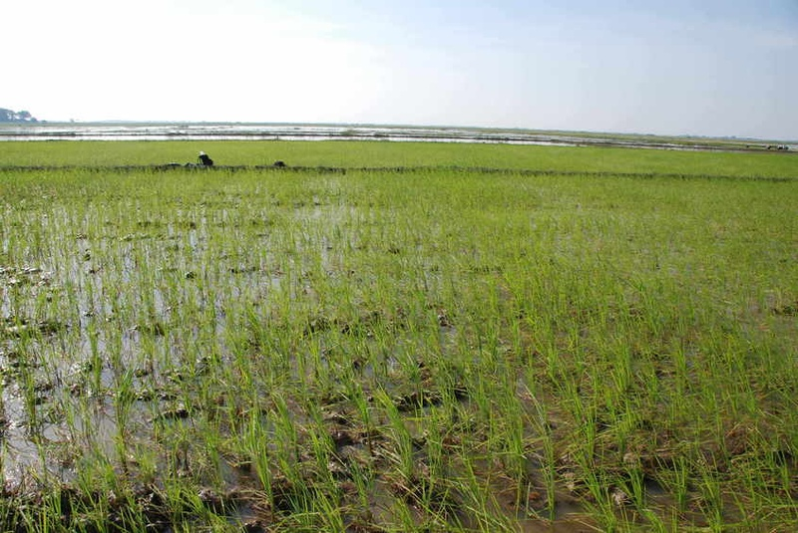
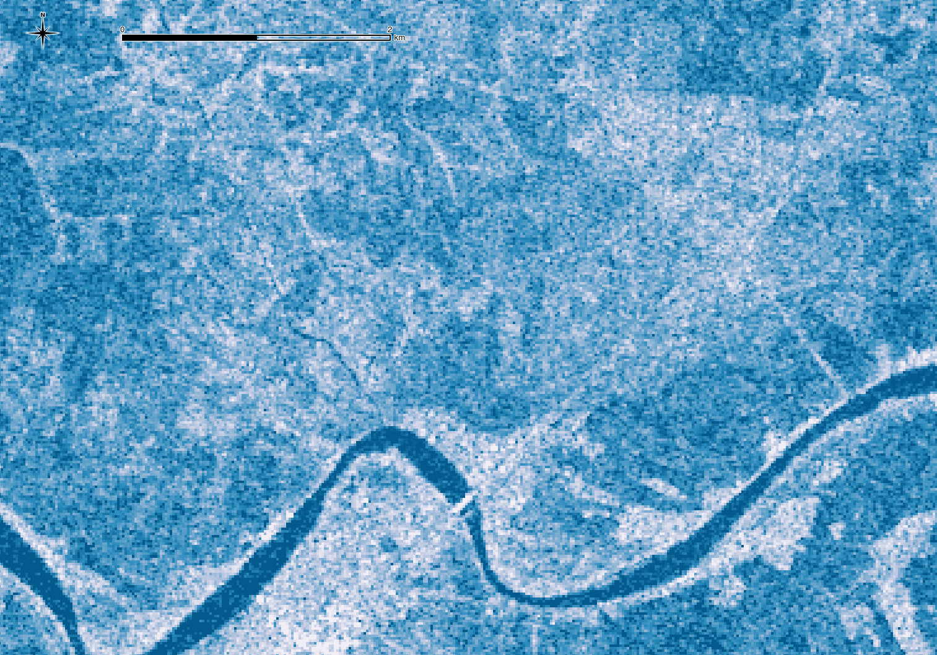
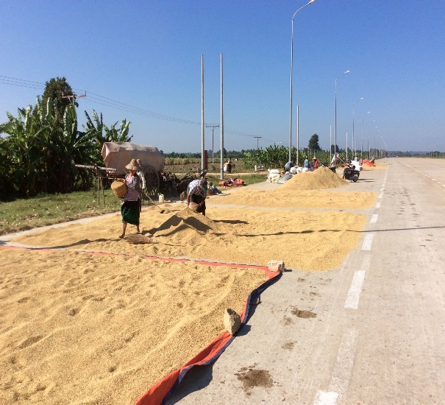
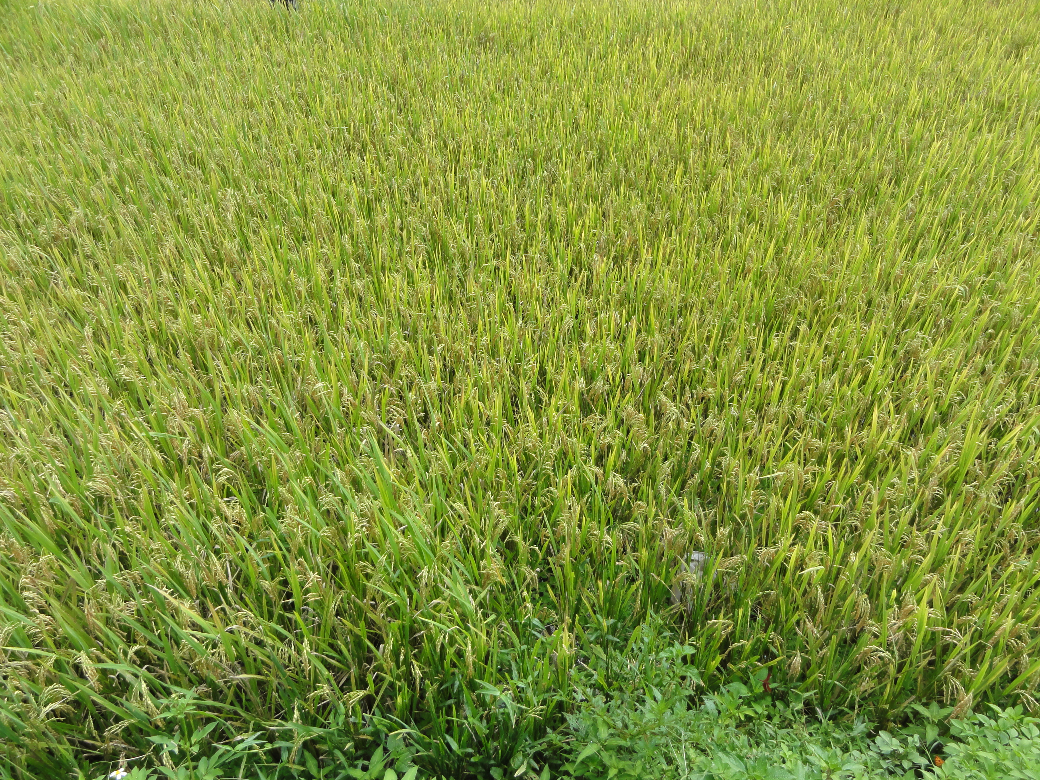
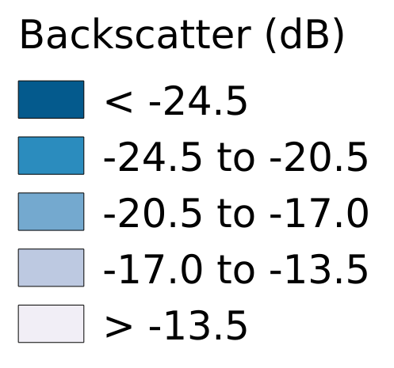
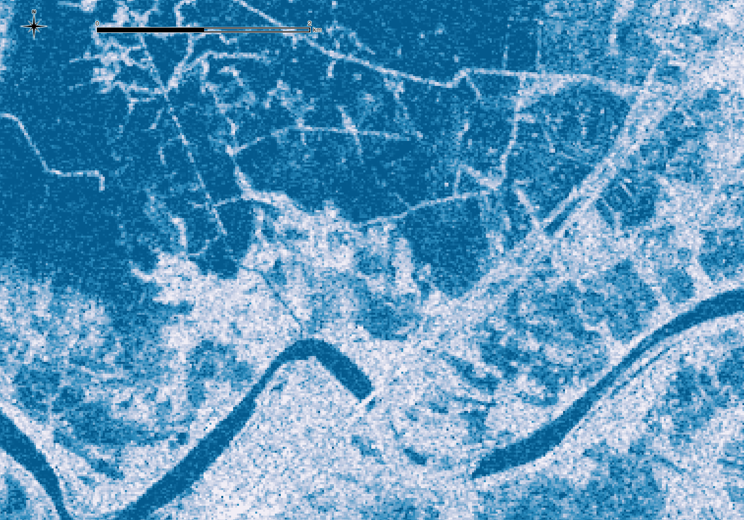
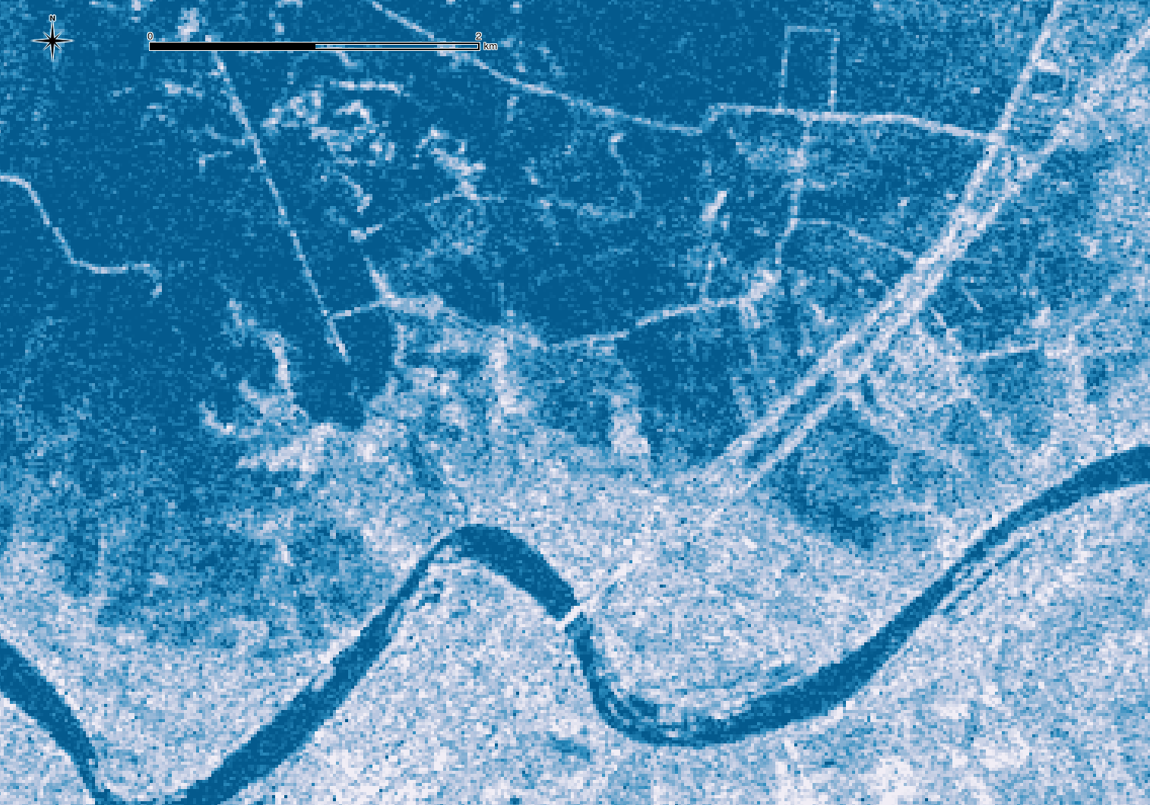
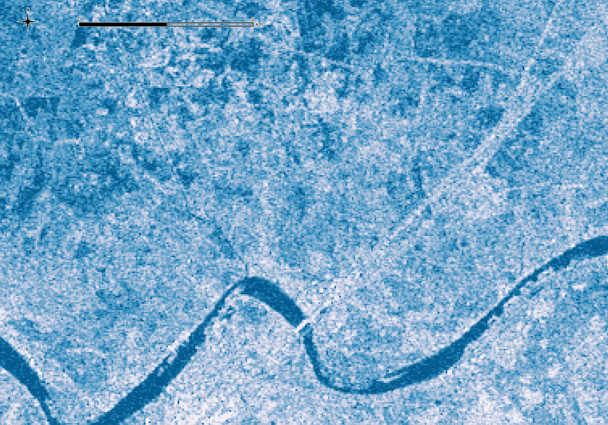
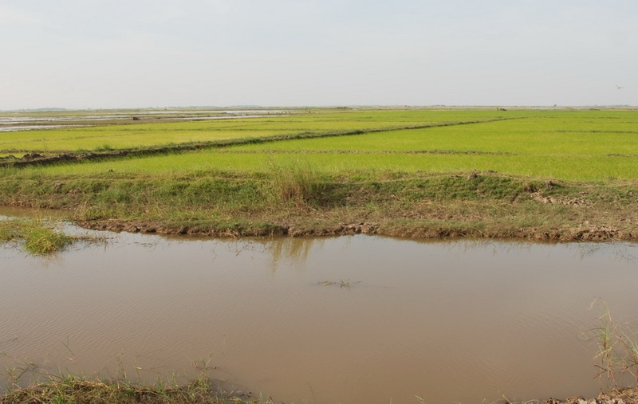
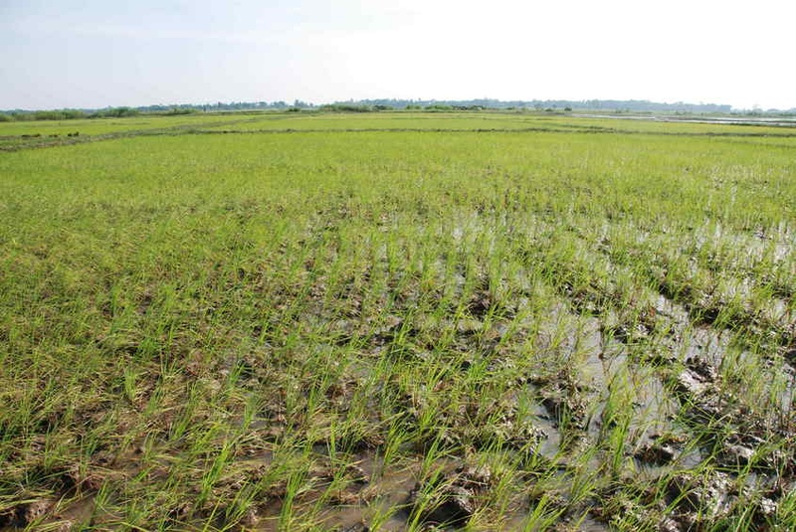
18/05/2015
03/06/2015
31/10/2015
24/11/2015

Slide 9
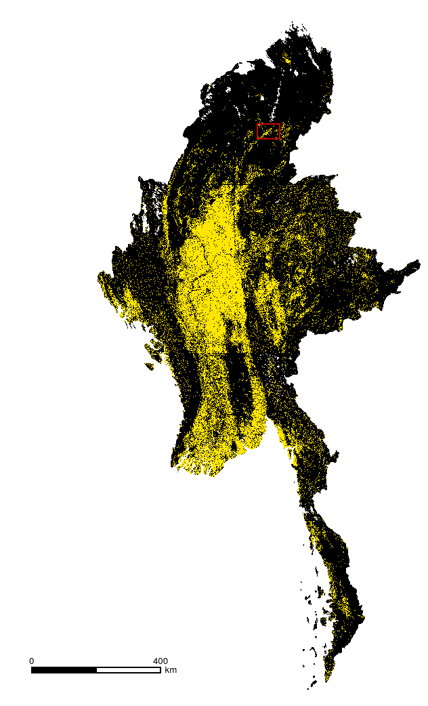
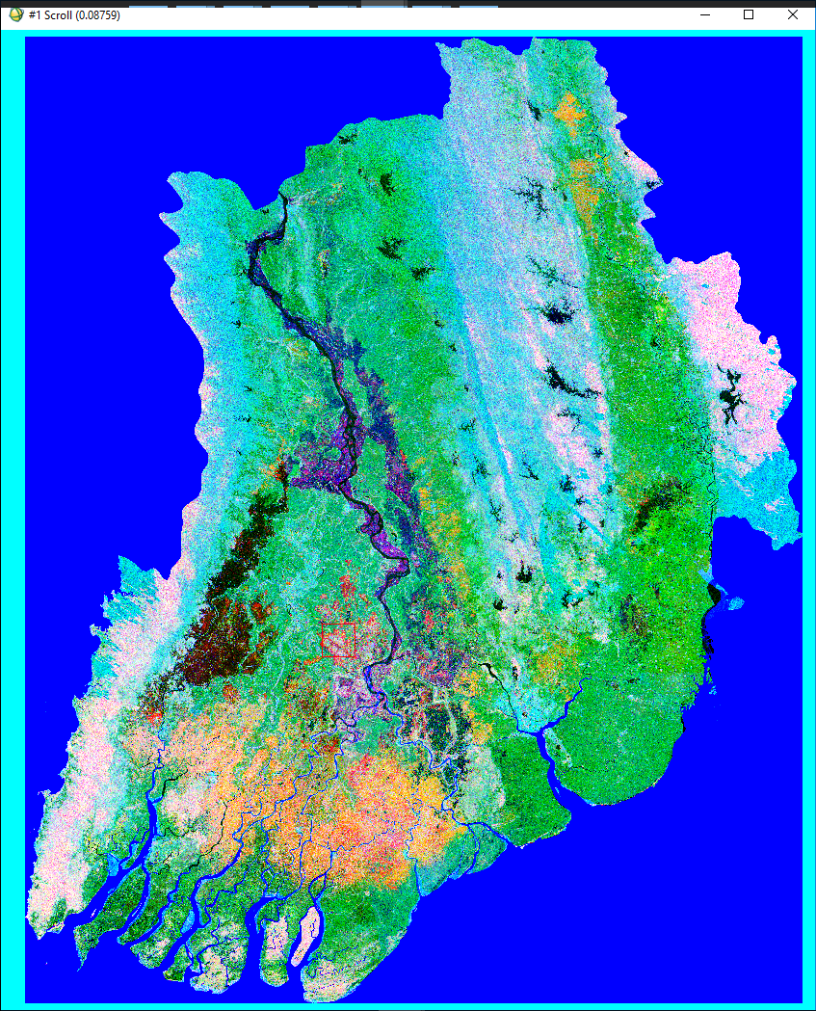
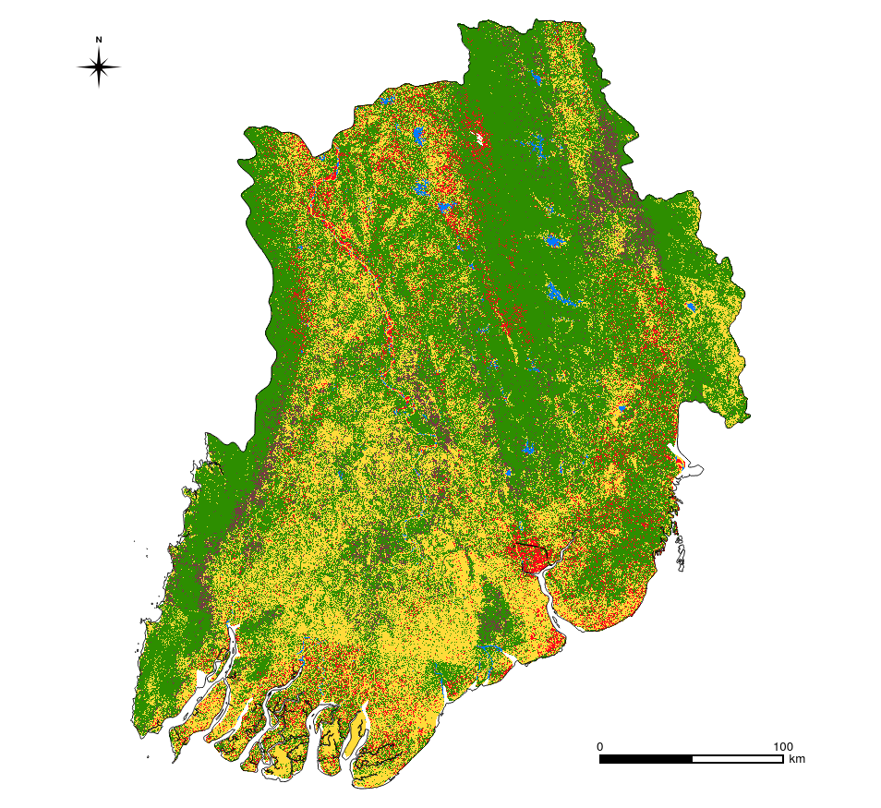
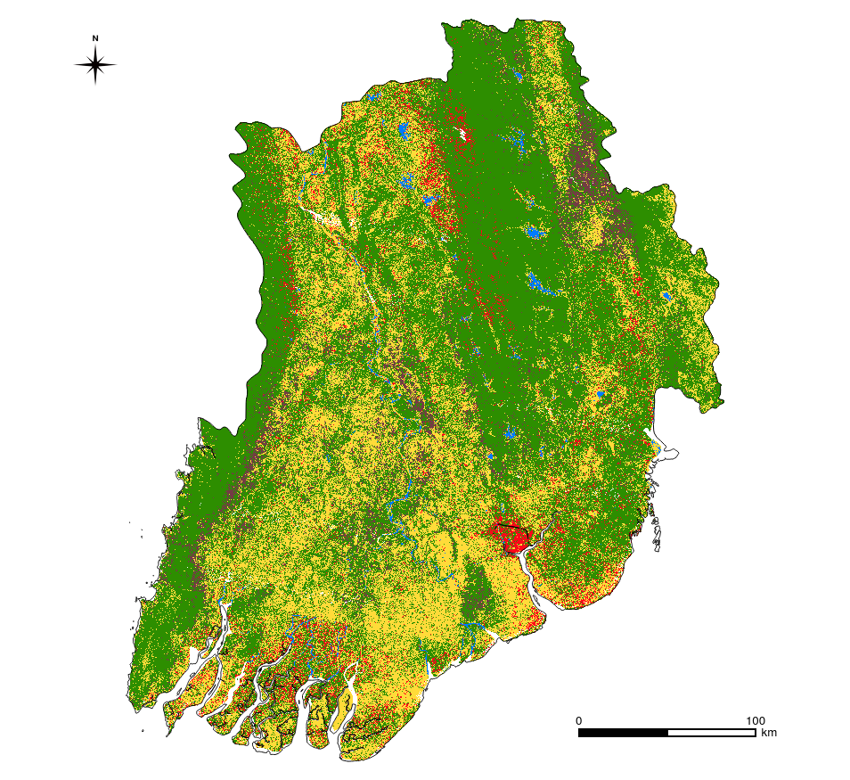
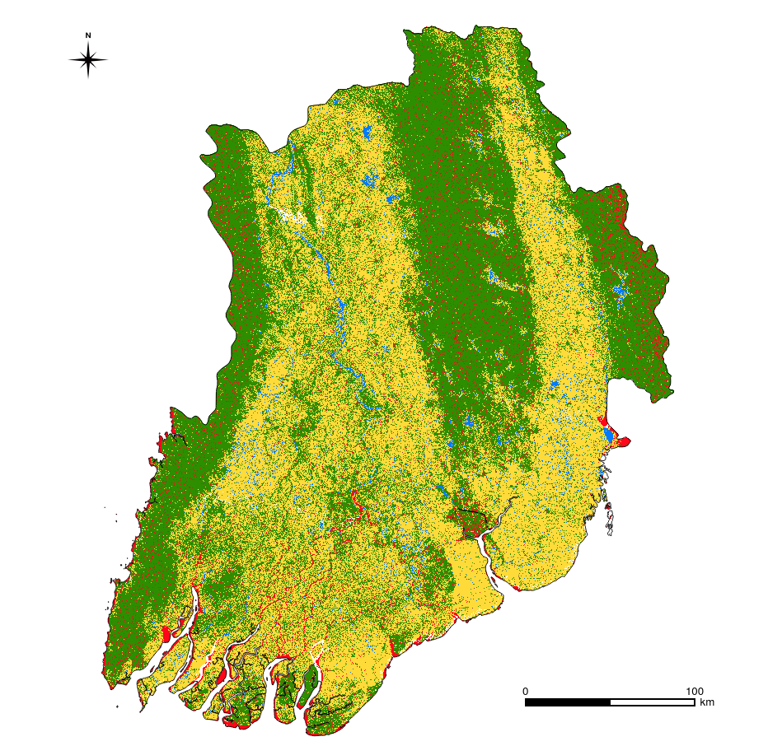
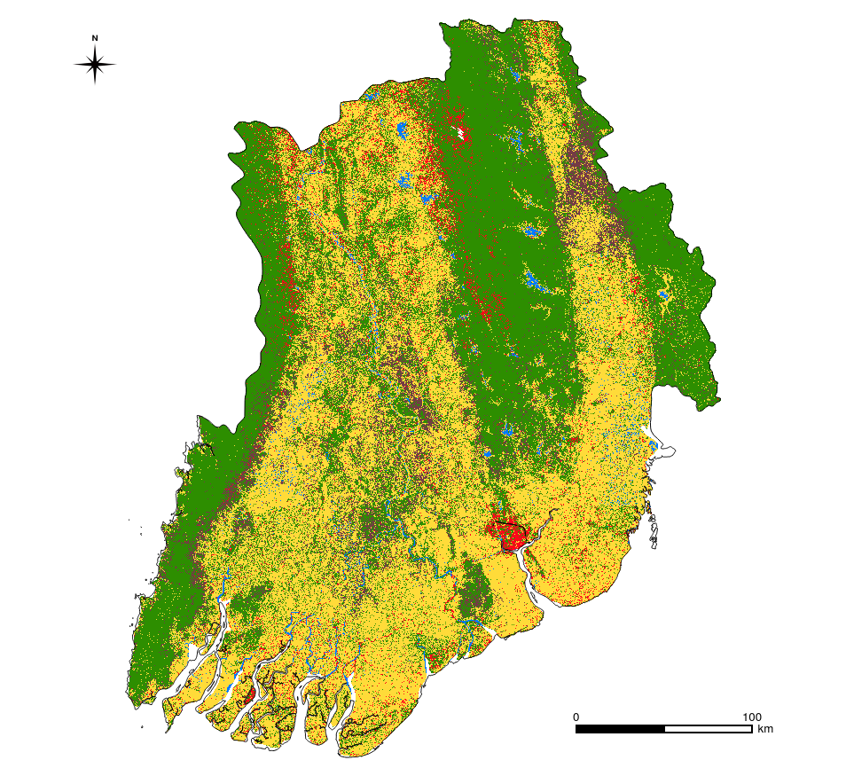
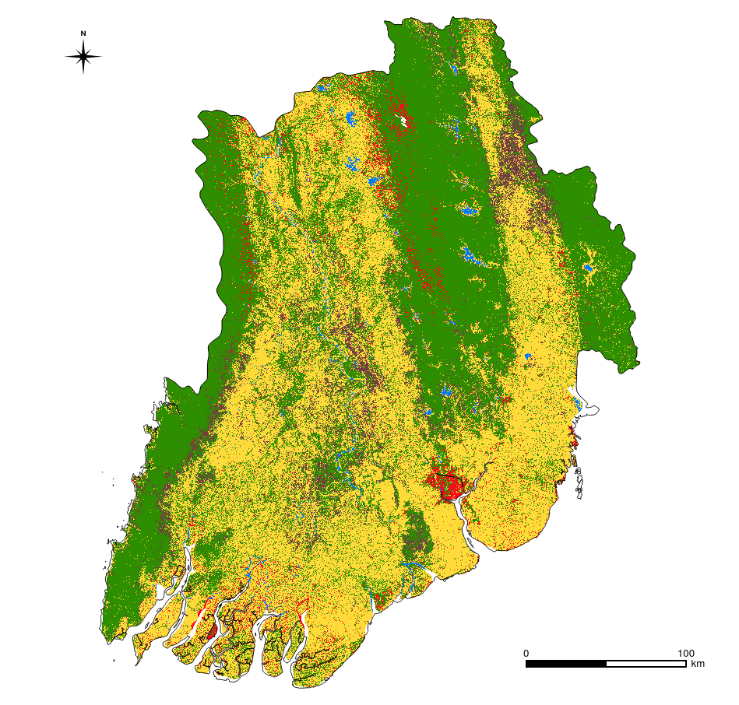
Crop
Water
Forest
Shrub
Built
0
100km
R:NDVI, G:VH, B:HV
L8
L8+S1
Crop
Other
P2+S1
L8+P2
L8+P2+S1
kappa = ~90%

Slide 10
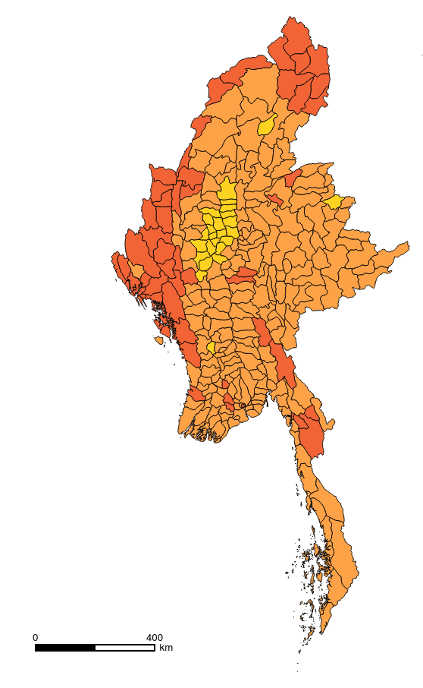
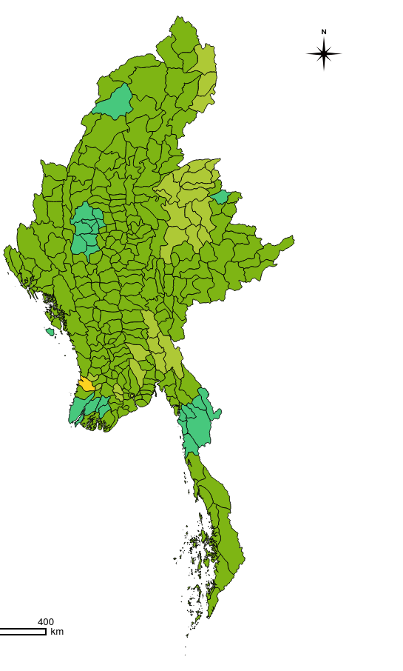
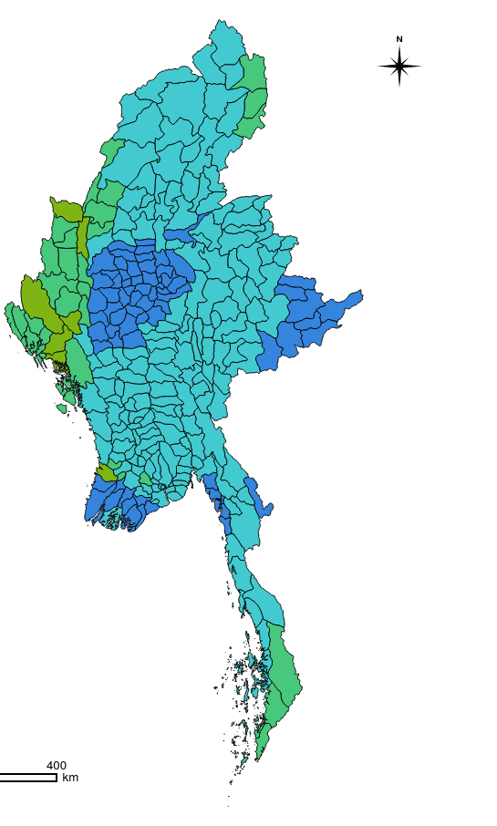
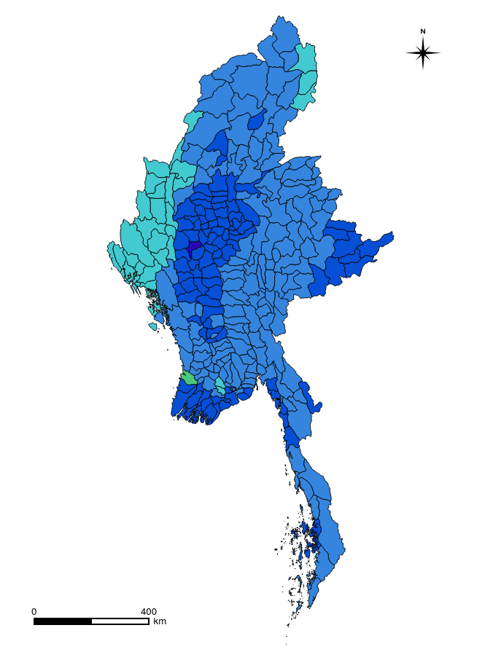
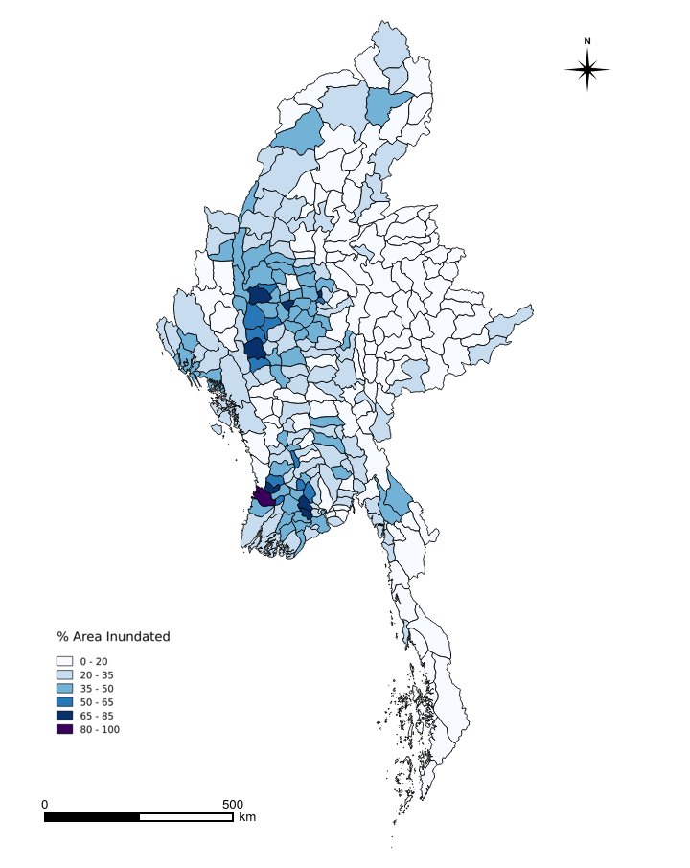

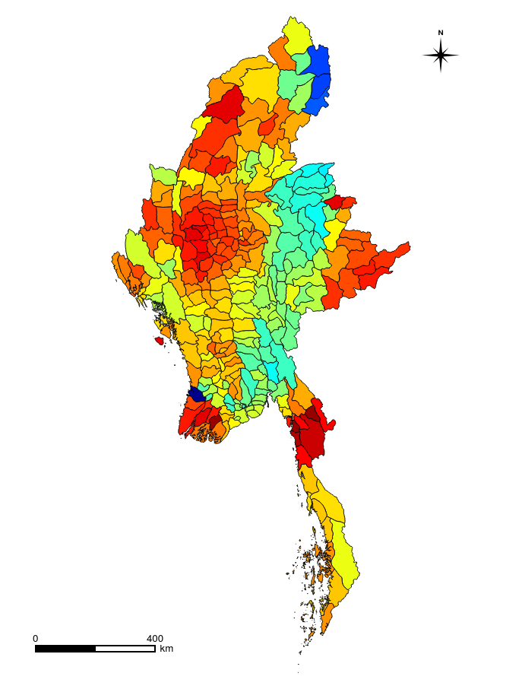
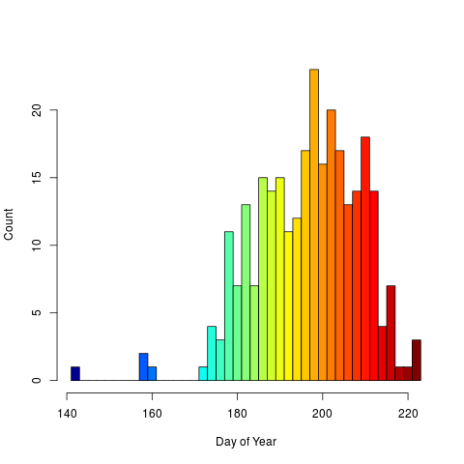
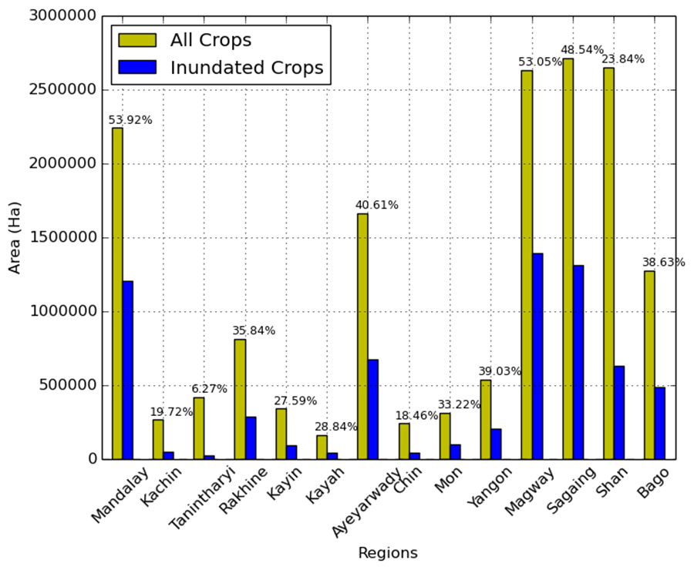
Emergence
SOS
Peak
EOS

Slide 11
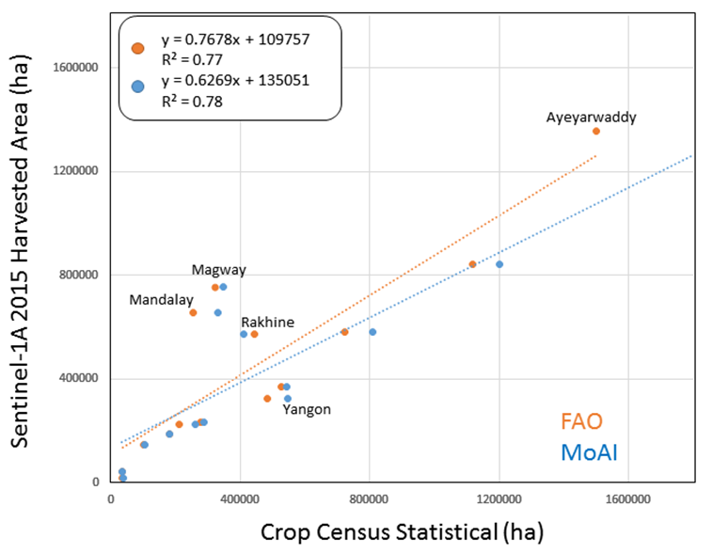
Large area rice mapping outcomes
L8+S1+P2 >90% overall/kappa accuracies
  S1 + P2 had lowest around 72%
Cropland area 186,701 km²
Harvested rice area 6,652,111 ha in 2015
Production down 20% since 2009
Yield relatively lowest in region
Many regions and populations remain extremely vulnerable to stressors

Slide 12
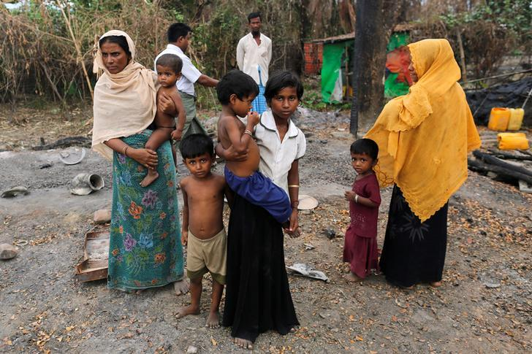
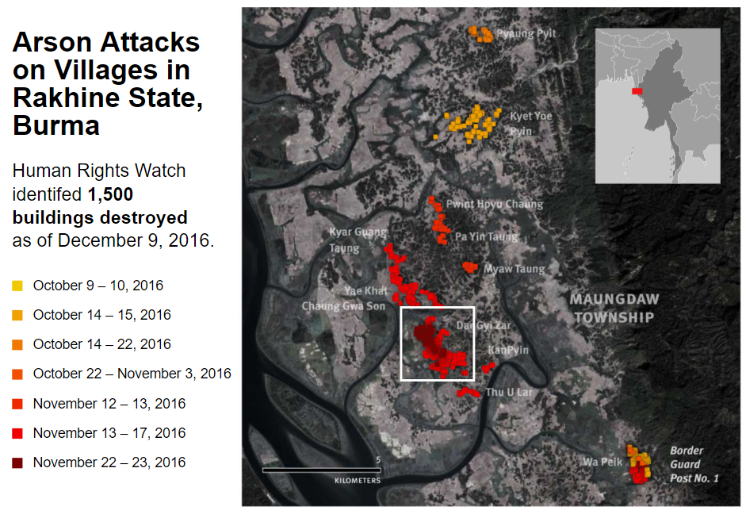
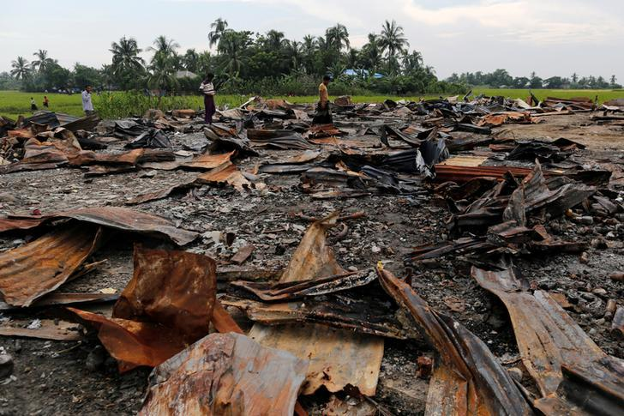
Drivers of food security case study
Rohingya Muslim refugees in Rakhine, Myanmar
70,000 displaced Oct ’16
~400,000 past decade fled to Bangladesh

Slide 13
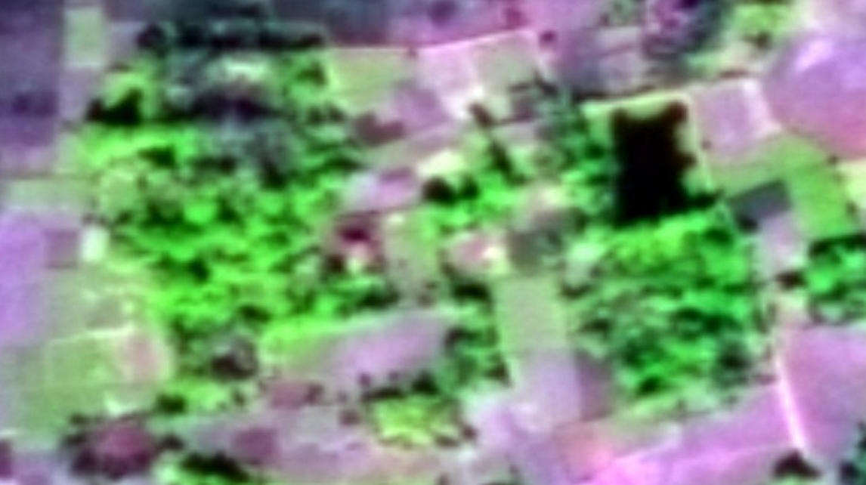
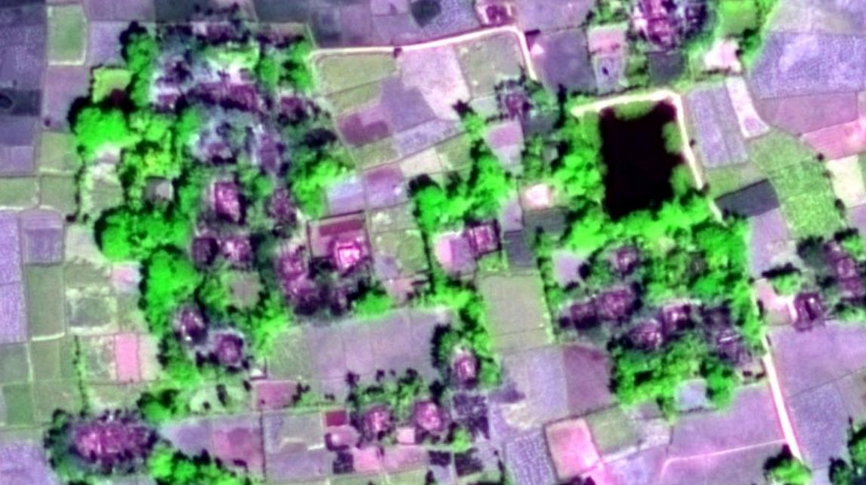
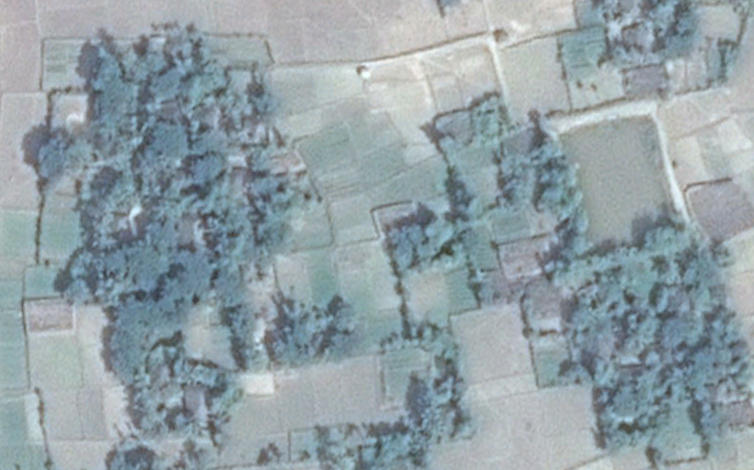
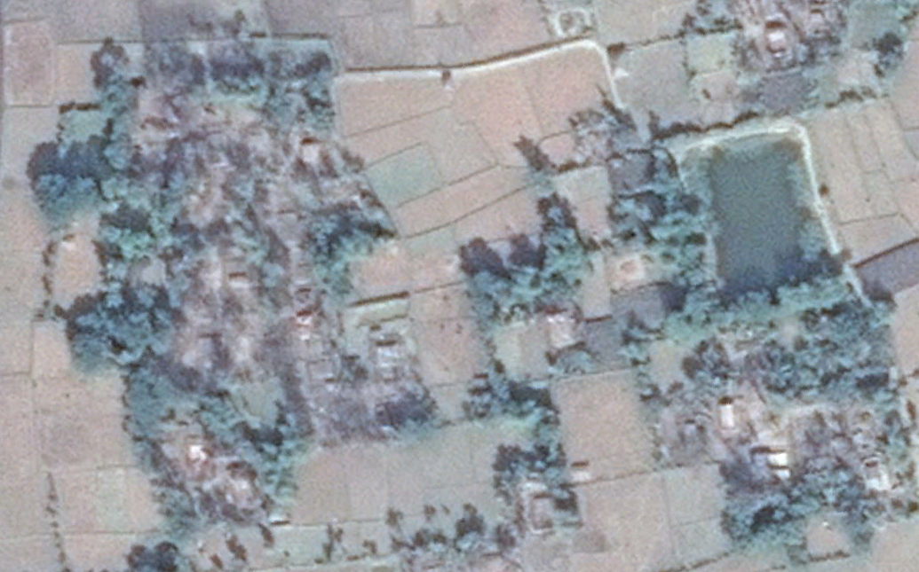
Dar Gyi Zar Village, Maungdaw Township, Rakhine State, Myanmar
Deimos-2 11/18/16
WorldView-3 11/23/16

Slide 14
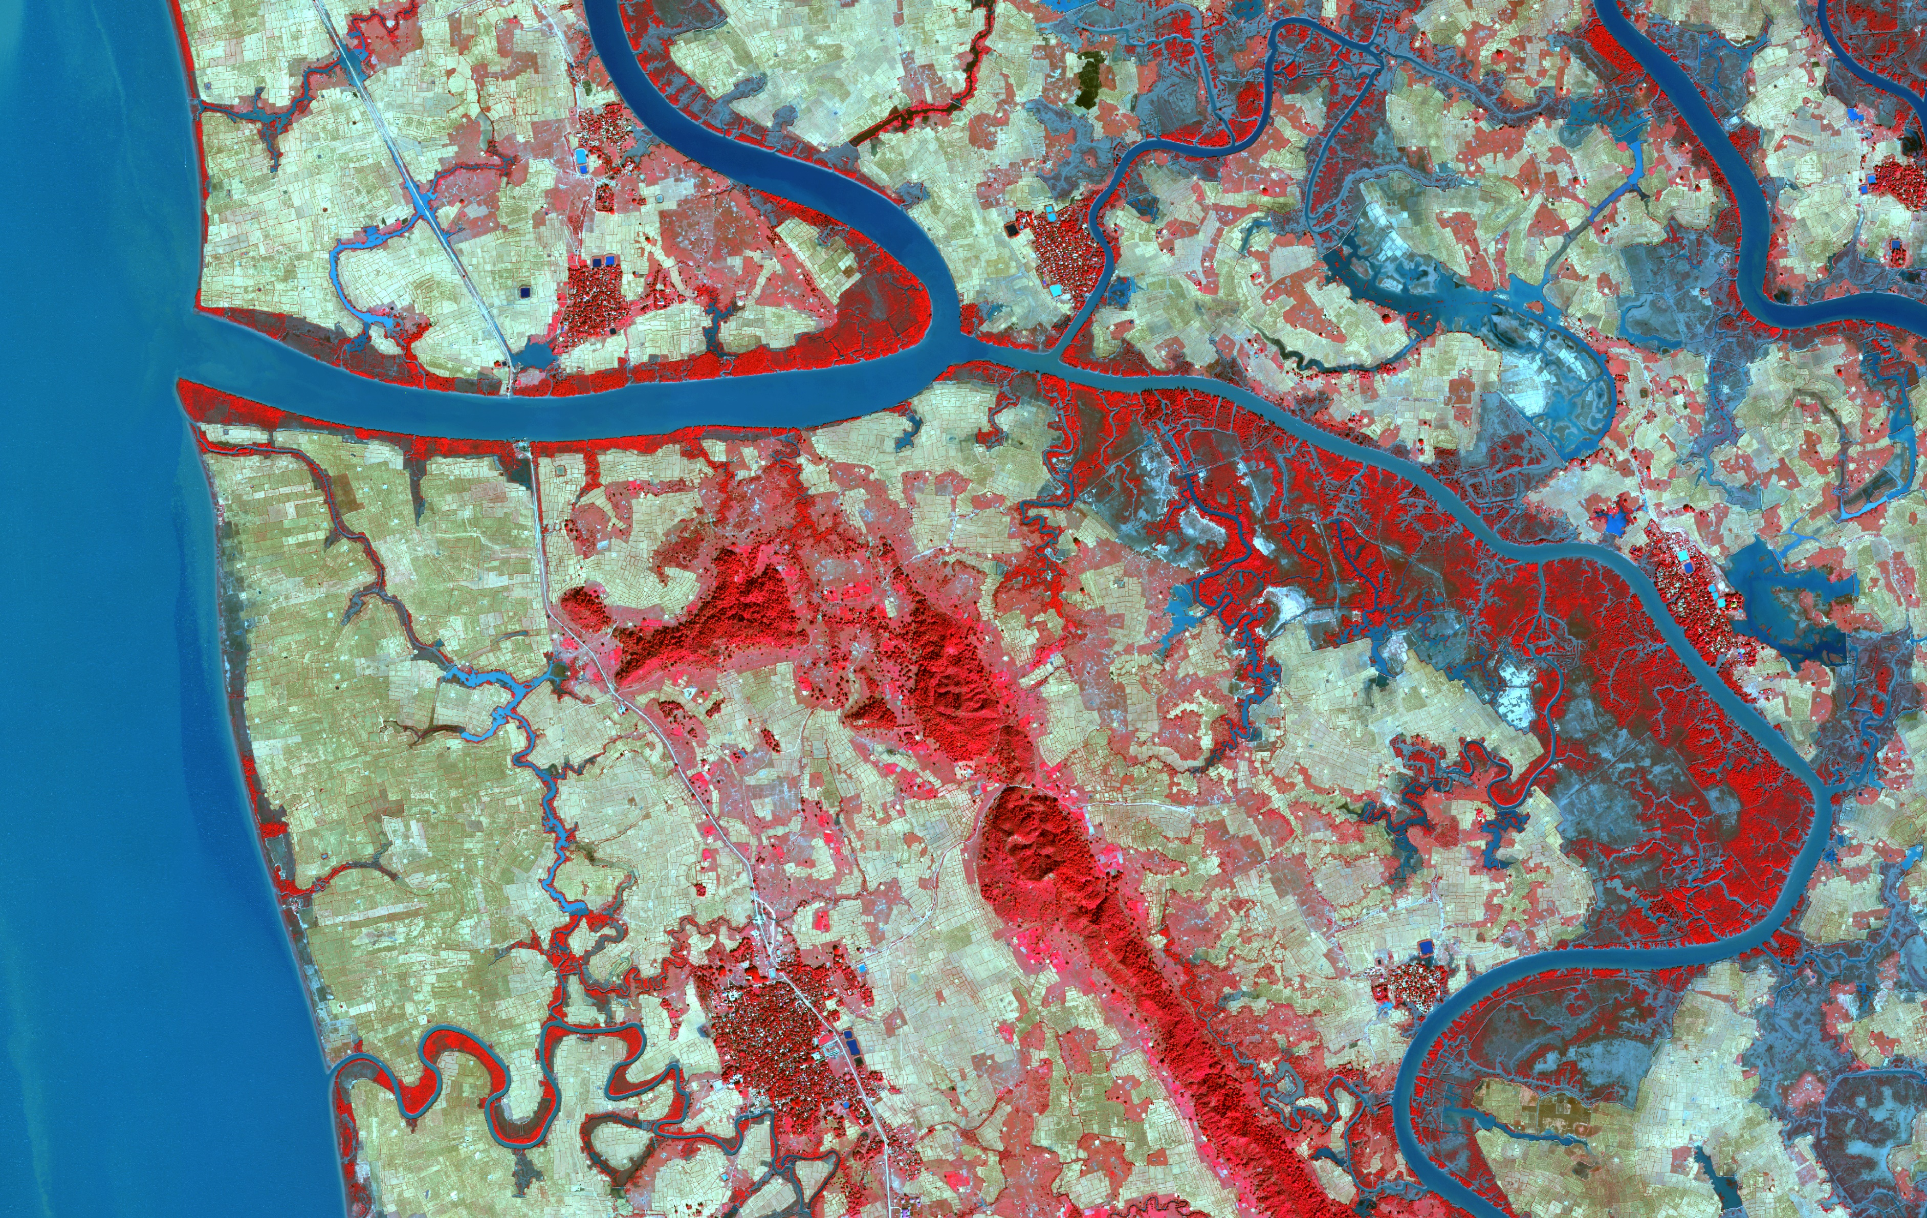
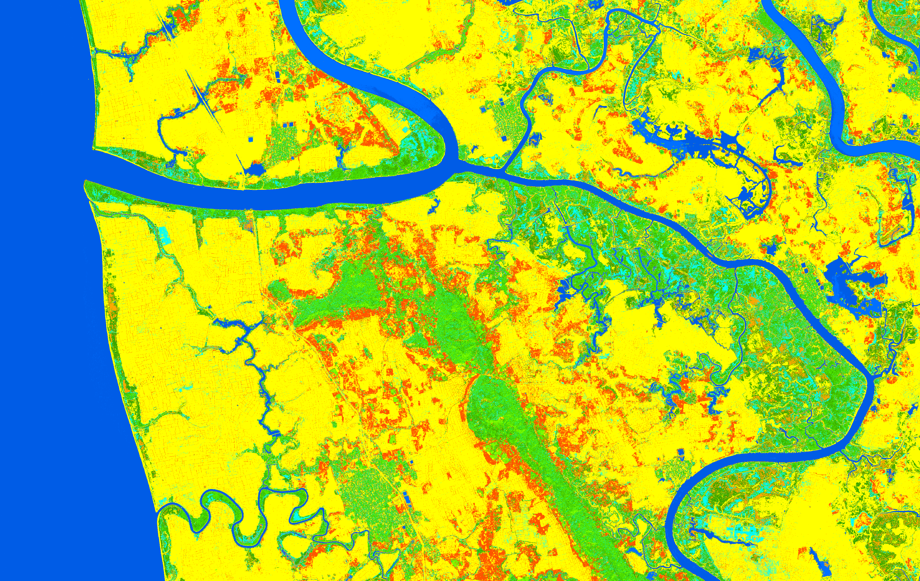
Assessing crop, fallow, and abandoned using high res NGA, L8/S2, and S1 time series
[In progress] >1/3 of cultivated cropland fallow / abandoned in 2016
Arable land 64%

Slide 15
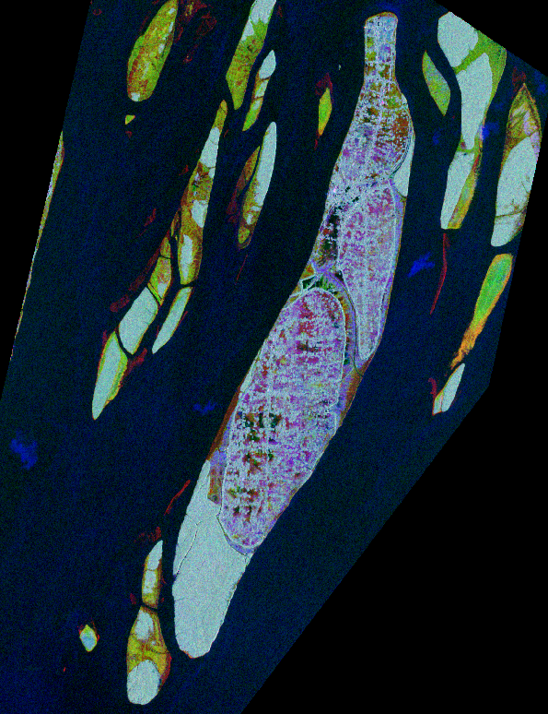
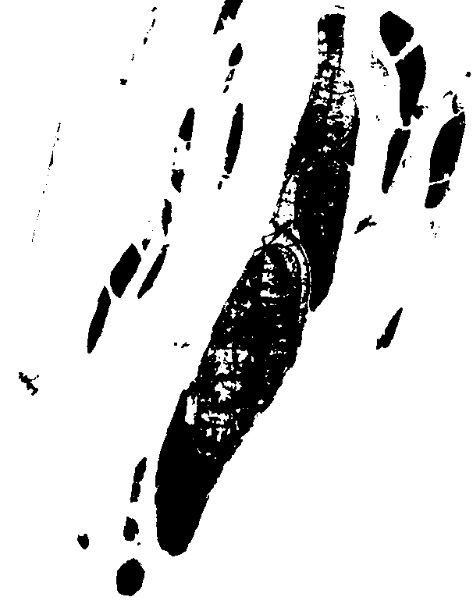
Refugee settlement camps remain in high risk areas
2016 (El Nino year rainfall) shows ~1/3 inundated

Slide 16
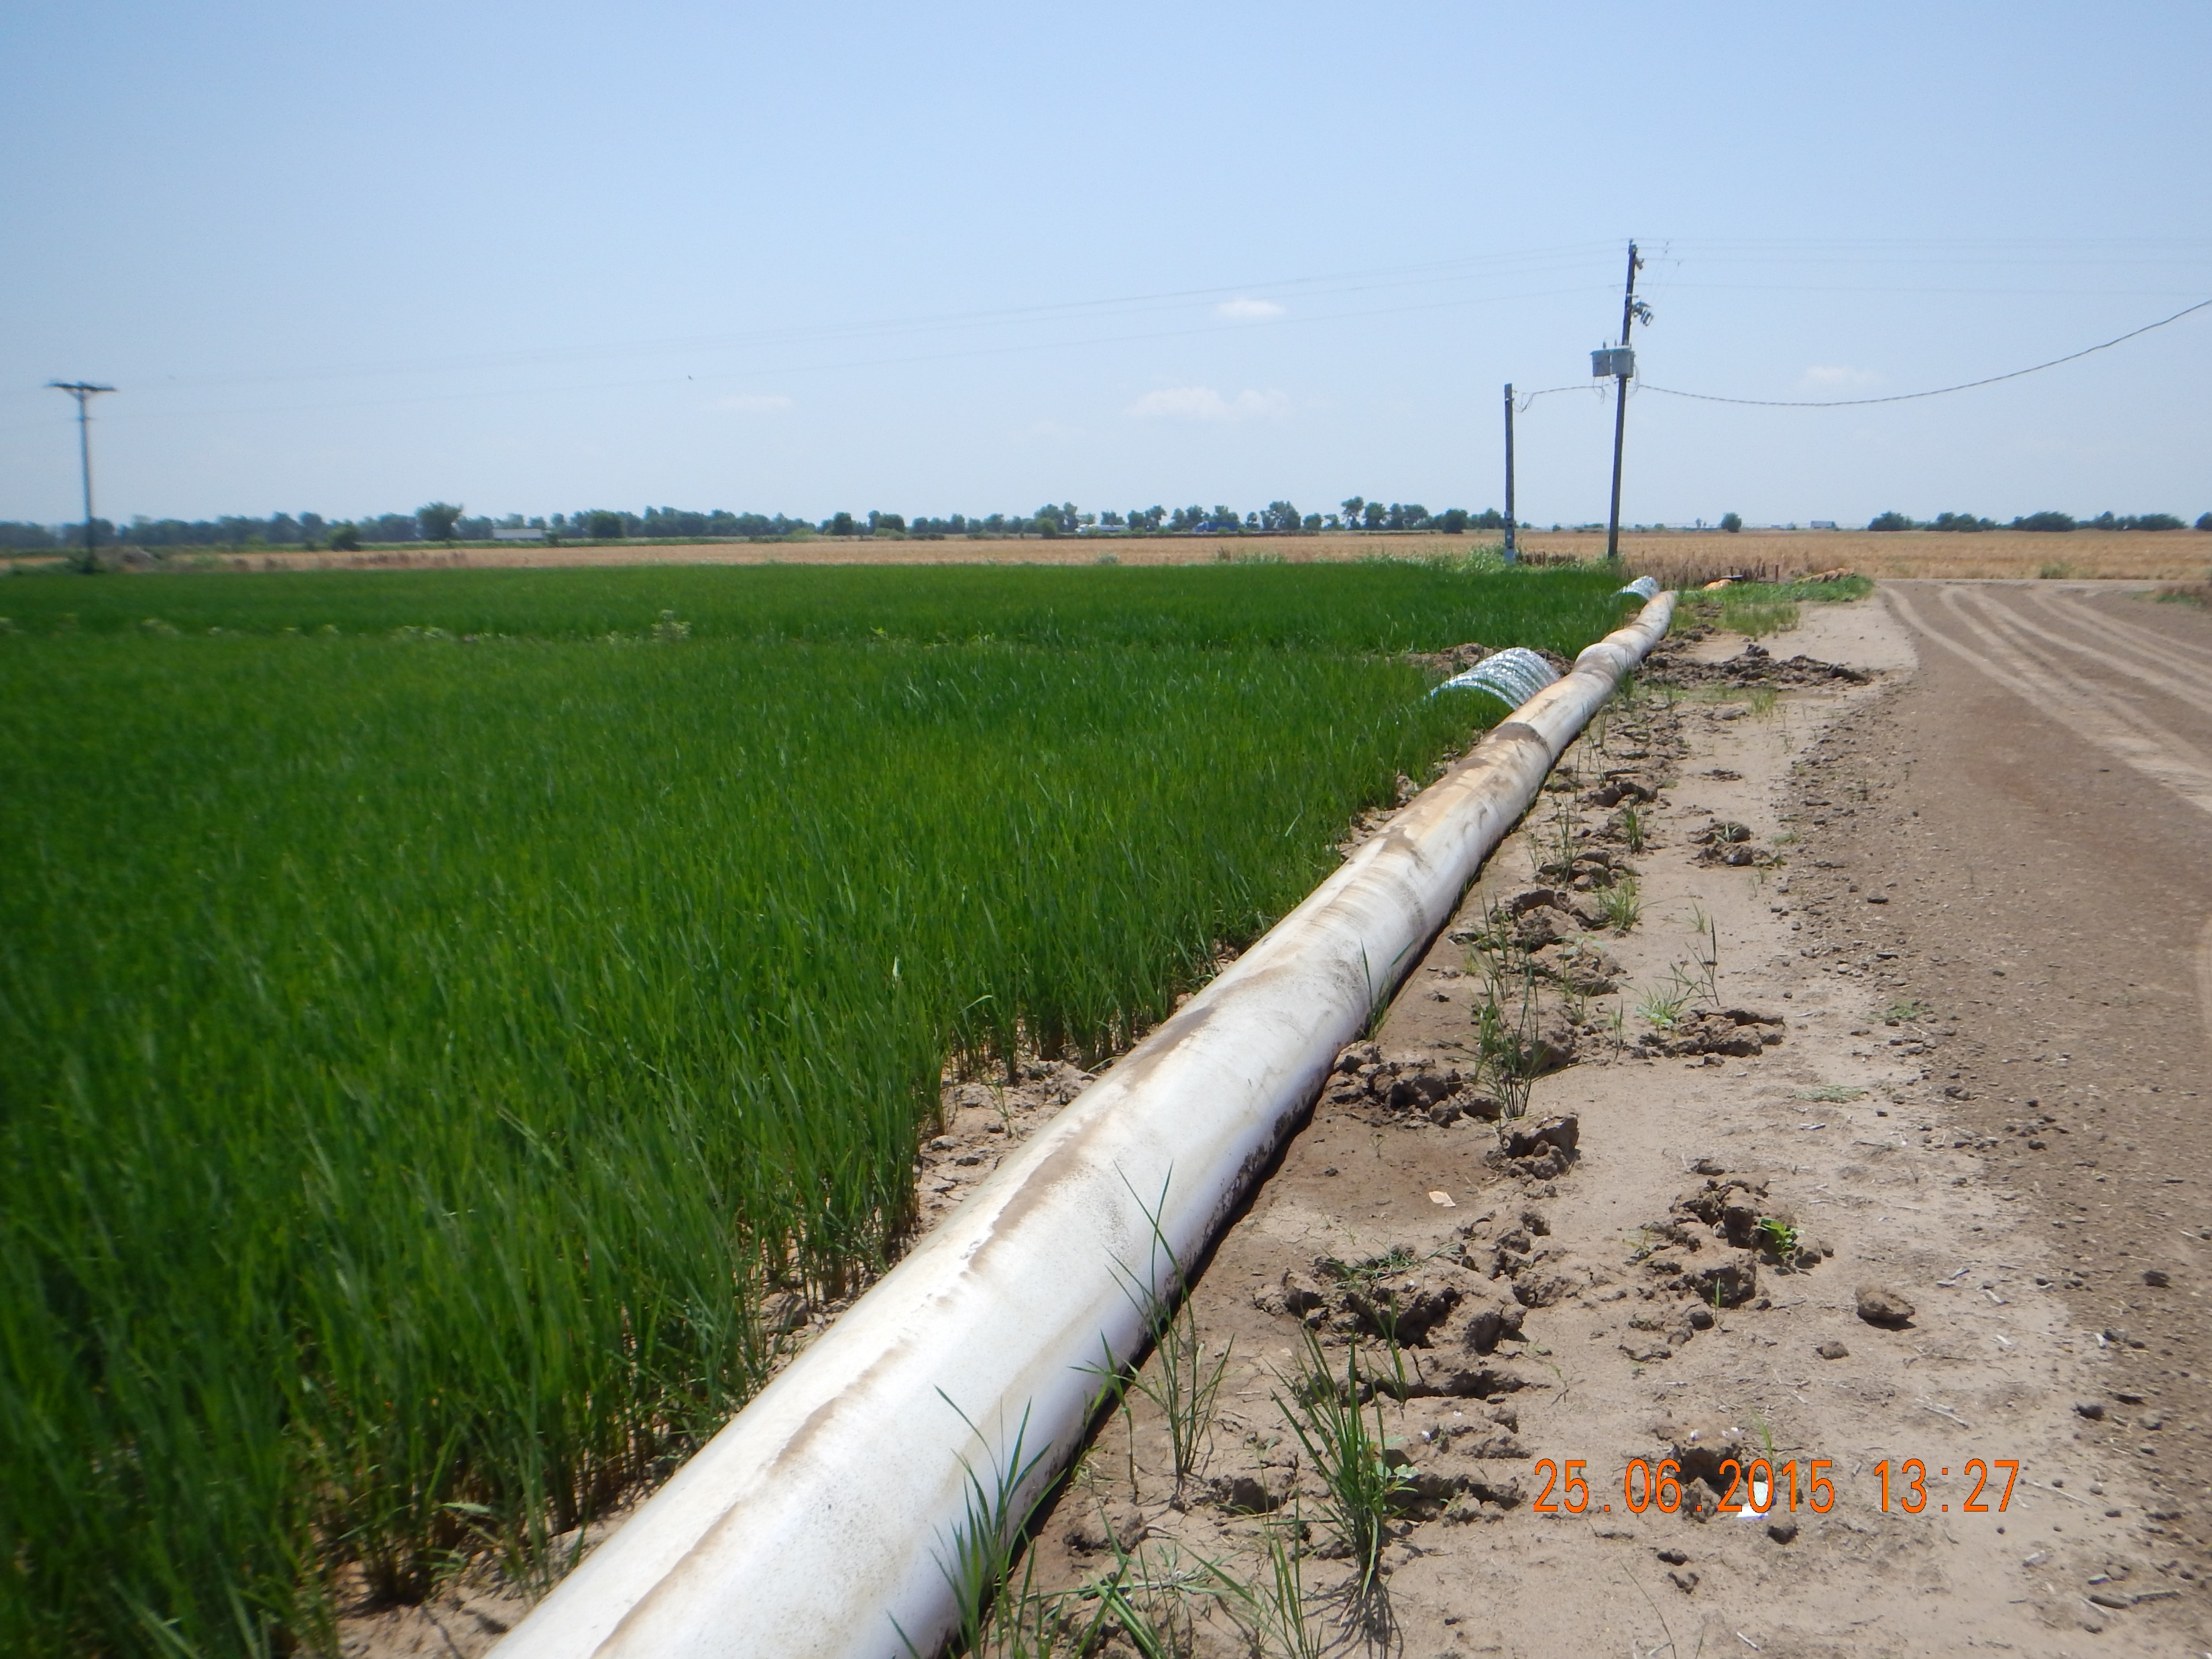






Arkansas inundation and soil moisture mapping: intense instrumentation

Slide 17











TerraSAR-X & Radarsat-2 scattering mechanisms
SM
WD
10S
SE

Slide 18




R2QP Field Inundation Mapping: overall accuracy 88%
20150601
20150625
20150719
20150812
Notes:
Rice fields show much strong double-bounce when flooded.
Assumption 1: Double-bounce only comes from the under water and rice stem.
Assumption 2: Volume scattering only caused by the rice canopy.
Much high accuracy is achieved with the value as high as 88.37%.

Slide 19








Transition to Sentinel-1?
30⁰ incidence angle
$$abs\left(HV\right)=36.29∗h^{−0.18}$$
$$R^{2}=0.60$$
40⁰ incidence angle
Flooded
Flooded
Non-Flooded
Notes:
The decision tree is refined based on the comparison of the VV and HV over flooded and non-flooded fields at the same height.
Absolute HV is strong related to the rice height.
Flood detection method is more suitable for the early growing stage before Middle of July.

Slide 20

Scaling inundation mapping using PALSAR-2 ScanSAR & Sentinel-1
beyond open surface water to understand cropland hydroperiod & water balances

Slide 21

Assessing integration of S1 with USDA NASS CDL framework (D. Johnson, R. Mueller)
Preliminary outcome
S2
S1

Slide 22
MuSLI take home massages so far:
Blending moderate resolution radar with optical (S1, P2, L8) generated best* overall classified LULC maps (*for this application)
Sentinel-1 shows good ability (sensitivity) to assess and monitor rice at moderate scales over a large cloud-prone region using phenology approach; PALSAR-2 great for research; not ideal for operational monitoring due to BOS (NISAR 2020? BIOMASS?)
Open access, operational BOS, short latency critical to support food security (GEOGLAM, AsiaRiCE); transparent and robust MRV
  Will take time and more work to integrate operational SAR into existing and new DSTs (FEWSNET, NASS)
Scaling from research to operational domain challenging; tradeoffs required; inundation signal saturation limits vary by sensor and BOS (eg, polarizations, incidence angles)
See LCLUC website for few recent publications and details
  Remote Sensing, Carbon Management

Slide 23
MuSLI next steps:
Carrying out further applications and algorithm development in Irrawaddy Myanmar; Odisha India, and Red River Delta Vietnam with partners (IRRI, CGIAR, VAST, IWMI, AsiaRiCE, Universities); and USA
Upcoming intense field campaigns in Thai Binh, Red River Delta, Vietnam and Odisha, India collecting suite of biogeophysical measurements (plant height, water depth, soil moisture, GHG emission chambers, management inputs)
Lobbying JAXA engineers for multi-temporal quad pol super site coverage and growth in SAR tools (NASA? And PPP)

Slide 24
Thank you.
Happy to share, discuss, and follow up.
ntorbick@ags.io

