Slide 1
Commercial Smallsat Data Acquisition (CSDA) Program
LCLUC Meeting
Science Mission Directorate
Earth Science Division
20 October 2022

Slide 2
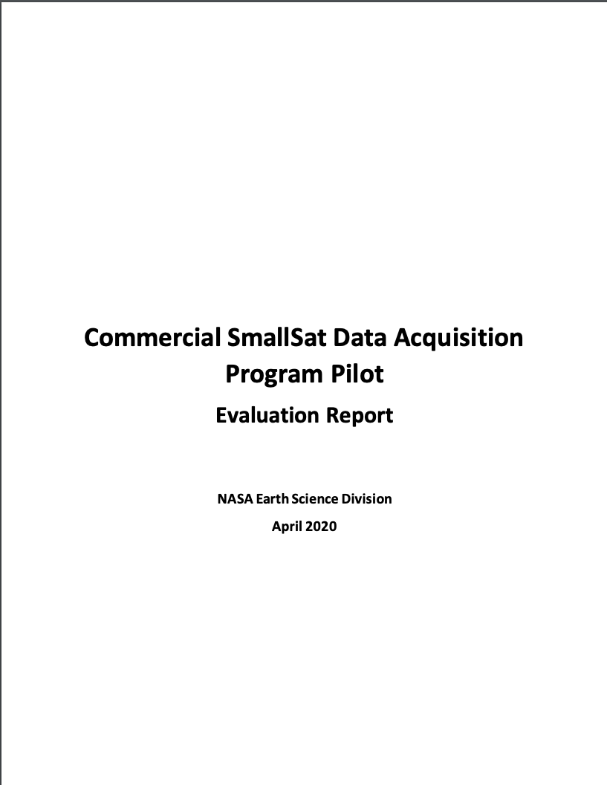
Commercial Smallsat Data Acquisition (CSDA) Program
Pilot initiated in November 2017 to evaluate data from operating commercial small-satellite constellations for research and applied science activities
Augment and/or complement NASA Earth observations
Cost effective means to advance/extend research and applications
Blanket Purchase Agreements (BPAs) were awarded in September 2018 to Maxar (DigitalGlobe) Inc., Planet Labs Inc., and Spire Global.
Pilot successfully ended early 2020 → sustained program - CSDA Program
Restrictive nature of the End User License Agreements (EULAs) made standard scientific collaboration difficult and must be addressed in future data purchases.
Notes:
Pilot Results
Majority of evaluations demonstrated the usefulness of commercial data and imagery for advancing scientific research and applications.
Investigators encountered limitations:
Calibration and geolocation
Increased the amount of work needed to access, preprocess, and analyze data (e.g., download services, documentation, and metadata).
Restrictive nature of the EULAs made standard scientific collaboration difficult and must be addressed in future data purchases.
Overall, the utility of the evaluated data outweighed the difficulties encountered.

Slide 3
Commercial Smallsat Data Acquisition (CSDA) Program
Program Objectives:
Establish a continuous and repeatable process to onramp new commercial data vendors.
Enable sustained use of purchased data for broader use and dissemination by Earth scientific community.
Ensure long-term data preservation, access and distribution of purchased data and long-term access for scientific reproducibility.
Coordinate with other US Government agencies and international partners on the evaluation and scientific use of commercial data.
https://earthdata.nasa.gov/csdap

Slide 4
End User License Agreements (EULAs) Tiered Approach
Scientific Non-Commercial Use License
Utilize the tiered EULA approach to satisfy other agency commercial data request via SNWG Assessment Process.
Tiered EULA approach is modeled after NRO’s family of EULAs.

Slide 5
CSDA Program License Uplifts
In 2021, CSDA licensing agreements expanded to broaden the applicability for scientific applications across the US Government
Spire Global, Inc.: Available to Federal/State/Local/Tribal Governments & funded research
Full GNSS Science Data Catalog
Planet Labs: Available to Federal Civilian Agencies, NSF, & their funded research
Full PlanetScope and RapidEye archive
Other licensing details remain similar:
30-day latency; scientific use only
Onramp 2 and beyond vendors– utilize the broaden licenses: USG, USG Plus, and Public Release
These licensing uplifts will make the data more readily-available across the government and improve both value and interagency collaboration.
Notes:
Went from NASA only End Users License Agreements (EULAs) to tiered EULAs (USG, USG Plus, Public Release)
Collaborations with NRO –
Tiered EULA approach is modeled after NRO’s family of EULAs.
Utilize the tiered EULA approach to satisfy other agency commercial data request via SNWG Assessment Process.
More information on CSDA’s holdings, including how to access the data, is available at the CSDA website:

Slide 6
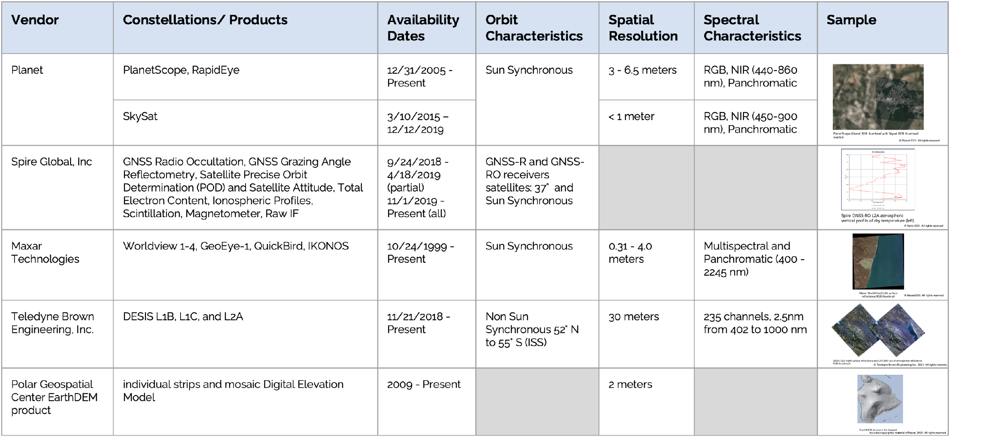
CSDA Data Holdings
https://earthdata.nasa.gov/esds/csdap/commercial-datasets
Notes:
Dataset details, access method, and licenses are found at https://earthdata.nasa.gov/esds/csdap/commercial-datasets

Slide 7
FY22 Activities & Beyond: On-ramp and Evaluation
Onramp #2: Onramp of qualified vendors from second Request for Information (RFI) (October 2019):
Airbus DS GEO (US) Inc BPA awarded July 2021
Selected PIs started the 1-year evaluation of the SAR data products: TeraSAR-X/TanDEM-X/Paz in January 2022.
Mid-Term Evaluation Review – July 12, 19, 2022; 13 PIs presented mid-term results of their evaluations.
AIRBUS data downloads going well.
Initial data analysis indicates high geolocation accuracy at high resolution.
Final Report – Due December 2022
Published Report via website - ~April 2023

Slide 8
FY22 Activities & Beyond: On-ramp and Evaluation (cont’d)
Onramp #2: Onramp of qualified vendors from second Request for Information (RFI) (October 2019):
BlackSky Geospatial Solutions, Inc BPA awarded Sept. 2021;
Selected PIs started the 1-year evaluation of optical data products June 2022.
Held PI and vendor kick-off meetings early June.; hold monthly tag ups
BlackSky conducted an interactive demo and discussion on the ordering/status Portal with PIs.
PIs submitted initial tasking plans and have downloaded 739 products as of 6/16.
Initial reports/project quad charts – Due ~end of July
Mid-term Review - January 2023
Final Report – Due ~June 2023
Published Report via website - ~October 2023

Slide 9
FY22 Activities & Beyond: On-ramp and Evaluation (cont’d)
Onramp #3: Onramp of qualified vendors from third RFI (December 2020) is underway. Sole source synopsis posted for Capella Space, ICEYE US, Inc, GeoOptics, Inc, and GHGSat, Inc. in November 2021.
Selection of PIs for evaluation via ROSES 2022 (A. 43); Proposals received: July 21; Review panels being assembled
GHGSat, Inc. BPA awarded September 27, 2022, to provide methane data products to be evaluated under the CSDA program.
2nd Commercial SmallSat Data Analysis solicitation will be released (ROSES 2022 A.44) to promote scientific use of purchased data by the scientific and applied science communities.

Slide 10
Future On-ramp Plans
Contract Vehicle Change
Moving from BPAs to Multiple-Award Indefinite-Delivery, Indefinite-Quantity (IDIQ) contract with Firm-Fixed-Price (FFP) task orders, ~mid-FY2023:
On-ramp new vendors for evaluation of new commercial Earth observing data products
Sustained use and dissemination of previously CSDA evaluated data products
NASA will continue to require End User License Agreements (EULAs) to enable broad levels of dissemination and shareability of the commercial data with the US government agencies and partners.
Draft Request for Proposal (RFP) posted Sept 26, 2022.

Slide 11
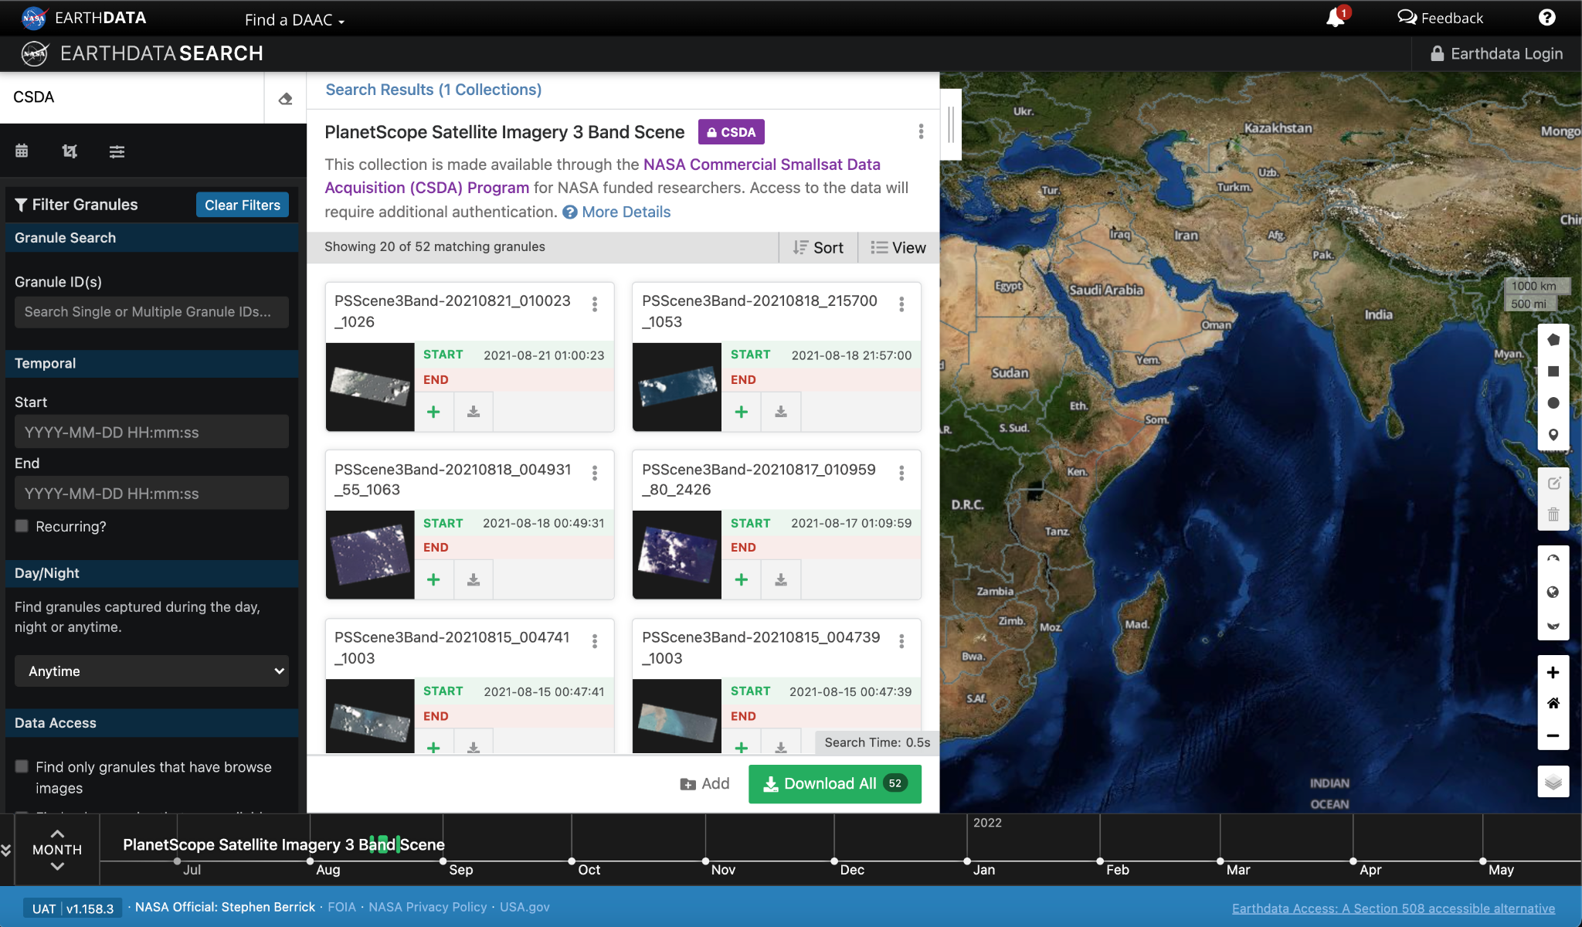
Data Search via EOSDIS
Coming Soon
Coming soon: Data discoverable and downloadable through NASA’s CMR, Earthdata Search Client

Slide 12
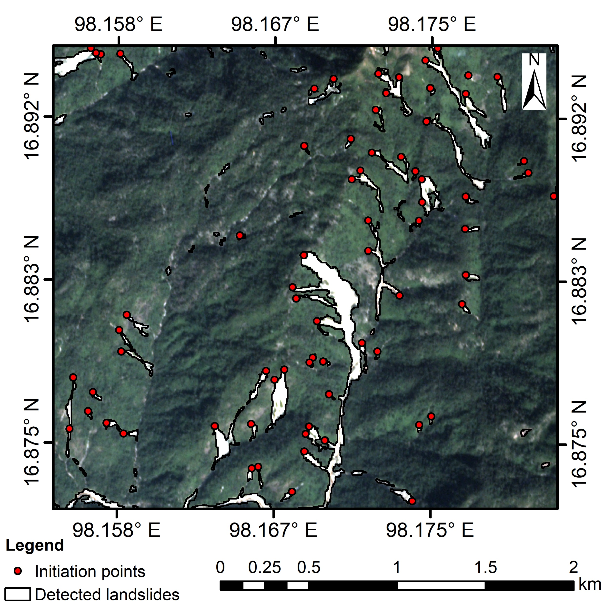
Landslide Detection using Commercially-Purchased Imagery
CSDA Science Results
NASA acquires satellite data from commercial vendors through its Commercial Smallsat Data Acquisition (CSDA) Program for scientific use
A recent study has utilized the Planet constellation to detect and map landslides in the Lower Mekong region
The white regions (right) show where landslides were detected by high-resolution optical imagery acquired from Planet
The landslide initiation points (red dots) can be determined by cross-referencing the detected landslides with a digital elevation model
These results leverage the high spatial resolution and temporal revisit available from the Planet imagery in conjunction the high-fidelity NASADEM data
Imagery (background), detected landslides (white), and landside initiation points (red dots) over Hpa-An, Kayin state, Myanmar on 5 Dec 2018
© Planet Labs, Inc. (2018). All rights reserved.
Amatya et al. (2022)

Slide 13
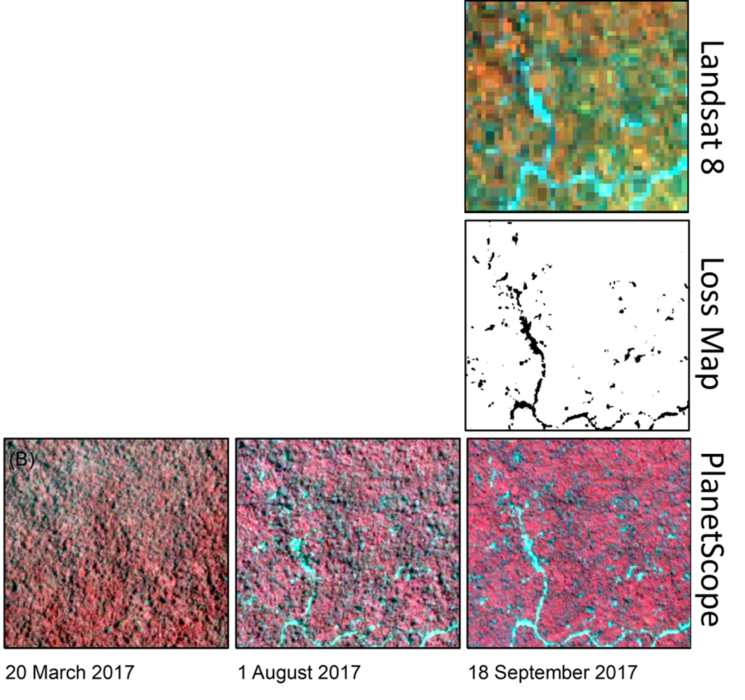
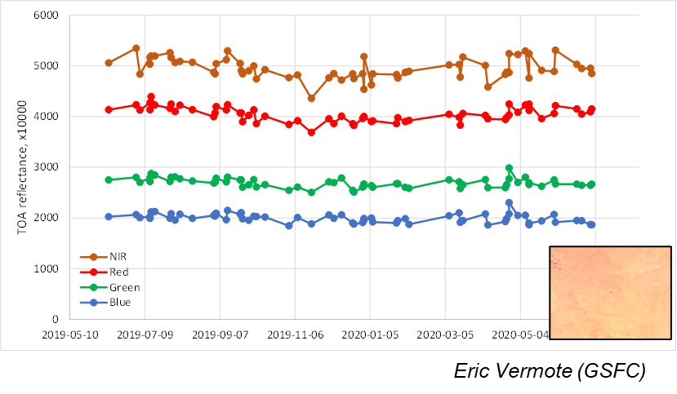
CSDA Science Results (cont’d)
PlanetScope constellation can add spatial and temporal detail to mapping tree cover loss
A selective logging harvest location in Peru (right) illustrates both:
The fine-scale logging features detectable by PlanetScope (bottom-right, cyan) relative to Landsat (top-right)
The temporal evolution of the logging (bottom row)
Ongoing monitoring of Planet data further characterizing the stability among the multiple instruments
Plot shows variability of four standard Planet Dove bands over well-characterized BELMANIP Site #236 (inset)
Pickering et al. (2021) doi:10.3390/rs13112191
Pickering et al. (2021) doi:10.3390/rs13112191
© Planet Labs, Inc. (2017). All rights reserved.

Slide 14
Summary
Commercial Smallsat Data Acquisition Program is a sustained program.
All data purchased by NASA as well as DESIS are available to funded researchers in accordance with the vendor’s scientific use license.
Onramp procurements for the new vendors are underway.
CSDA data holdings will be coming available via Earthdata Cloud Search CY2022.
Accessing and Requesting Commercial Smallsat Data FAQ:
https://earthdata.nasa.gov/esds/small-satellite-data-buy-program/faq-commercial-data
Notes:
Earthdata search – dataset will be phased in – starting with Planet.

Slide 15
Contact Us
Program related questions:
Alfreda Hall @ alfreda.a.hall@nasa.gov
Data Management:
Manil Maskey @ manil.maskey@nasa.gov
Science related questions:
Frederick Policelli @ frederick.s.policelli@nasa.gov
Will McCarty @ will.mccarty@nasa.gov
https://earthdata.nasa.gov/esds/csdap

Slide 17
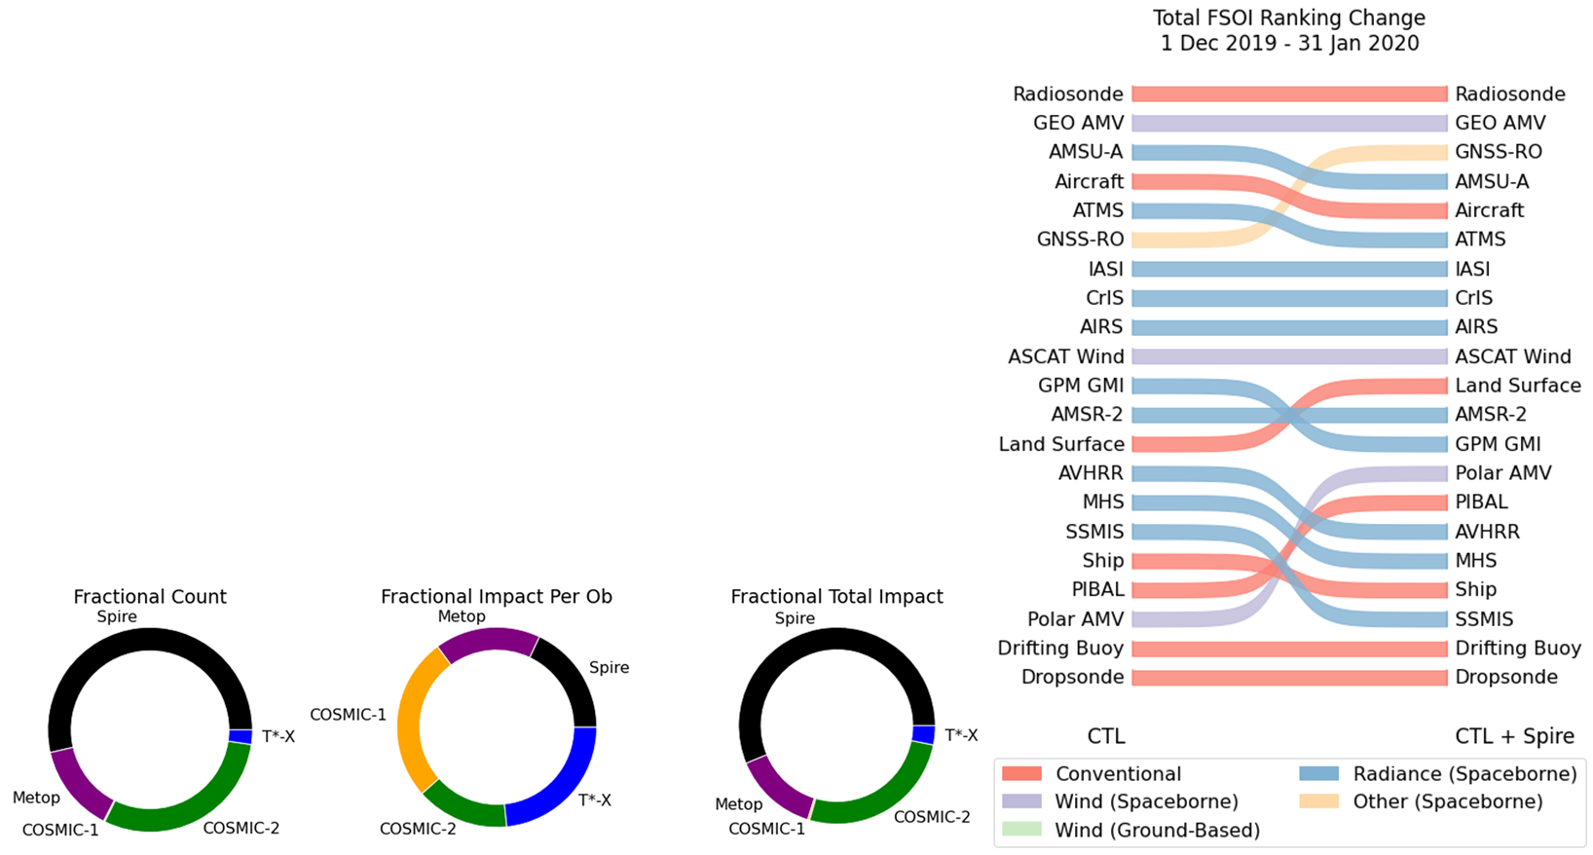
CSDA Science Results (cont’d)
Forecast Impacts of Spire Radio Occultation Observations
Spire data were seen to cause a substantial improvement on forecasts at NASA GMAO
Addition of Spire data improved radio occultation observations to be the 3rd largest reducer of 24-hour forecast error (right)
Spire observations seem to have comparable per-observation impact to other RO observing systems (below)
Pickering et al. (2021) doi:10.3390/rs13112191
© Spire Global Subsidiary, Inc. (2019). All rights reserved.

