Slide 1
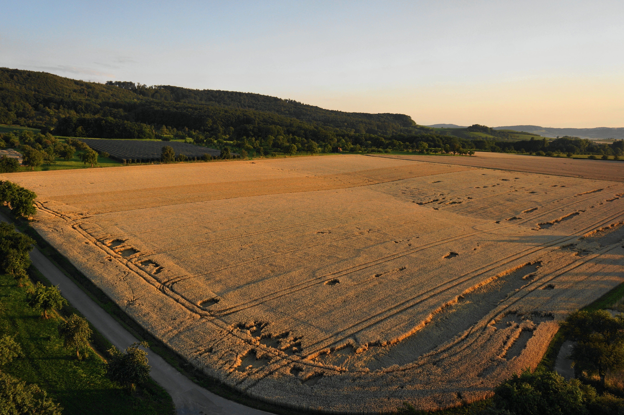
GEOGLAM
Chris Justice
LCLUC 25th Science Team Meeting 2022

Slide 2
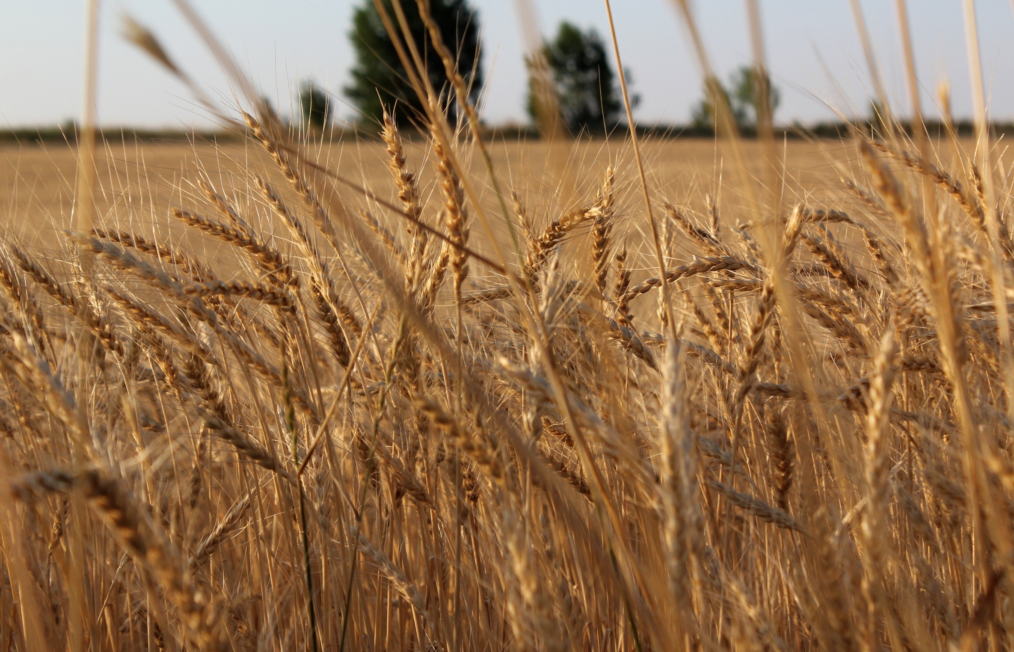
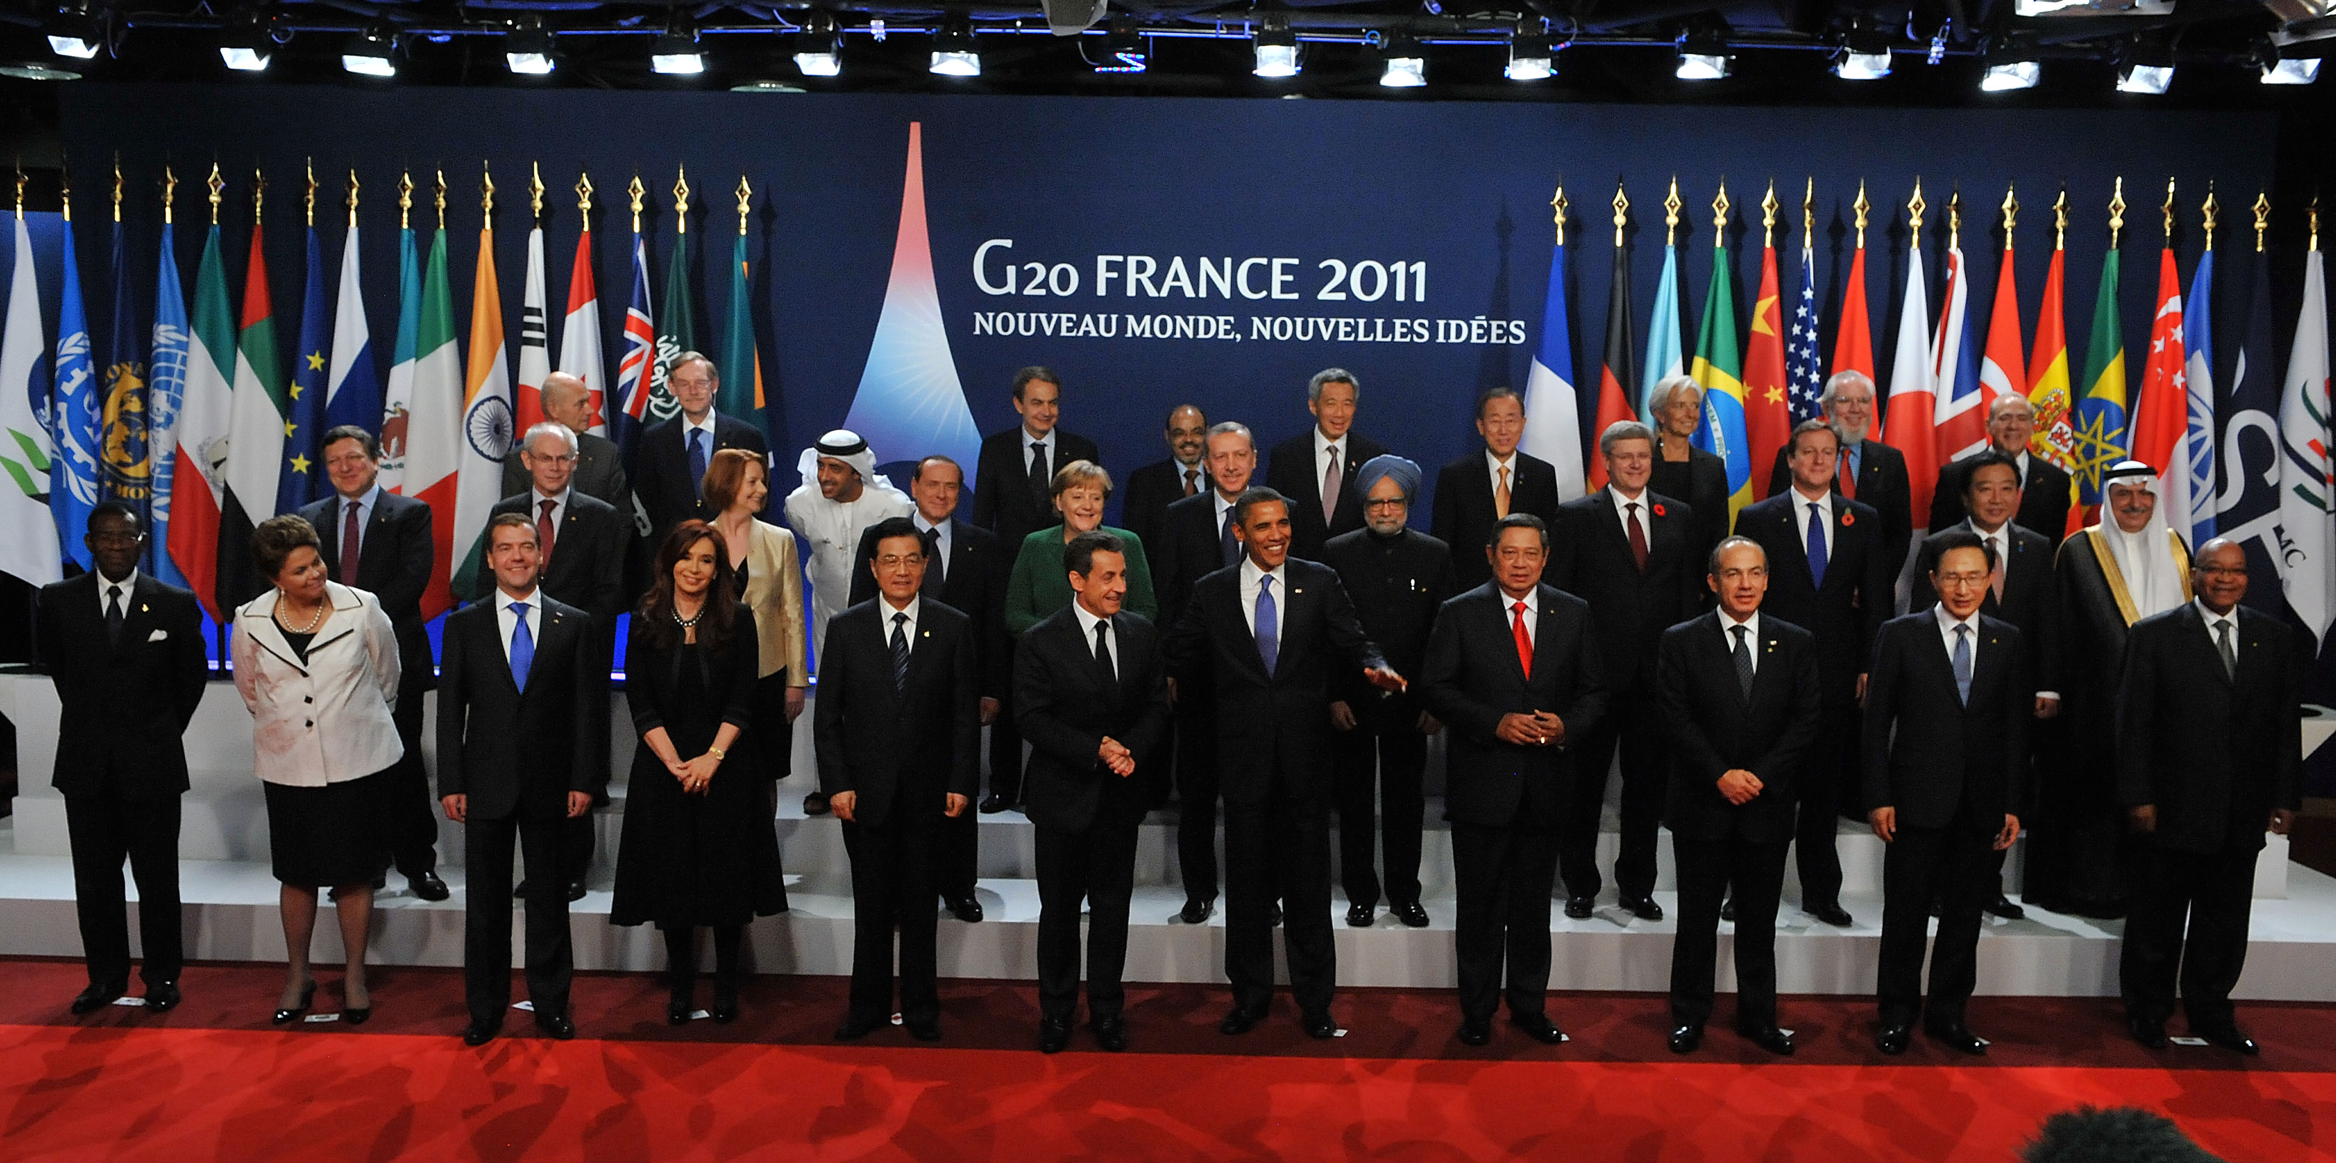
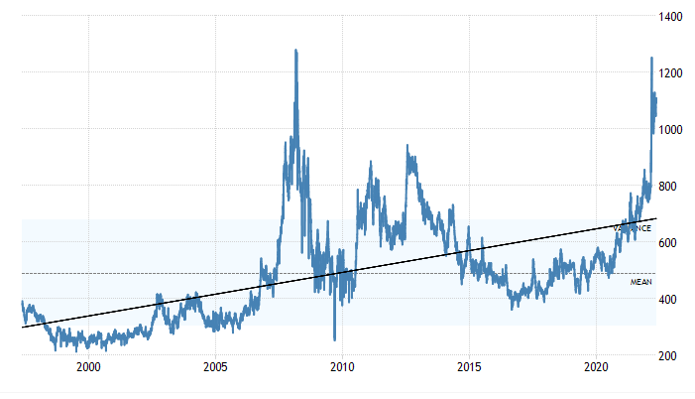
GEOGLAM Launched by the G20 Agriculture Ministers
Context For GEOGLAM
Monthly Wheat Prices 1997-2022($/Metric Ton) Source: World Bank
2008 Price hikes
Droughts:
Australia & Ukraine
COVID 19, Ukraine War, Persistent Drought
2010/11 Price hikes
Drought Russia USA
G20
GEOGLAM Start
2

Slide 3
GEOGLAM: a GEO Flagship
Vision: the use of coordinated, comprehensive and sustained Earth Observations to inform decisions and actions in agriculture… through a system of agricultural monitoring systems
Aim: strengthen the international community’s capacity to utilize Earth Observations to produce and disseminate relevant information on agricultural production at national, regional and global scales
Approach: Identifying information gaps, building on existing monitoring systems – strengthening international and national capacity -
Emphasis on: producer countries (G20+), countries-at-risk and national capacity building
Fostering international cooperation and collaboration

Slide 4
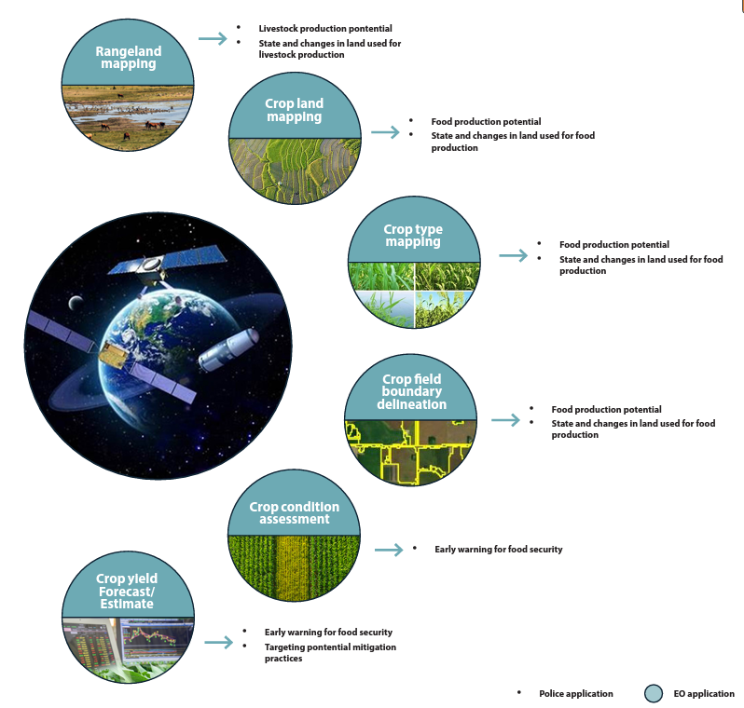
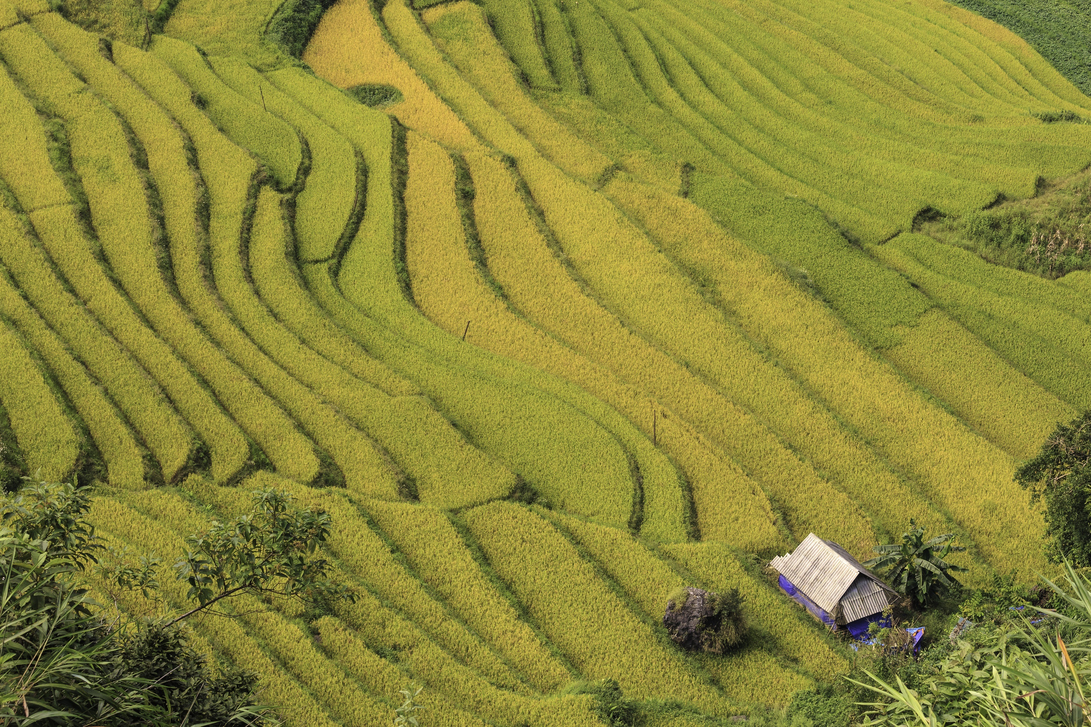
Monitoring and Measuring Agriculture Land Use & Trends Using
Earth Observations
Better information means better decisions across the value chain
Improving information from the international to national and farm levels
Driven by Open Science and Open Data
Observation Focus
Notes:
We have this with a graphic designer, will get you a copy of the results, hopefully it will be more legible in presentation format

Slide 5
Current GEOGLAM
Thematic
Structure
I
Open Source
Analytical Tools
R&D
Operations
Ongoing Operations –
Continue and Enhance:
- AMIS Crop Monitor
- CM4 Early Warning
- Geoglam Knowledge Hub
- JECAM
Essential
Agriculture
Variables
In Situ
Data
Coordination
Information
Products
Needs
Capacity (co) Development Guidance
(National and International)
Adaptation
National Adaptation Plans (NAP)
UNFCCC Supplemental
NAP Guidance
Mitigation
AFOLU Roadmap
Global Stocktake (GST)
Nationally Determined Contributions (NDCs)
Climate
Early Warning & Food Security
Crop monitor for early warning
Seasonal Forecasts
Special Reports
Market Information
Agricultural Markets Information System (AMIS)
Commodity Crop Conditions
Seasonal Forecasts
Food
Security

Slide 6
…. with Expanding Policy Relevance
Supporting policy priorities:
Climate Change Adaptation and Mitigation
Sustainable Development Goals
Disaster Risk Reduction/Early Warning

Slide 7
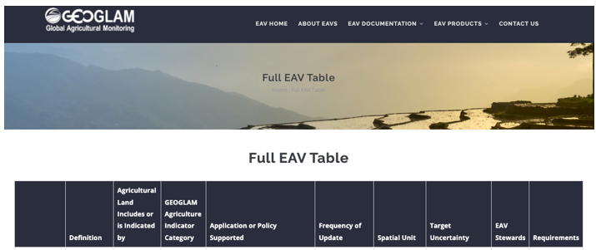
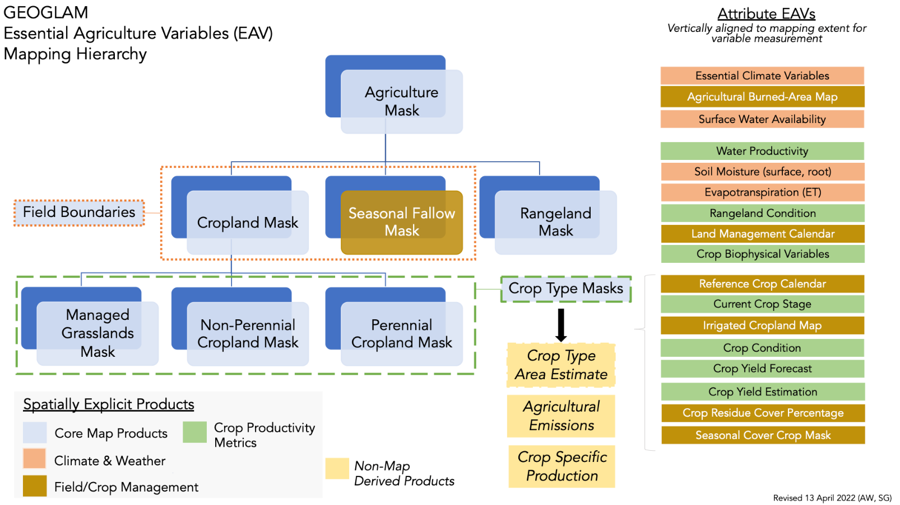
Responding to the Challenge:
New EAV Website
AgVariables.org
Essential Agricultural Variables
Defining and Developing EAV’s
EO data needs
In-situ data requirements
Research gaps
Operational requirements

Slide 8
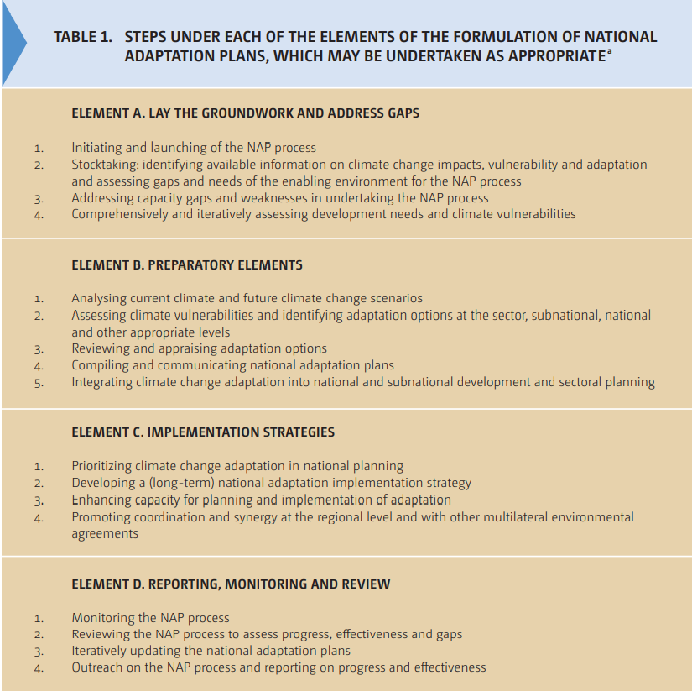
Climate Action:
National Adaptation Plans (NAPs)
Earth Observations for Agriculture & Food Security
Overview
Essential EO Variables for Climate Action
Institutional & Technical requirements
Essential Agriculture Variables (EAVs)
National Crop monitoring systems
Capacity co-development
Technical Capacity
Institutional Capacity
Data, tools and analytics

Slide 9
GEOGLAM: the way forward
Factors influencing international food insecurity can be expected to increase
Climate extremes
Pest and disease
Conflict
Nationally focused policy responses - to the above
Earth Observation will play an ever increasing role to help inform policies and programs with an increasing number of space assets
Exploring how to establish partnerships with commercial data providers
Key actions to rise to the challenge
Greater international cooperation and collaboration – funding mechanisms needed to enable that
Need to continue the evolution towards open data – Transparency, Innovation, Efficiency
Need for sustained operational solutions ensuring long term continuity
Scale up co-development efforts to less developed nations – Public Private Partnerships

