Slide 1
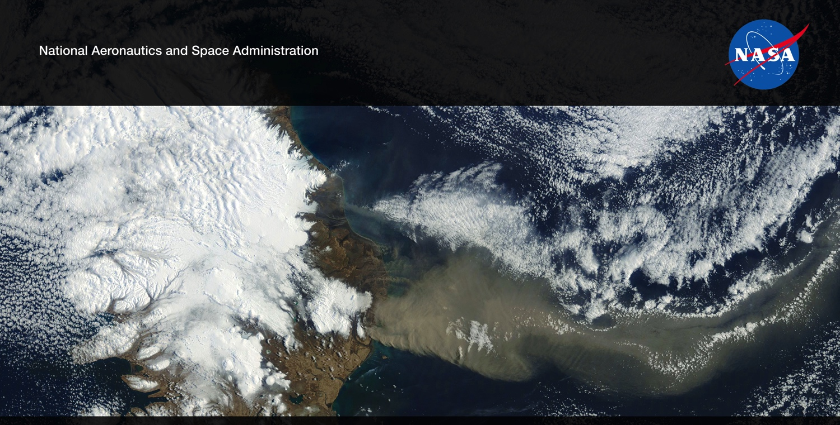
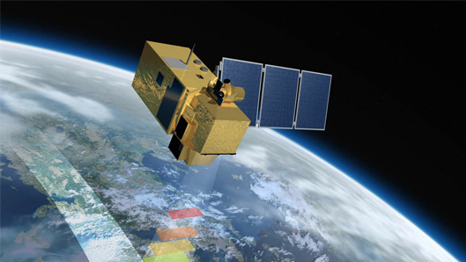
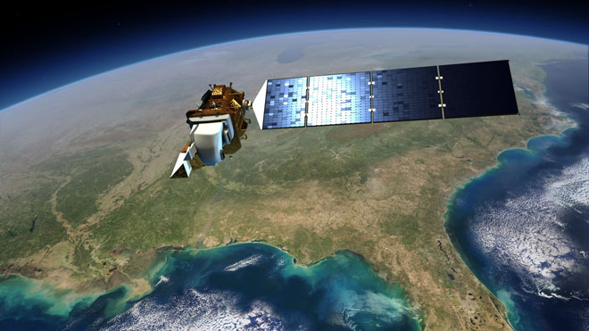
Future US Land Imaging
Jeffrey Masek, NASA GSFC
Multisource Land Imaging (MuSLI) and
Harmonized Landsat-Sentinel (HLS) dataset
Garik Gutman, NASA GSFC
NASA Agency Update – CEOS LSI-VC-2
July 20-22, 2016
Dave Jarrett, NASA HQ
Jeff Masek, NASA GSFC

Slide 2


NASA MuSLI Program
LCLUC community needs dense time series observations for more frequent cloud-free observations and for studying rapid land-cover and land-use changes (phenological, agricultural, hydrologic, etc.)
NASA Multi-Source Land Imaging (MuSLI) Team designed to advance the use of multi-source remote sensing data for land monitoring
  First solicitation in 2014 through NASA LCLUC Program
  Re-competed in 2017, 2020
  Will be solicited in 2023
MuSLI Objectives:
  Develop algorithms and prototype products that make use of multiple satellite sources, including international and commercial data
  Understand challenges associated with algorithms & processing streams that incorporate multiple satellite systems
  Develop stronger community of practice among US and international (especially EU) researchers
Jeff Masek, NASA GSFC
MuSLI Project Scientist
Landsat-9 Project Scientist
RETIRED!

Slide 3
MuSLI Evolution
Phase 1: 2015-17
  Emphasis on combining Copernicus Sentinel-1 and -2 and Landsat data to prototype new land & coastal science products
Phase 2: 2018-20
  Continued emphasis on fusion of Copernicus and Landsat: prototype projects (Type 2) and continental-scale dataset production (Type1)
Phase 3: 2021-23
  Combining moderate-resolution data with very high resolution (VHR) imagery to support LCLUC science (“Hotspots” of LU change)
Phase 4: 2023-25
  Combining optical and microwave medium spatial resolution and VHR data with infrared observations

Slide 4
2015-17 NASA MuSLI Teams
International Collaborators
Project Title
PI
Multisource Imaging of Seasonal Dynamics in Land Surface Phenology | Friedl/BU | Eklundh / Lund
Integrating Landsat 7, 8 and Sentinel 2 Data in Improving Crop Type Identification and Area Estimation | Hansen/UMD | Defourny / Louvain
Towards Near Daily Monitoring of Inundated Areas Over North America Through Multi-Source Fusion of Optical and Radar Data | Lang / UMD | Creed / Western
Prototyping a Landsat-8/Sentinel-2 Global Burned Area Product | Roy / SDSU | Chuvieco / Alcala; Tansey / Leicester
Operational Algorithms and Products for Near Real Time Maps of Rice Extent and Rice Crop Growth Stage Using Multi-Source Remote Sensing | Salas / Applied Geosystems | Hoekman / Wageningen; Le Toan / CESBIO
Multi-Source Imaging of Infrastructure and Urban Growth Using Landsat, Sentinel and SRTM | Small / Columbia U | Esch / DLR
Multi-Source Imaging of Time-Serial Tree and Water Cover at Continental to Global Scales | Townshend / UMD | Schmullius /Jena

Slide 5
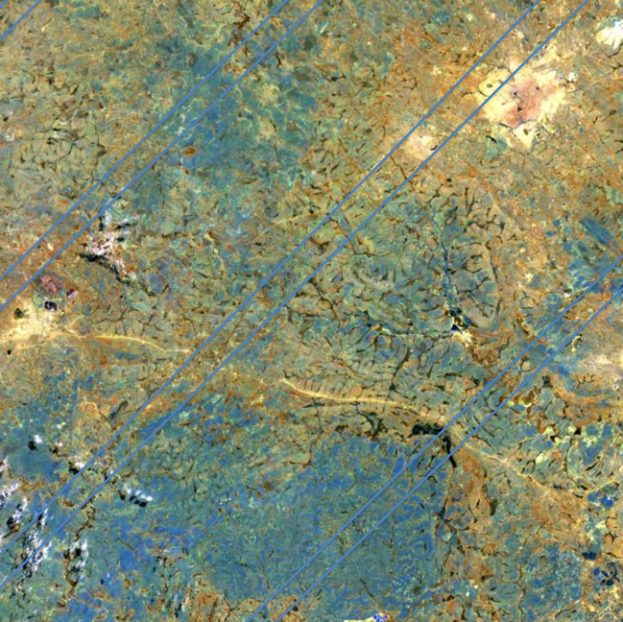
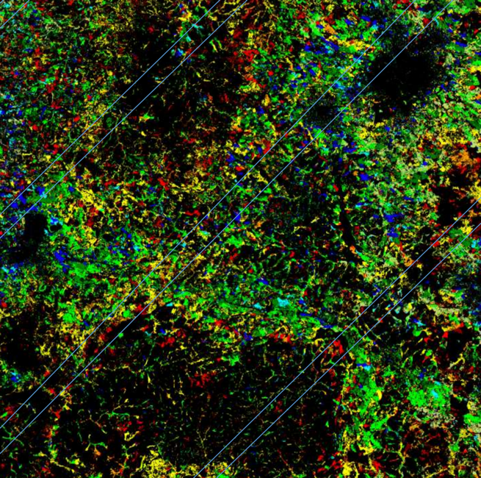
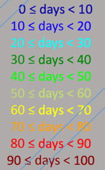
Roy/SDSU – Africa Annual Burned Area
Uses Landsat and S2 time series to map:
- timing of fires (day of year)
- (fraction burned) x (combustion completeness)
Zambia, Copperbelt Province
Day of Burning 2016 (minus 167)

Slide 6

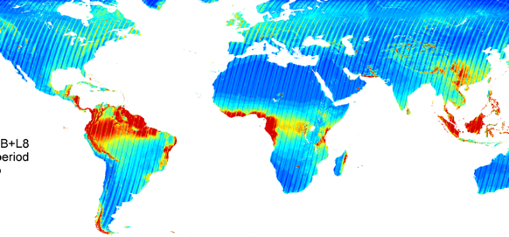
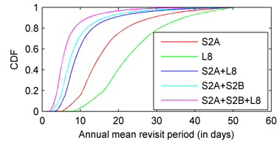

Harmonized Landsat-Sentinel (HLS) Project
Merging Sentinel-2 and Landsat data streams can provide 2-3 day global coverage
Goal is “seamless” near-daily 30m surface reflectance record including atmospheric corrections, spectral and BRDF adjustments, regridding
Project is a collaboration among NASA GSFC, UMD, NASA Ames, MSFC/UAH, and LP-DAAC
Prototype for a multi-sensor Analysis Ready Data product
Potential Revisit using
different Virtual Constellations
S2A+S2B+L8 Mean Revisit period (in days)
Cloud free
Claverie, M., Ju, J., Masek, J. G., Dungan, J. L., Vermote, E. F., Roger, J.-C., Skakun, S. V., & Justice, C. (2018). The Harmonized Landsat and Sentinel-2 surface reflectance data set. Remote Sensing of Environment, 219, 145-161.

Slide 7
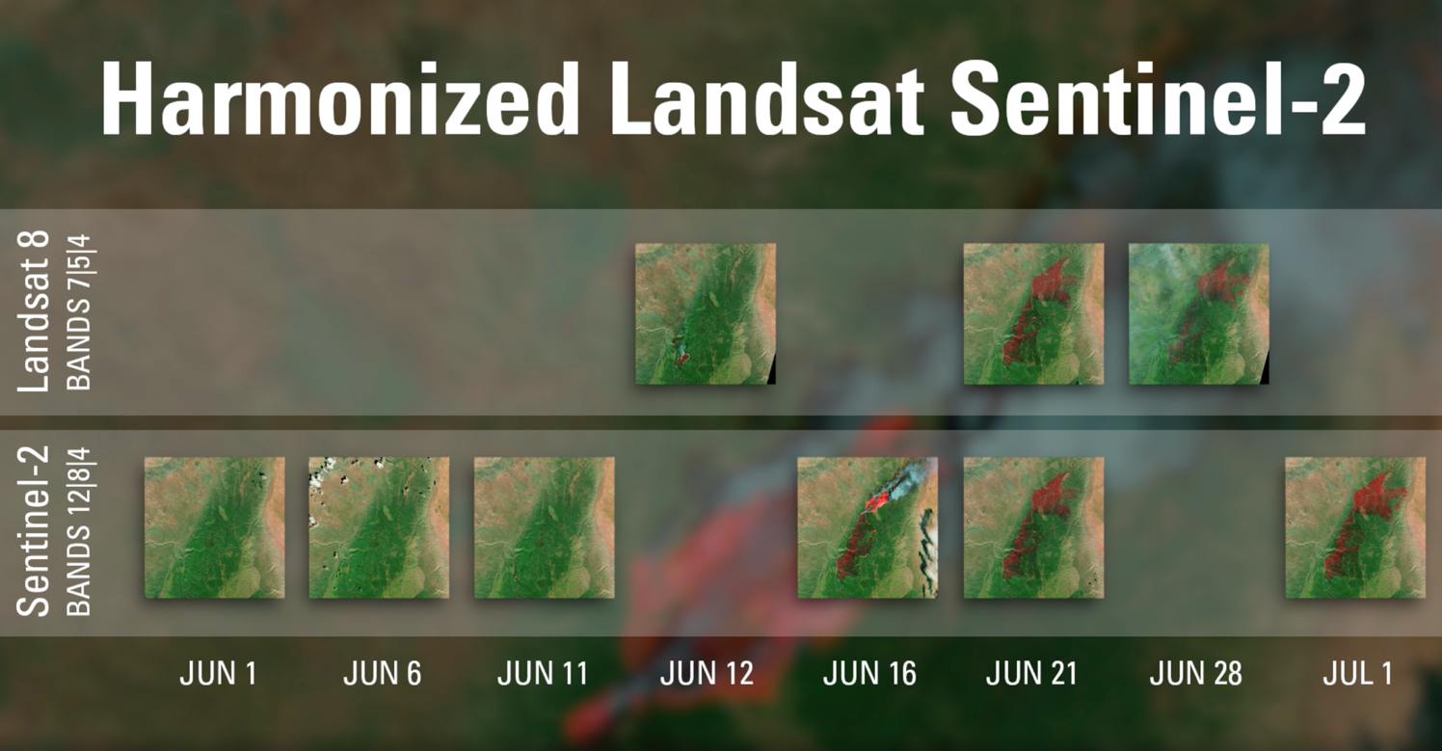
The Human Landing System (HLS) is the final mode of transportation that will take astronauts to the lunar surface in the Artemis lunar exploration program.

Slide 8
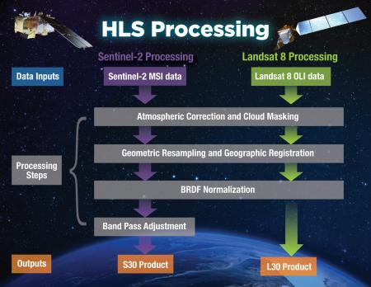
HLS Version 1.5 (Global HLS)
Global processing via NASA MSFC Interagency Implementation and Advanced Concepts Team (IMPACT) cloud computing project
  Forward processing started October 2020
  Back-processing to the beginning of the Landsat 8 and Sentinel-2 data records (2013 and 2015 soon, respectively); Plans to complete in 2023
  ESDIS compliant metadata, user guide, & ATBD
  Cloud Optimized Geotiff (COG) distribution format
  Earth Data interface for search/order
  GIBS interface for browse
  Unique aspect of HLS: processed, archived, and distributed on Amazon Web Services (AWS) commercial cloud
  Reducing from 2-week processing to 2 days
LP DAAC landing page: https://lpdaac.usgs.gov/products/hlss30v015/
EDSC: https://search.earthdata.nasa.gov/search?q=HLS
Processing workflow including atmospheric correction of the data, geographic registration, and adjustment for bidirectional reflectance differences. Image credit: NASA Earthdata; HLS Science Team.

Slide 9
2018-2020 MuSLI Projects
Mark Friedl (Boston U) | An Operational Multisource Land Surface Phenology Product from Landsat and Sentinel 2
David Roy (South Dakota State U.) | Africa Burned Area Product Generation, Quality Assessment and Validation - Demonstrating a Multi-Source Land Imaging (MuSLI) Landsat-8 Sentinel-2 Capability
Crystal Schaaf (U. Mass - Boston) | Circumpolar Albedo of Northern Lands from Landsat-8 and Sentinel-2
Martha Anderson (USDA) | Characterizing Field-Scale Water Use, Phenology and Productivity in Agricultural Landscapes Using Multi-Sensor Data Fusion
Petya Campbell (U. Maryland - Baltimore County) | Prototyping MuSLI canopy Chlorophyll Content for Assessment of Vegetation Function and Productivity
Glynn Hulley (JPL) | A High Spatio-Temporal Resolution Land Surface Temperature (LST) Product for Urban Environments
Volker Radeloff (U. Wisconsin) | Monitoring Abandoned Agriculture, Fallow Fields, and Grasslands with Landsat and Sentinel-2
Sergii Skakun (U. Maryland - College Park) | Crop Yield Assessment and Mapping by a Combined use of Landsat-8, Sentinel-2 and Sentinel-1 Images
Type 1: Continental-scale products
Type 2: Regional-scale prototypes
9

Slide 10
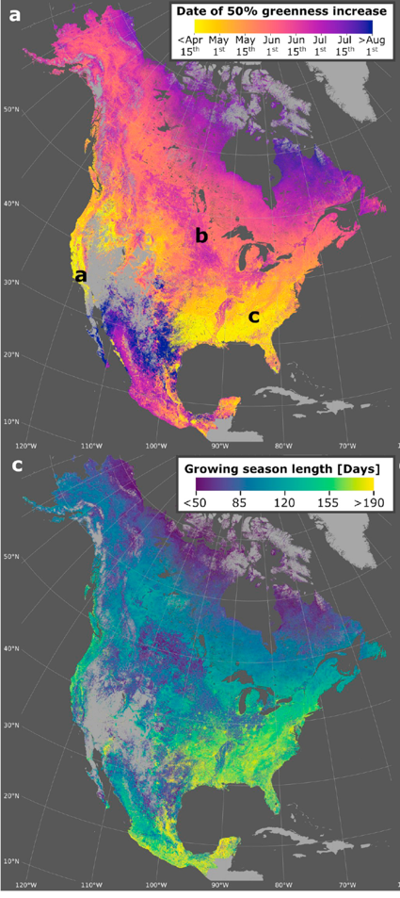
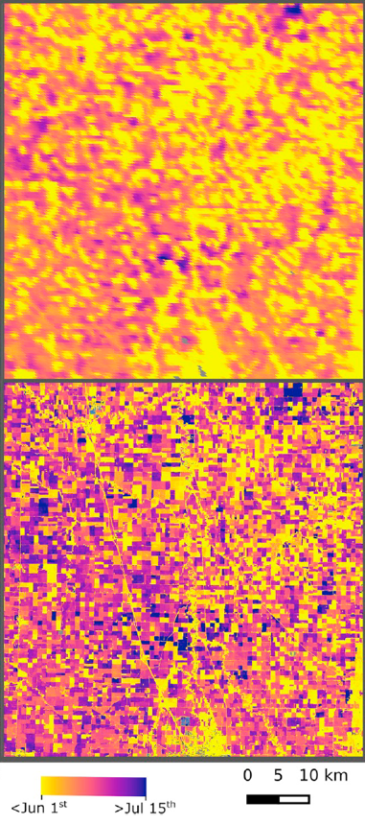
North American Phenology (Friedl, BU)
MODIS
Bolten et al., Continental-scale land surface phenology from harmonized Landsat 8 and Sentinel-2 imagery, RSE, 2020
HLS
(Landsat + S2)

Slide 11
2021-2023 MuSLI Projects
See posters
Sean Healey(USFS) | Sensor fusion using daily Planet imagery allows rapid deforestation monitoring in Madagascar
Volker Radeloff (U. Wisconsin) | Global Hotspots of the Wildland-Urban Interface
David Skole (Michigan State U.) | Hot spot detection for monitoring new trends in carbon sequestration in systems of Trees Outside of Forests (TOF)
David Lutz (Dartmouth College) | Rapid Change from Alluvial Mining and Development in Madre de Dios, Peru: A Multi-Sensor Fusion Approach to Quantify Terrestrial and Aquatic Impacts and Test Policy Effectiveness
Alexandra Tyukavina (U. MD) | Multi-Resolution Quantification and Driver Assessment of Hot Spots of Global Forest Disturbance
Chris Neigh (NASA GSFC) | The Impact of Investment on Irrigated Rice, Dryland Agriculture and Afforestation in Senegal using SAR and Optical Time-Series Imagery in Data Fusion Approaches
Michael Keller (USFS) | Quantifying agricultural expansion and tropical forest degradation in the Brazilian Arc of Deforestation: A multi-sensor, multi-scale approach

Slide 12
2021-2023 MuSLI Projects (cont.)
See posters
Jody Vogeler (Colorado State) | The last urban frontier: Assessing drivers of urbanization and tradeoffs among social and ecosystem services associated with LCLUC in Africa
David Roy (Michigan State U.) | Where are the missing burned areas? Global hotspots of burned area - a multiresolution analysis
Marc Simard (JPL) | Global Hotspots of Change in Mangrove Forests
Yufang Jin (U. California, Davis) | Multi-source Wildland Urban Interface Characterization Enhanced with Machine Learning: Dynamics and Hazard Assessment
Sergii Skakun (U. MD) | High-Impact Hot Spots of Land Cover Land Use Change: Ukraine and Neighboring Countries
Nick Magliocca (U. Alabama) | Making the Hidden Visible: Accelerated Land-Use Change and Degradation Caused by Narco-Trafficking In and Around Central America’s Protected Areas

Slide 13
MuSLI Accomplishments
Projects successfully developed new and improved land products via multi-source data
US researchers gained knowledge and experience with Copernicus sensors and data sets
MuSLI team was able to provide feedback to ESA on data quality and usability issues
  Geolocation errors
  Product format (filenames, granule organization, etc)
  Importance of reprocessing & collections
Improved collaboration with international researchers
  International Co-I’s on MuSLI Projects
  ESA Living Planet Special Sessions 2016, 2019, 2022

Slide 14
HLS Features
Harmonized surface reflectance seamless dataset
  Like it is coming from a single platform
  Temporal resolution better than Landsat alone
  Improves studies of fast processes
  Spatial resolution much better than MODIS (or VIIRS) images
Full HLS global coverage every 2-3 day on a common 30-m grid
Complementary, co-registered Landsat 8 TIRS and Landsat 9 TIRS-2 temperature data
For land management, ag fields, individual forests, urban areas
Already used in the development of a new vegetation seasonal cycle dataset available through LP DAAC: the Multi-Source Land Imaging (MuSLI) Land Surface Phenology Yearly North America product (under LCLUC Program)
  2

Slide 15
Collaborative Effort
NASA LCLUC Program
  Science support and feedback through Multi-Source Land Imaging (MuSLI) projects
  Testing HLS dataset potential in LCLUC MUSLI research projects
NASA’s GSFC and the University of Maryland
  Software development, debugging, algorithm validation
IMPACT, NASA MSFC
  Ensure compliancy of data formats, metadata, file names
  Code implementation
  Production stream to get data to LP DAAC for distribution
NASA-USGS LP DAAC
  Preparing Landsat data and the atmospheric correction code for HLS
  Archiving and distributing data

Slide 16
Status and Future Plans
Add new satellites into the HLS data production stream
  Landsat 9 [launched in 2021] has been integrated in HLS V2.0 production system producing global products and reducing the repeat frequency to 2.9 days
  Sentinel-2C [to be launched in 2023]
Integrate HLS into their Application for Extracting and Exploring Analysis Ready Samples (AppEEARS) tool
  AppEEARS allows users to work with long time-series, transform data in various ways, and reduce data volumes
  Refactor the AppEEARS code to evolve the tool to run in the AWS commercial cloud
Enhancements will include
  new BRDF correction
  new bandpass adjustment
  topographic correction of reflectance for the mountainous areas
What is planned:
  Feedback to the atmospheric correction code (LaSRC) developers for possible improvement
  Comparison of HLS products and ESA Sen2-like products to better understand the properties of HLS algorithms and improve them

Slide 17
Conclusions
Jeff Masek, NASA GSFC
MuSLI Project Scientist
Landsat-9 Project Scientist
MuSLI provides PI’s the support needed to harness a richer set of Earth Observations to better characterize land and coastal processes
As combined use of Landsat and Copernicus data has become commonplace, MuSLI program has evolved to focus on new ”tall poles” of multi-sensor fusion
Integration of VHR commercial imagery
Application of multi-modal data (SAR, multispectral, hyperspectral, lidar)
Robust & validated application of ML and AI
RETIRED!

