Slide 1
ECOSTRESS Science and Applications
Highlights
Simon J. Hook, Kerry Cawse-Nicholson, and the ECOSTRESS Science and Applications Team
NASA Jet Propulsion Laboratory, California Institute of Technology, USA
© 2022 California Institute of Technology. Government sponsorship acknowledged.

Slide 2
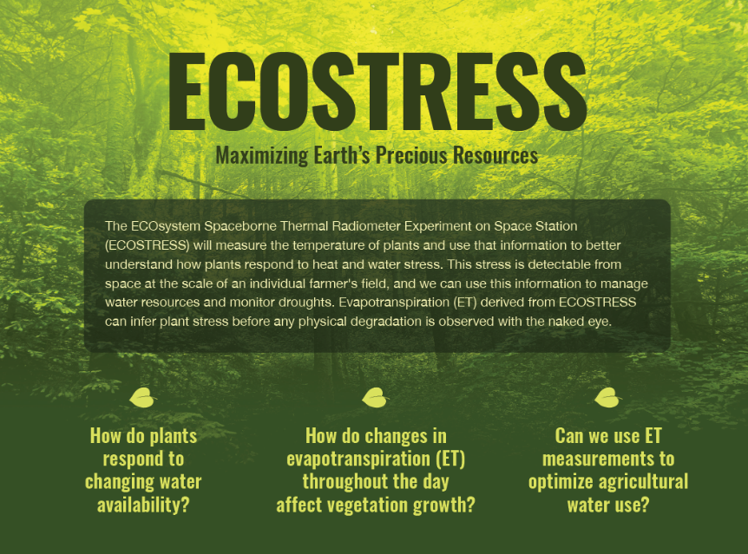
ECOSTRESS measures temperature from the ISS
This can be used to detect and monitor wildfires, volcanic eruptions, urban heat, and even subtle changes in temperature that indicate plant stress
ECOSTRESS is unique because it makes measurements both frequently (sub-daily to sub-weekly) and at high resolution (agricultural field scale or urban block scale; 70 m)
ECOSTRESS helps guide decision making for water resource managers, urban planners, fire resource allocations and others

Slide 3
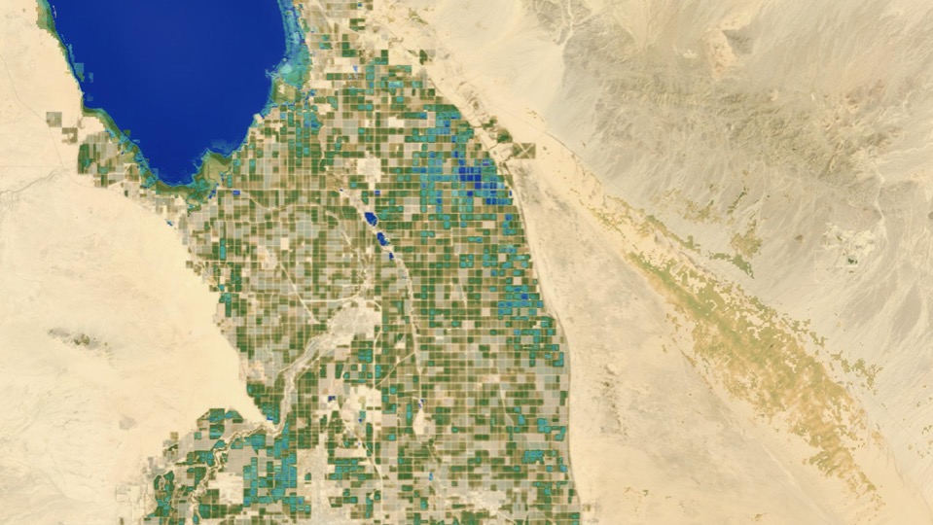
ECOSTRESS measures plant stress in agricultural regions
Fields in blue and green have sufficient water and fields in brown are dormant or have insufficient water
Credit: Gregory Halverson

Slide 4
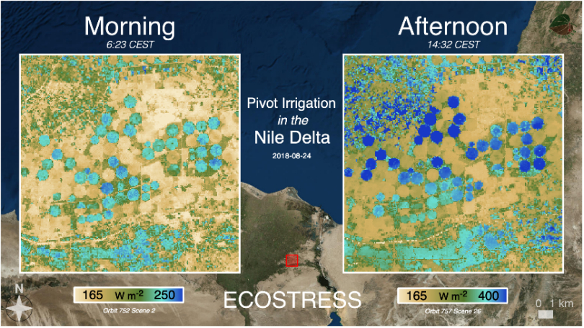
The ISS orbit provides data at different times of day allowing us to look over the diurnal cycle

Slide 5
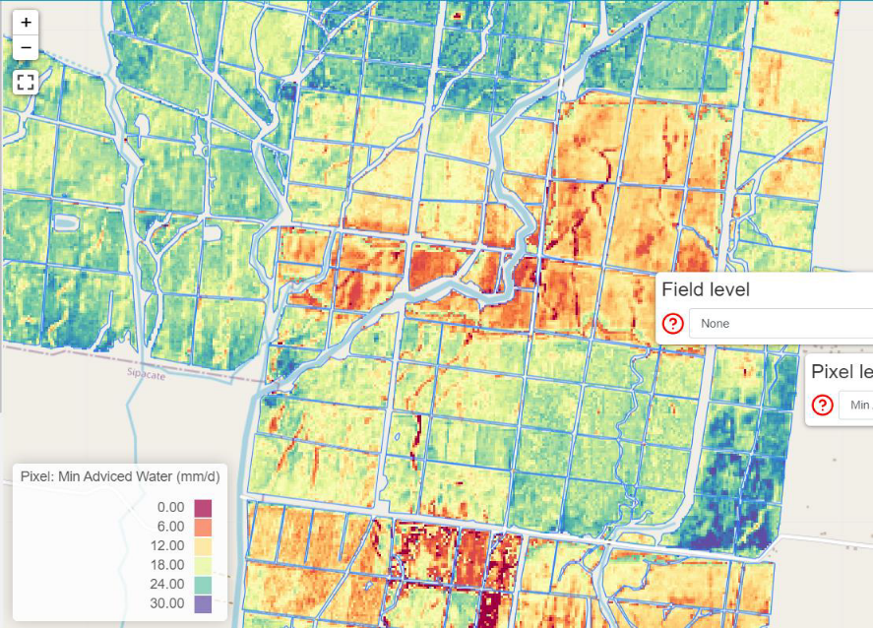
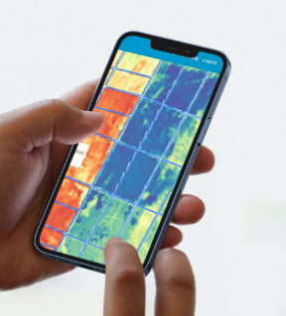
ECOSTRESS Data are already used in commercial applications
“Bringing ECOSTRESS Information to farmers” - IrriWatch CEO Wim Bastiaanssen
IrriWatch integrates ECOSTRESS data into high quality estimates of water use and delivers irrigation advisories to over 18,000 fields in 25 countries around the world.

Slide 6
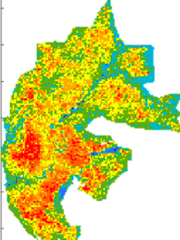
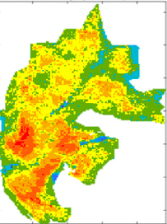
Pre-Fire Season Plant Stress Reveals Patterns of Burn Severity
Plant stress represents fuel load and flammability and is an important predictor of burn severity
Relationship of burn severity and plant stress differs by land cover and topography
Burn severity calculated from Sentinel-2 is highly spatially heterogeneous
70m ECOSTRESS Evapotranspiration
Predicted Burn Severity based on ECOSTRESS ET
Pascolini-Campbell et al., 2022, GEB

Slide 7
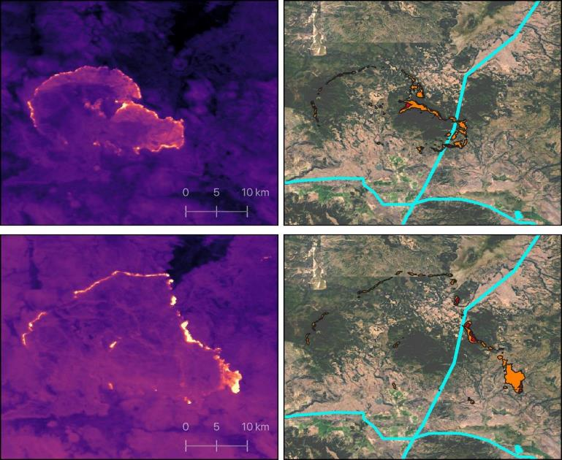
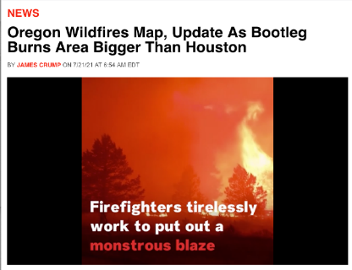
ECOSTRESS used to map
Bootleg Fire
Oregon, July 2021
“ECOSTRESS allows us to use the [fire maps] from last night in the morning…this is what’s required if you’re going to put data into the hands of incident commanders.” -- USGS podcast with PNNL and USFS
ECOSTRESS imagery is integrated into an operational active fire response tool by PNNL to support USFS fire operators and responders.
High-voltage transmission lines
Fire front breaking power lines

Slide 8
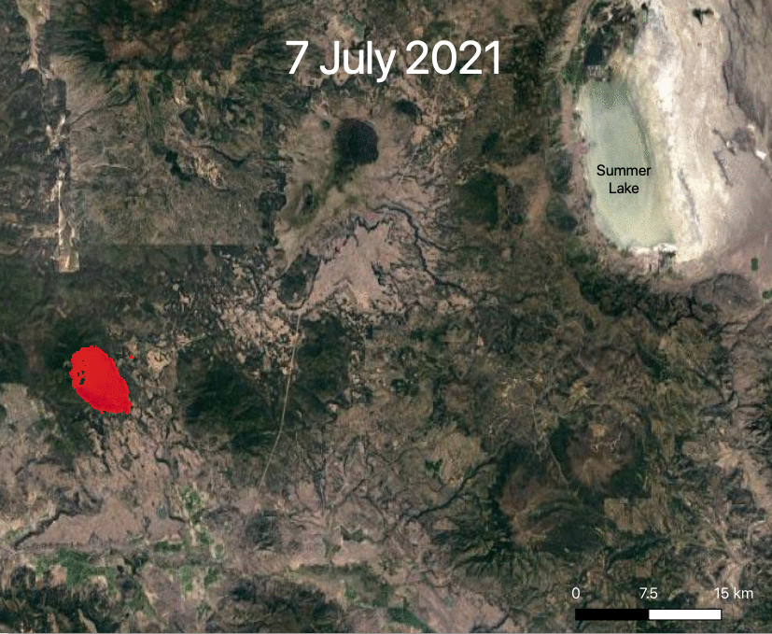
ECOSTRESS is used to monitor fire progression

Slide 9
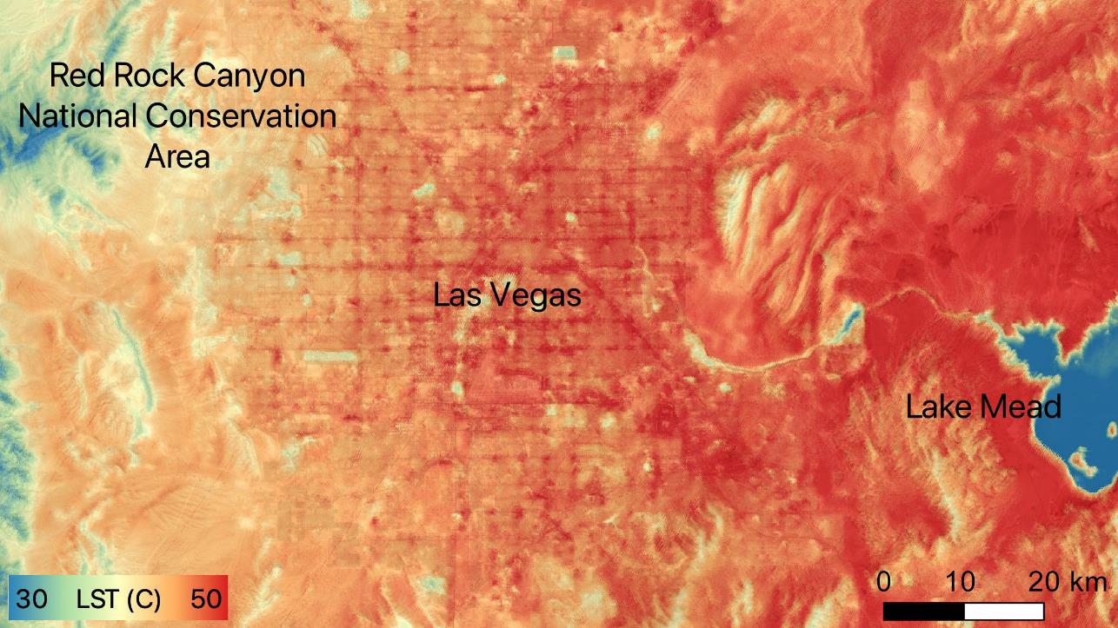
ECOSTRESS measures urban heat
During a Las Vegas heatwave, the hottest surfaces were the streets. Suburban neighborhoods averaged about 14 F (8 C) cooler than pavement, and green spaces such as golf courses were 23 F (13 C) cooler.

Slide 10
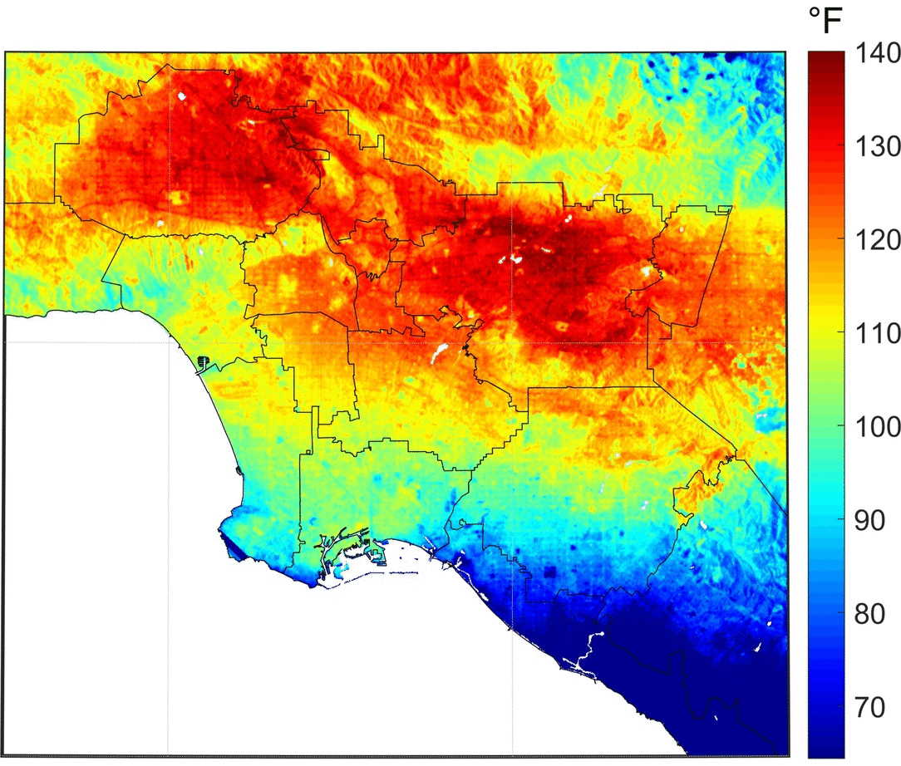
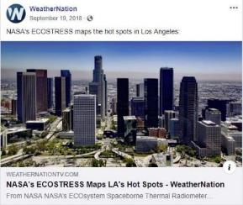
ECOSTRESS Watches Cities “Breathe”
Land Surface Temperature
Diurnal Cycle
03:01 pm July 31 2018
09:26 pm Aug 8 2018
11:43 pm Aug 14 2018
04:07 am Aug 22 2018
Credit: Glynn Hulley

Slide 11
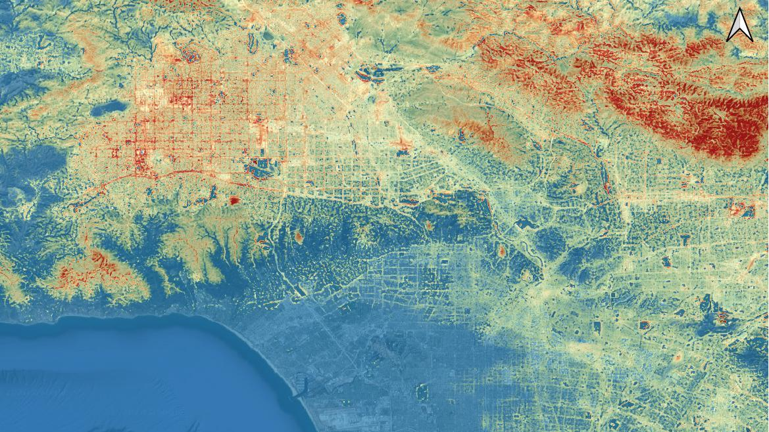
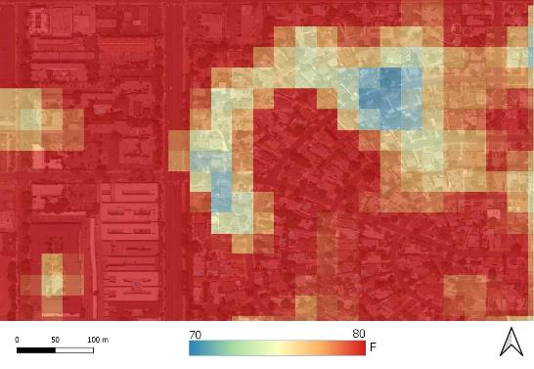
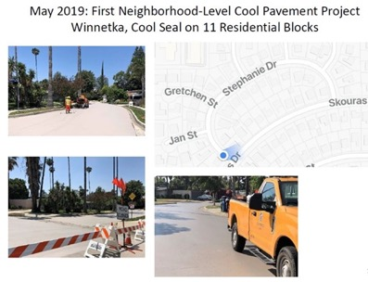
The City of Los Angeles is using ECOSTRESS to identify hotspots and quantify the effects of heat mitigation strategies such as cool roads
Stephanie Dr
City of Los Angeles is testing road surface coatings to minimize urban heat. ECOSTRESS shows cooling effect on local streets.
“I call this the 4 million dollar image” – Greg Spotts, City of Los Angeles
ECOSTRESS imagery used by City of LA to secure funding for urban heat mitigation solutions for heat-vulnerable neighborhoods
11

Slide 12
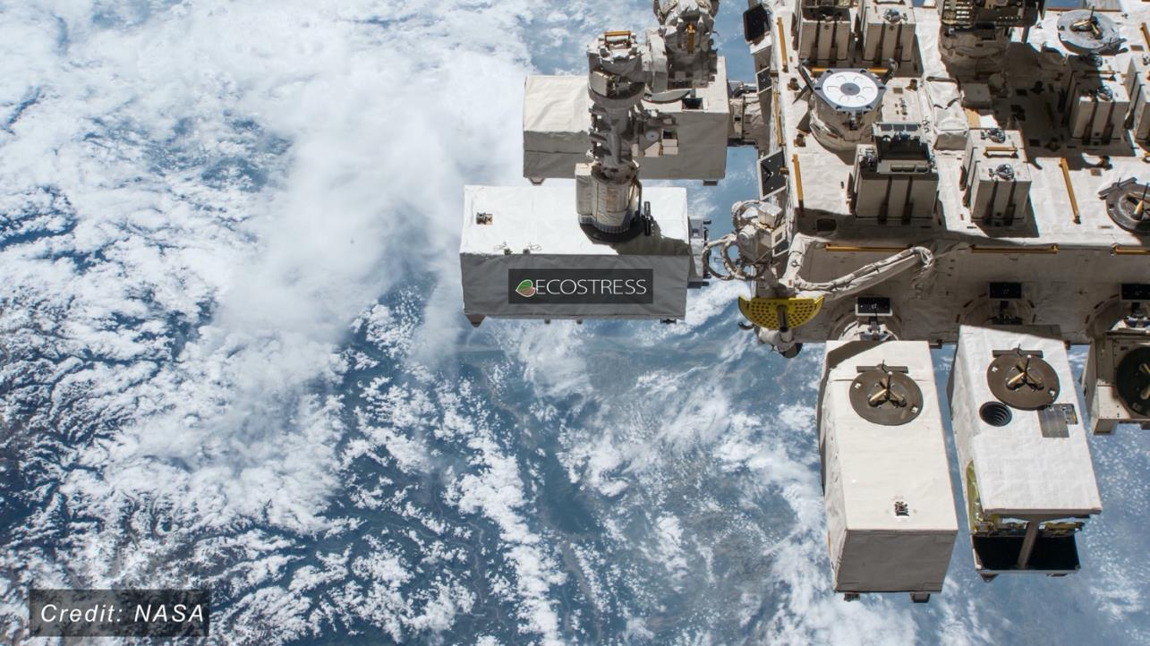
ECOSTRESS Science and Applications Team Meeting
November 15-17
Ventura, CA
© 2022 California Institute of Technology. Government sponsorship acknowledged.

Slide 13
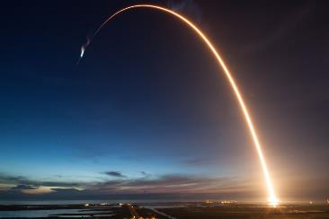
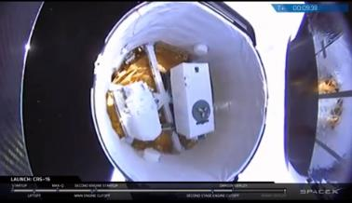
Questions

