Slide 1
Michael Falkowski
David Green, Mike Seablom, Barry Lefer
NASA Headquarters
NASA FireSense Priorities
Notes:
ANIMATED-option 1

Slide 2
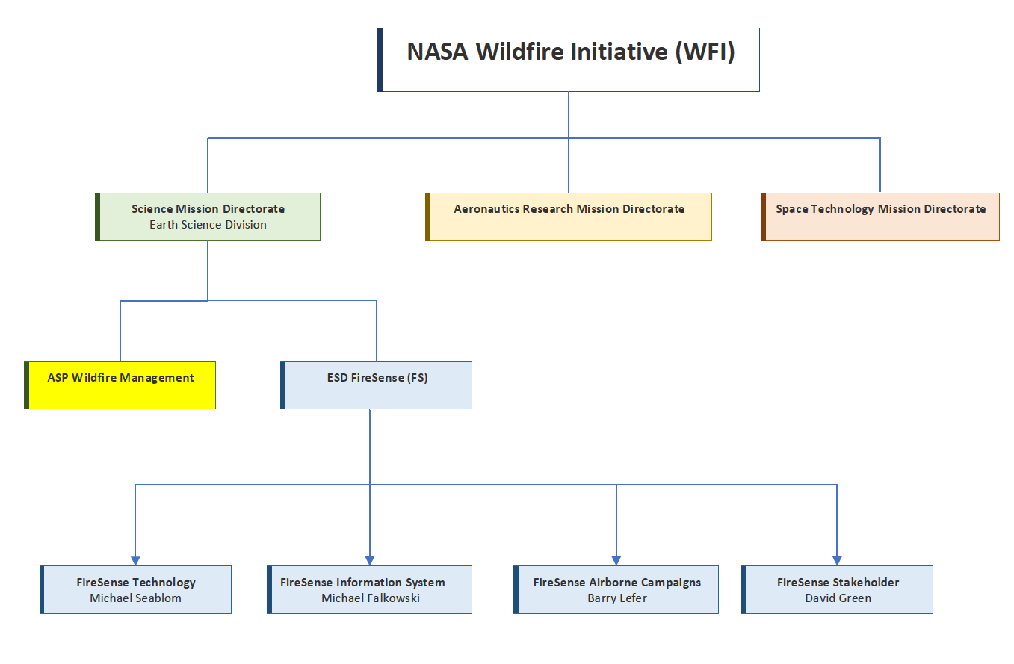
Notes:
Org Chart for NASA Wildfire Initiative and FireSense
Theme Mangers:
Weather and Information Systems Tsengdar Lee
Disaster Response & Resilience Shanna McClean
Health & AQ John Haynes
Water Resources & Hydrology Brad Doorn, Jared Entin
Land Cover Use & Change Garik Gutman /

Slide 3





NASA Earth Science Division
Wildland FireSense Project
Ecosystems Michael Falkowski michael.falkowski@nasa.gov
Atmosphere Barry Lefer barry.lefer@nasa.gov
Technology Michael Seablom michael.s.seablom@nasa.gov
Applications David Green david.s.green@nasa.gov
Cooperative effort to reduce current barriers faced by wildfire management agencies by leveraging NASA’s core competencies in the areas of technology, research, and stakeholder engagement
- Through innovation NASA will help society thrive with future fire
Notes:
NASA Earth Science Division has end-to-end integrated effort.
NASA has been observing wildires fires (fire locations, smoke, forest ecosystems, burn scars) for 50 years using LandSat.
And 2x daily global coverage with MODIS for the past 20 years.
We don’t know where/when fires are going to occur, so satellites observations are needed.
Theme Mangers:
Weather and Information Systems Tsengdar Lee
Disaster Response & Resilience Shanna McClean
Health & AQ John Haynes
Water Resources & Hydrology Brad Doorn, Jared Entin
Land Cover Use & Change Garik Gutman /

Slide 4
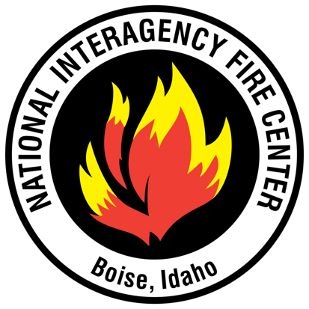
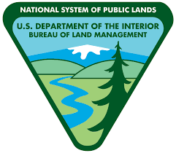


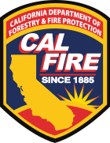









Wildfire Management and Response is a Multi-organizational Effort
Requires coordination among numerous local, county, state, tribal, and federal authorities
  United States Forest Service
  National Interagency Fire Center
  Federal Aviation Administration
  United States Department of Interior
  United States Department of Agriculture
  Joint Fire Science Program
  National Oceanic and Atmospheric Administration
  United States Geological Survey
  National Guard
  United States Department of Defense
  Bureau of Land Management
  Cal Fire
  NASA
  … in addition to many others
Notes:
Fire management in the US is a complex process.
NASA is not an operational agency. We see our role to as a pathfinder.
Our objective is to help these other agencies by providing tools (observations, products, models, etc) so that decisions makers can make better informed decisions.

Slide 5
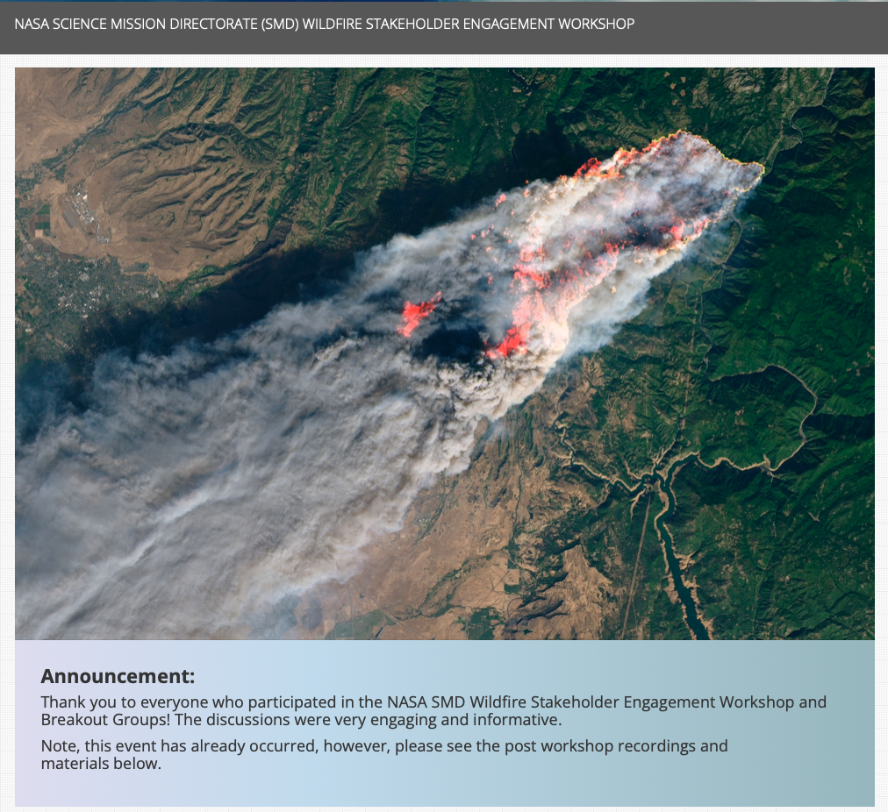
NASA Wildland FireSense is driven by Stakeholder Needs
NASA SMD Wildfire Stakeholder Engagement Workshop – Held Early Feb 2022
Workshop Purpose:
To hear wildfire management stakeholders visions for successful wildfire management.
Participants asked to identify the following:
  Barriers the community has in integrating science, technology, and knowledge into the fire management problem.
  Areas where NASA can help enable collaborative programs and partnerships across the fire lifecycle, including preparedness and adaptation, response, and recovery.
  Key opportunities and priorities to make progress in pre-, active, and post-fire management.
  Identify partnerships and programmatic activities to guide near term action in the wildfire management space
Over 800 participants!
https://nari.arc.nasa.gov/smdwildfire
Notes:
First thing the FireSense team did was have a stakeholder engagement workshop where we listened to wildfire managers needs for 2.5 days (with more than 800 stakeholders participating.
We used what we herd form stakeholders in this workshop to set the goals and objectives of the the NASA Wildland FireSense Project.
Specifically we asked asking: What are your key barriers to managing fires?
We heard that they need better NRT observations. Higher spatial resolution 5 m or better. Persistent observations 24/7. Better observations of species composition, fuel loadings, soil/fuel moisture. Better communications in the field – the last mile problem. Do not need another website.

Slide 6
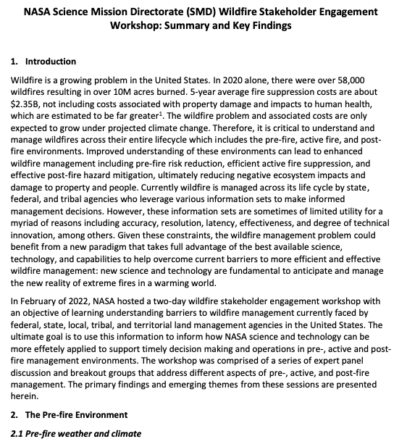
NASA Wildland FireSense is driven by Stakeholder Needs
NASA SMD Wildfire Stakeholder Engagement Workshop – Held Early Feb 2022
Workshop Outcomes: Primary deliverable - whitepaper describing current barriers faced by agencies responsible for managing fire across its life cycle (pre-, active, and post-fire).
Some of What we heard*:
Pre-fire –
Current fuels map of limited utility for operational management
Fire behavior models do not have the necessary fidelity to accurately predict fire behavior and fire spread
Current observations and forecasts of winds, humidity, and fuel moisture are insufficient for fire risk assessment and prediction
Active Fire –
Must reduce of time from ignition to detection and response
Need persistent (24/7) IR imagery of active fires to support fire management and monitoring (and fire science)
Lack of Reliable, high-speed communications/data
Need instruments capable of mass/power limitations of new suborbital platforms
Post-fire –
Improved mapping of forest burn extent and fire severity
Understand impacts to air and water quality and human health
Reduce debris flow prediction uncertainty: landslides, floods, impacts to watersheds
https://aam-cms.marqui.tech/aam-portal-cms/assets/ki2yd52vavkccskc
* In the context of operational fire management
Notes:
Biggest take away…. All the data, capabilities, tech we have to offer is drastically underutilized in terms of operational fire management. Described in white paper summarizing workshop outcomes.

Slide 7
Current Challenges in Operational Wildfire Suppression
NASA ARMD Wildfire Stakeholder Engagement Workshop – Held May 2021
~150 participants
Aerial Suppression Support
Duration of aerial firefighting limited to daylight, clear visibility (4-6 hours/day)
Airspace operations is manual and workload intensive; only a few aircraft allowed at a time
Not able to accommodate drones in the same airspace as other aircraft
Lower aircraft safety record in aerial firefighting than other areas of aviation
Multi-Agency Planning
Multi-agency collaboration for resource and technology roadmap does not exist
Budgets to support forest management and strategic planning are often redirected in season for tactical firefighting (limits adoption of new research and tools in fire management)
Detection Tracking, Surveillance, and Prediction
  Surveillance - infrequent high spatial resolution satellite or aircraft observations
  Fire detection and location accuracy is not precise enough for effective targeting
  Few models for tracking and predicting fire progress, many are unreliable
Better sensing is needed, difficult to observe through clouds and at night
Data and model fusion is limited, need for an integrated observing system
Notes:
ARMD also had a stakeholder workshop. Focused more on fire suppression (i.e., active fire management). Not similar conclusions to the SMD workshop.

Slide 8
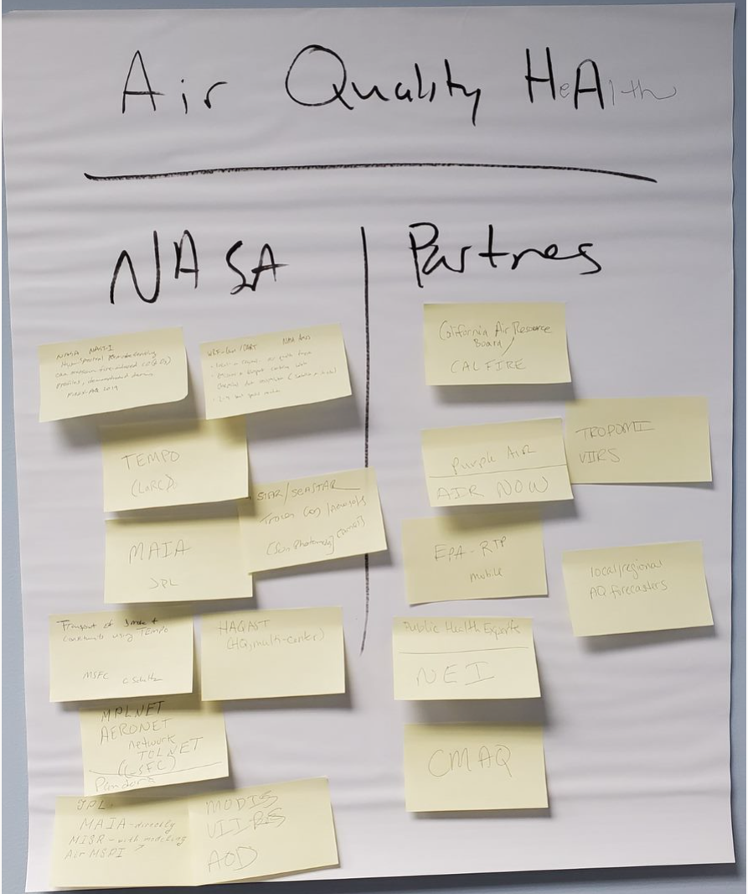
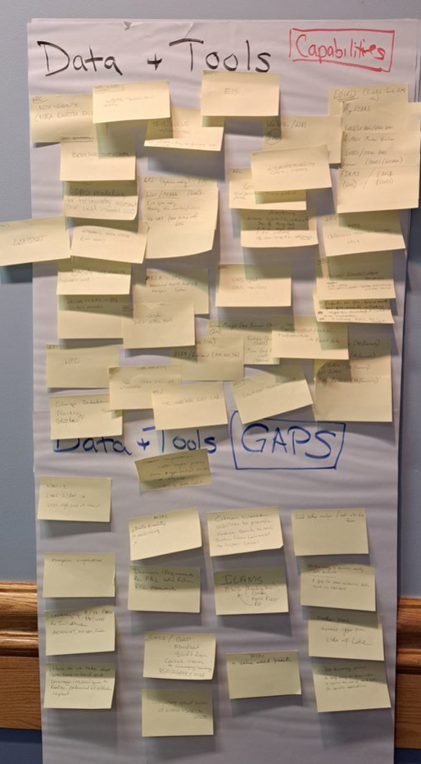
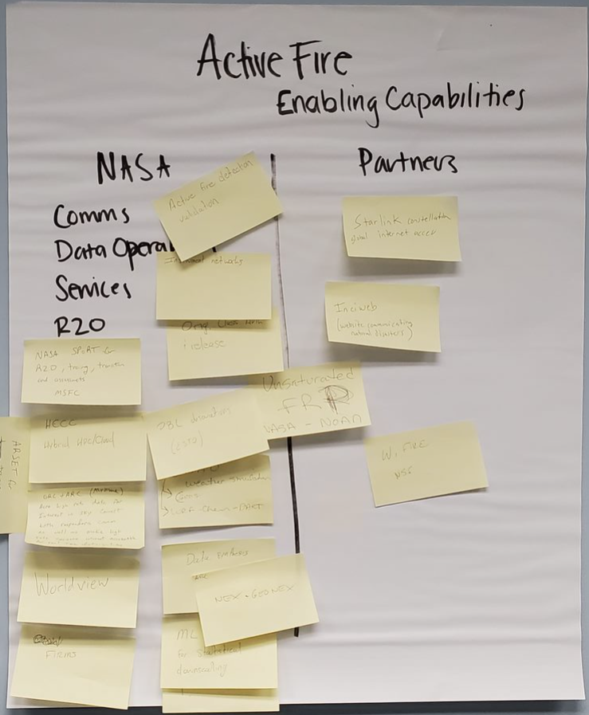
NASA Response to Stakeholder Identified Needs
NASA Center & Partners Capability Mapping Workshops
A series on internal NASA Workshops have been/will be held
Workshop Objectives: Map NASA Research Center (ARC, GSFC, JPL, LRC, MSFC) capabilities to stake holder needs. Identify gaps in NASA capabilities and identify partners (govt agency, industry, academia) with capabilities that can help fill those gaps.
Workshop Outcomes: A workplan identifying overall goals, implementation strategy and milestones for the NASA SMD Wildland FireSense project as well as the NASA Wildland Fire Initiative
Future Stakeholder Workshops
Plan to hold annual stakeholder workshops to assess progress and adaptively plan initiatives going forward

Slide 9
NASA Wildland FireSense – Integrated & Targeted Activities
Applications:
Working with interagency and community stakeholders to identify barriers in wildfire management (pre-, active, and post fire)
Accelerate, empower and improve wildland fire adaptation: community planning, infrastructure and supply line protection, landscape conservation and restoration strengthening the collective outcome of thriving sustainably with fire
Delivering trans-disciplinary and multisector solutions across the fire cycle (pre, active, post) at societal scale
Technology:
Instruments & Information Systems:
Reduce mass and power requirements for next-generation small sat and aerial platforms
Observations from new vantage points
“Sensor webs” enabled by autonomous tasking from numerical models
High performance computing and new algorithms
New on-board computing
Machine learning for modeling, data fusion, and processing in real-time environments
Technology transfer to commercial partners
Research & Analysis:
Improve estimation of fire fuels information (structure, composition, moisture) with NASA observations
Leverage NASA observations to better understand and predict fire behavior
Understand the cumulative impacts of smoke plumes on air quality
Integrate data and create analysis-ready products for fire managers
Provide near real-time fire risk assessments based on improved characterizations fuel loading, fuel moisture and weather (e.g., temperature, lightening potential, etc.)
Improved (accuracy, speed) fire behavior models to aid in the management of prescribed fire and wildfire

Slide 10
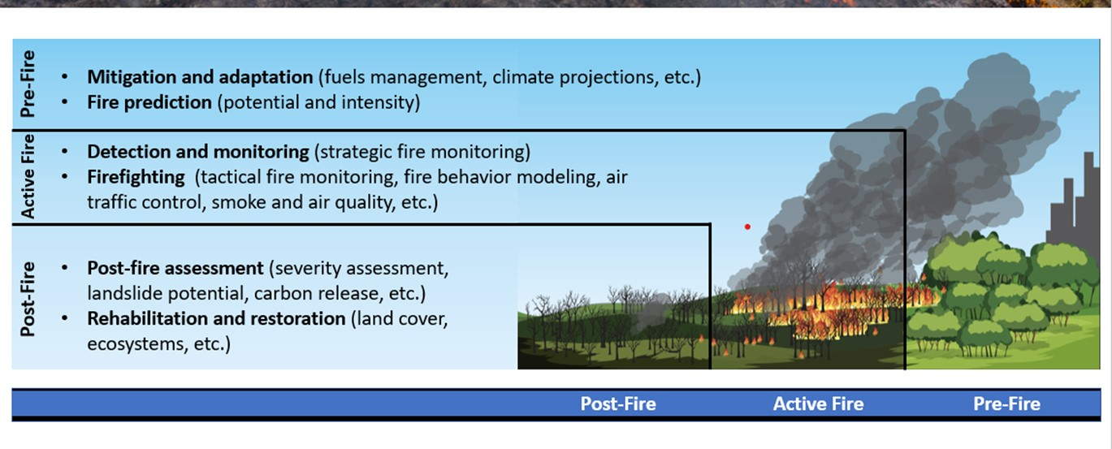
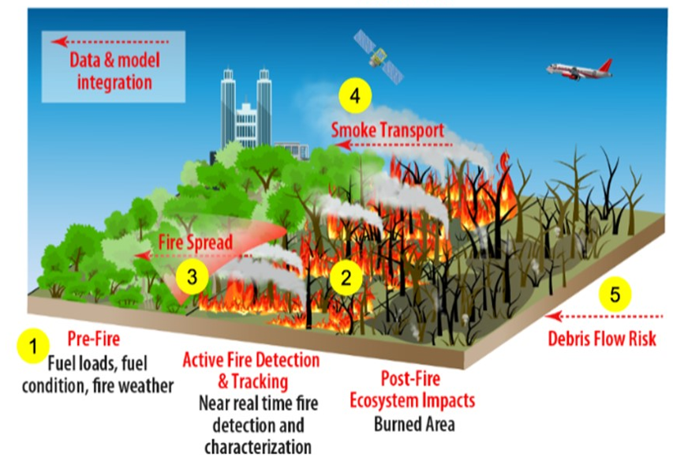
Coordination Across All Fire Phases
NASA's unique capabilities in fire science, technology, and applications are being codeveloped with fire management agencies and other partners to more effectively manage fire across its entire life cycle (pre, active, post fire)
Goal: Over the next 5 years we will continue to work across the agency to reduce current barriers faced by fire management agencies and related stakeholders by integrating NASA’s core competencies in the areas of technology development, remote sensing, & predictive modeling. Through innovation NASA will help society thrive with future fire.
Figures: Morton, Randerson et al., in prep

Slide 11
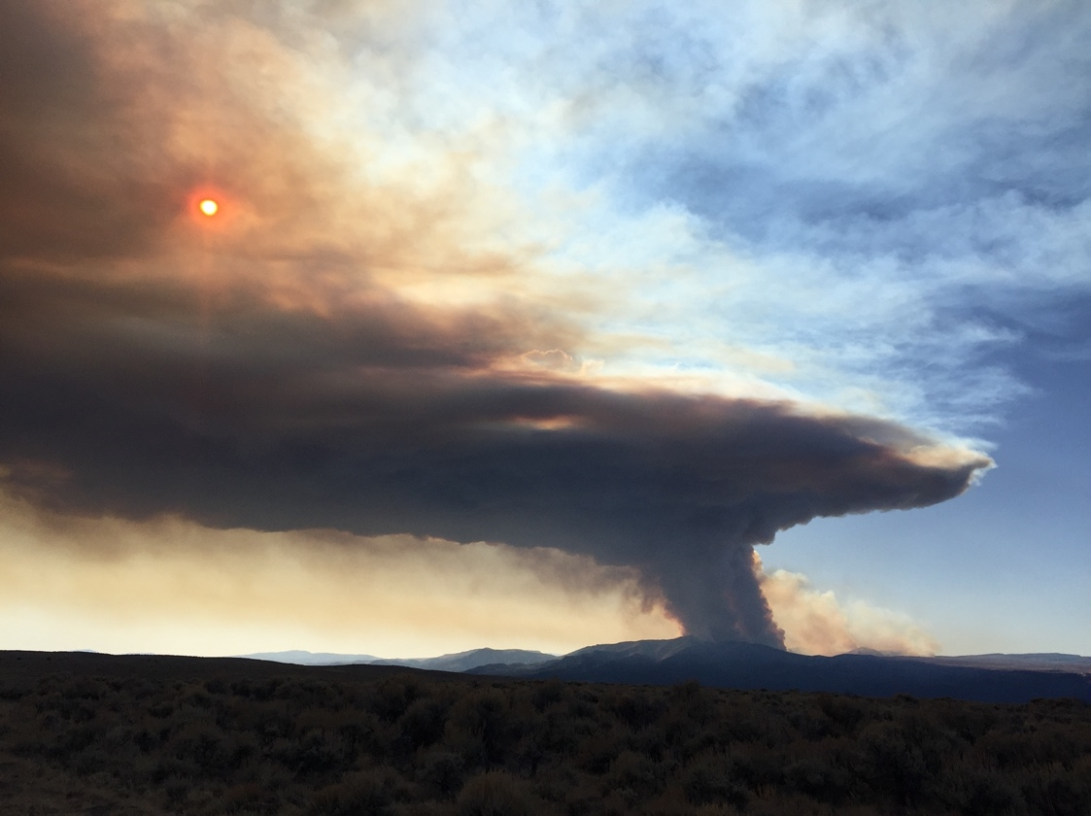
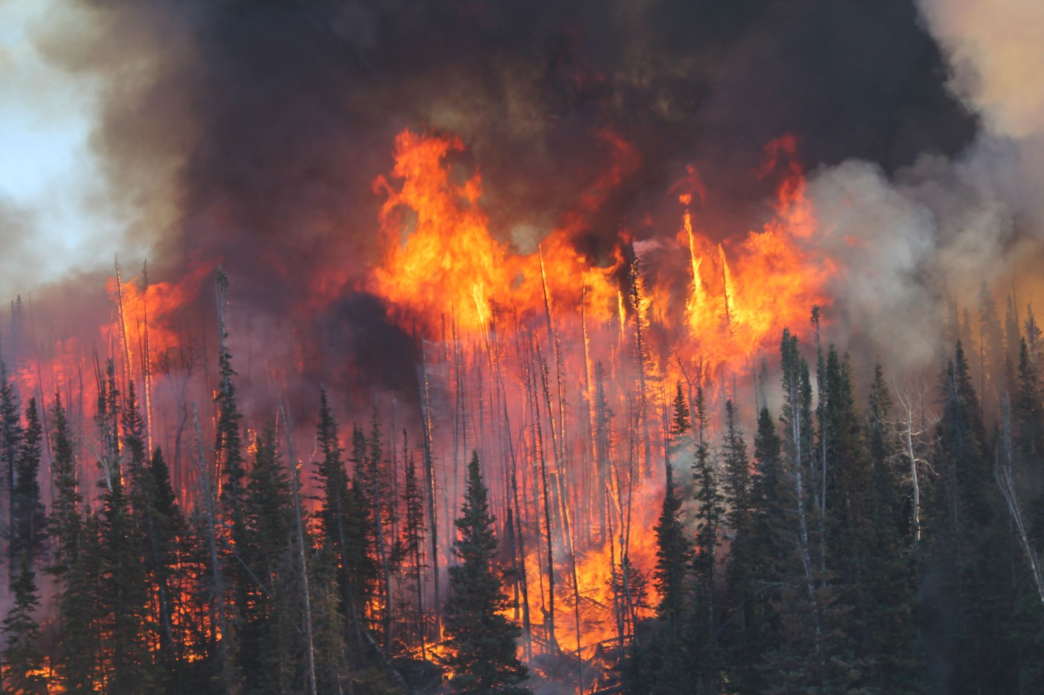
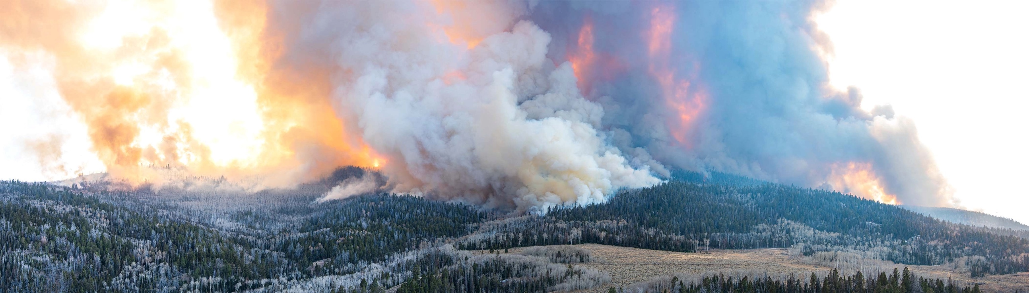
Initial FireSense Field Campaign in Fall 2023
ESD and ARMD have partnered with USFS Fire and Smoke Evaluation Experiment (FASMEE) team to execute a 5000+ acre prescribed burn in the Fishlake National Forest in central UT, planned during October-November 2023. This a dense stand replacement burn will result in a large crown fire. (see FASMEE photos from Langdon Mountain Burn)
Stakeholder Desired Observations
  Species Composition (AVIRIS-ng)
  3-D Forest Structure (LIDAR)
  Soil Moisture (SAR)
  Fuel Moisture (SAR)
  Fire Radiative Power (MASTER)
  Fire Perimeter (MASTER)
  Flaming/Smoldering (MASTER)
  Aerosol Optical Depth (MASTER)
  Plume Height (LIDAR)
  Burn Area and Severity (AVIRIS-ng/MASTER)

Slide 12
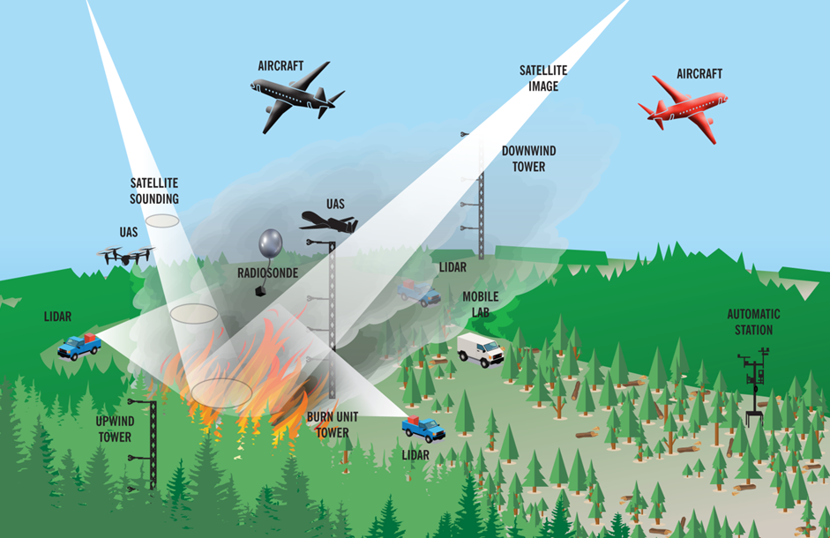
Capstone Field Campaign in Year 5 (2027-28) – Integrated Observation System Demonstration
The Capstone Field Campaign will serve as a technology demonstration event for stakeholders to use/evaluate the tools, products, sensors, and capabilities (Integrated OS) developed during the first four years of FireSense.
The hope is that the success of the Capstone Field Campaign will enable the successful adoption/transition of FireSense developed capabilities by our stakeholder/operational agencies, and ultimately enable more prescribed fire and more effective wildfire management.
Started conversations with USFS, NOAA, EPA, and USGS. Need to have good stakeholder engagement (years in advance) for this effort to succeed.

Slide 13
Wildfire Capabilities & Support Delivered by NASA
NASA ARMD is leveraging innovative capabilities to support the US wildfire community including:
  Scalable Traffic Management for Emergency Response Operations (STEReO) demonstrations of prototype capabilities for integration of UAS into wildfire response operations USFS, CalFire, 2021
  Hosted workshops with Flight Safety Foundation to develop wildfire and disaster response use cases for In-time Systemwide Safety Assurance capabilities, January 2020
  Collaborative agreements with US Fire Service, CalFire and JAXA to help modernize aerial operations associated with emergency response.
NASA STMD support to the US wildfire community includes:
  SBIR-STTR – Wildfire-related awards to small business have been made totaling $2,363,784 (2005-2019) and wildfire-related subtopics proposed for current solicitation
  Space Technology Research Grants - 6 wildfire-related grants (2007-2014)
  Possible directed funding opportunities
    SBIR Phase II Sequential
    Prizes and Challenges
    iTech, Commercialization acceleration
NASA Work with the Wildfire Community Provides Strong Foundation on Which to Build

Slide 14
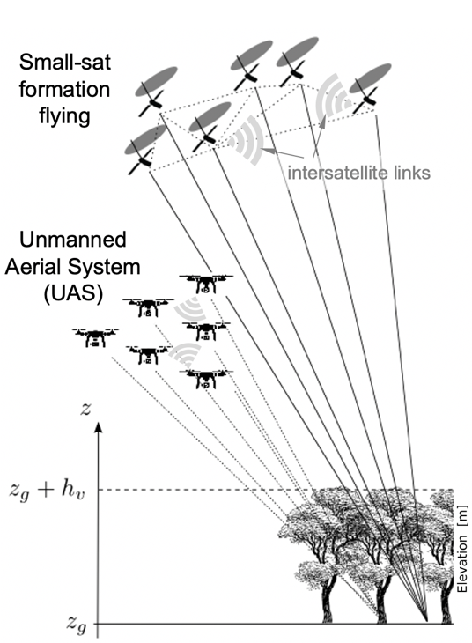
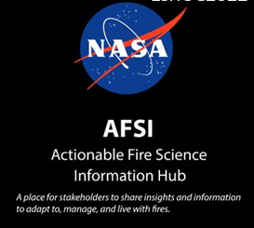
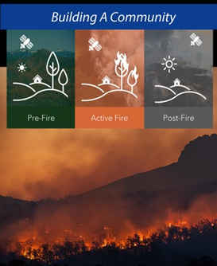
NASA ESD Wildland FireSense - Execution
Work to date:
Hosted a stakeholder engagement workshop in Feb 2022 to better understand current barriers to fire management faced by fire management agencies (~800 participants)
Hosted internal NASA workshop (May 2022) at GSFC to map NASA center capabilities to the previously identified stakeholder needs
Coordinating with ARMD on UASs, scalable traffic management, and aerial operations for emergency response (August 2022 meeting at ARC, regular virtual meetings)
FireSense Technology solicitation released in June 2022
Wildland Fire Management Program funded nearly 40 projects in fire applications (late FY22) and developed the Actionable Fire Science Information Hub
SBIR partnership and selections through new “Climate Sequentials” program (2 awards for new instruments)
The Research and Analysis program released a wildfire focused topic under the Interdisciplinary Science Solicitation in ROSES 2022. Wildfire impacts on terrestrial ecosystems, feedbacks to the atmosphere and consequences to human communities. Due date 11/16/22.

Slide 15
NASA ESD Wildland FireSense - Execution
Planned work:
Continue to engage with NASA centers and stakeholders through regular meetings and workshops (next workshop in Nov 2022 at ARC)
Continue to collaborate with ARMD on scalable air traffic management to support wildfire management (e.g., tabletop exercises)
Make selections for the FireSense Technology and Interdisciplinary Science solicitations, which are expected to start work in the second half of FY23
Continue to partner with STMD through SBIR, expect to have a topic in FY23 “Climate Sequentials” program
Conduct annual targeted airborne campaigns to test new technology and also further improve characterization of the prefire (fuel characteristics), active fire (fire spread and smoke) and postfire (burn severity and impacts) environments
Develop technology and modeling to support a capstone airborne field campaign in 2027 to demonstrate the tools we develop to support fire management in near-real-time
Directed funding to centers and ROSES solicitations

Slide 16
Thank You – Questions?

