Slide 1

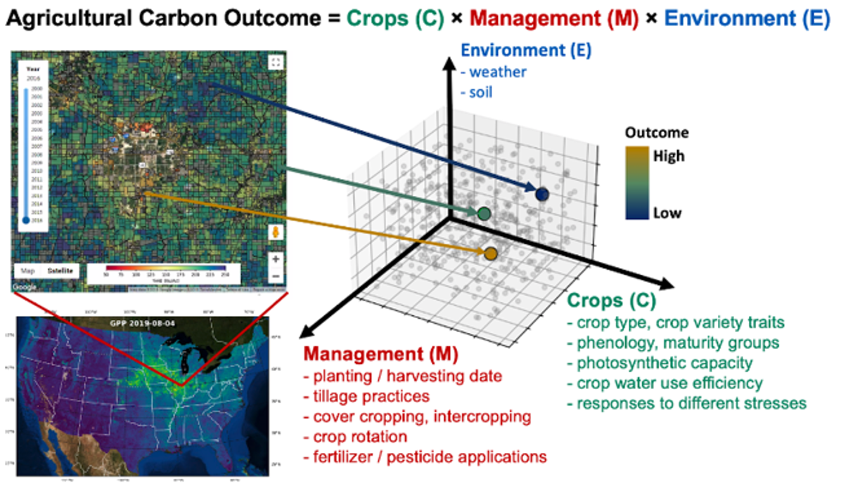
Kaiyu Guan (University of Illinois)
Challenges in Ag LCLUC Science
Progress, Challenges, & Opportunities
We call for a holistic consideration and characterization of agroecosystems:
  Not only mapping of crop type and crop yield
    But also other ag traits (e.g. soil carbon change, carbon budget/fluxes, crop water uses (ET), canopy nitrogen, etc)
  Urgent needs to map Management Practices
    such as tillage practice, cover cropping, marginal land use) – critical for land management, climate-smart practices, carbon market
  Quantify outcomes of LCLUC change
    monitor, modeling, and optimizing – a strong need of integrating remotely sensed information with advanced biophysical/biogeochemical models to quantify outcomes
  Socio-economic impacts and decision-making
    Supporting farmers, supporting policy-makers (e.g. farm bill, international policies), support private industry’s investment on realizing their climate pledge
  Leverage new sensors and technologies
    SBG, GOES-R, ECOSTRESS, Landsat9, ESA’s missions
    IoT sensors, mobile vehicles, airborne hyperspectroscopy
Kaiyu Guan, Zhenong Jin, et al. (2022): “A scalable framework for quantifying field-level agricultural carbon outcomes” - A white paper can be downloaded here: https://eartharxiv.org/repository/view/2905/

Slide 2
Sergii Skakun
Challenges in Agriculture LCLUC Science
Classification → Mapping → Area estimation
  CS → validate methods, RS → validate maps
  Recommended practices exist but followed
Production = yield x area
Uncertainties
  Russia, winter wheat (2021): Yield ~3.4 t/ha, Area ~15.4M ha,
  assuming ~10% uncertainty in both yield and area:
  Production = 52.4 ± 7.4 MT (14%)
Lack of long-term crop-specific maps
  Monitoring changes
  Crop rotations
Science-to-operation transition
  Limits of methods/models are important

Slide 3

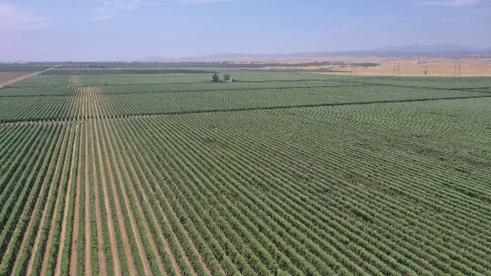
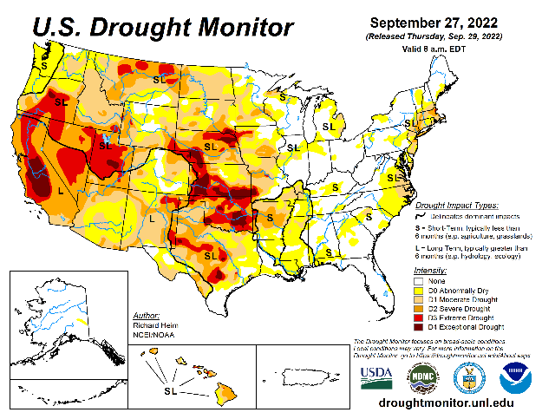
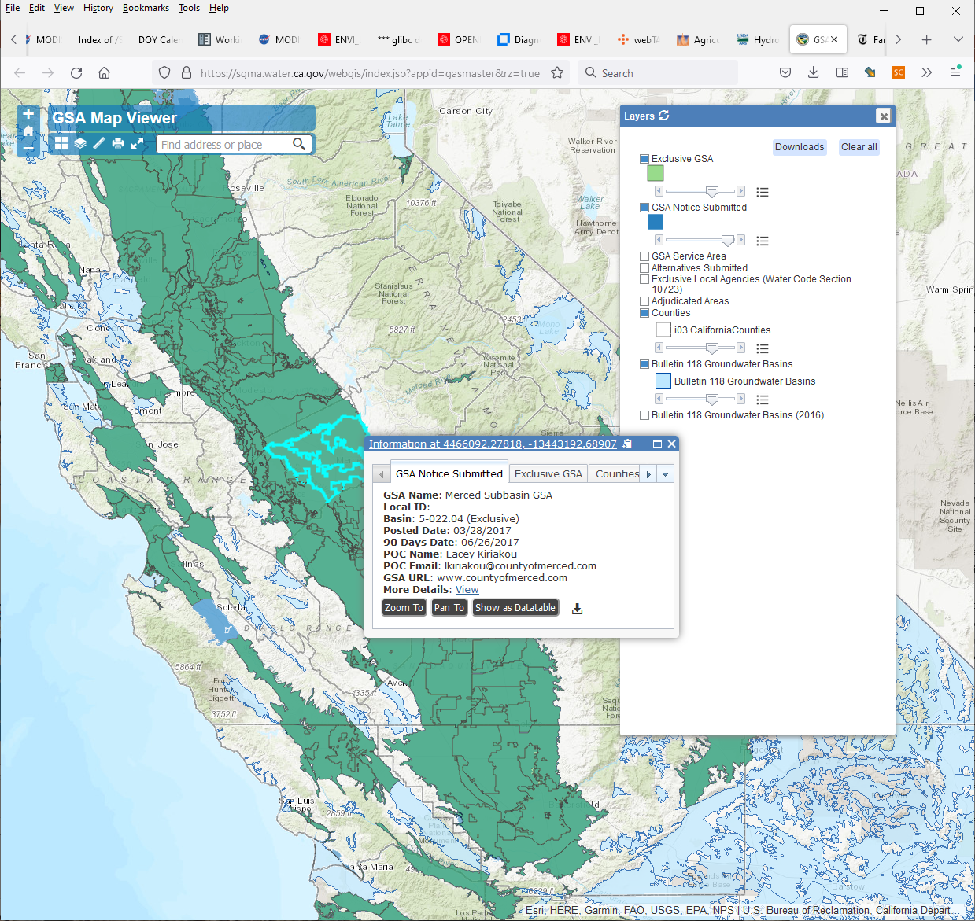
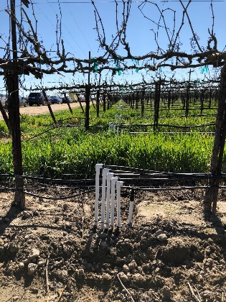
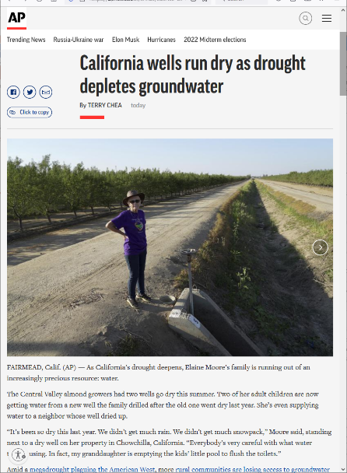
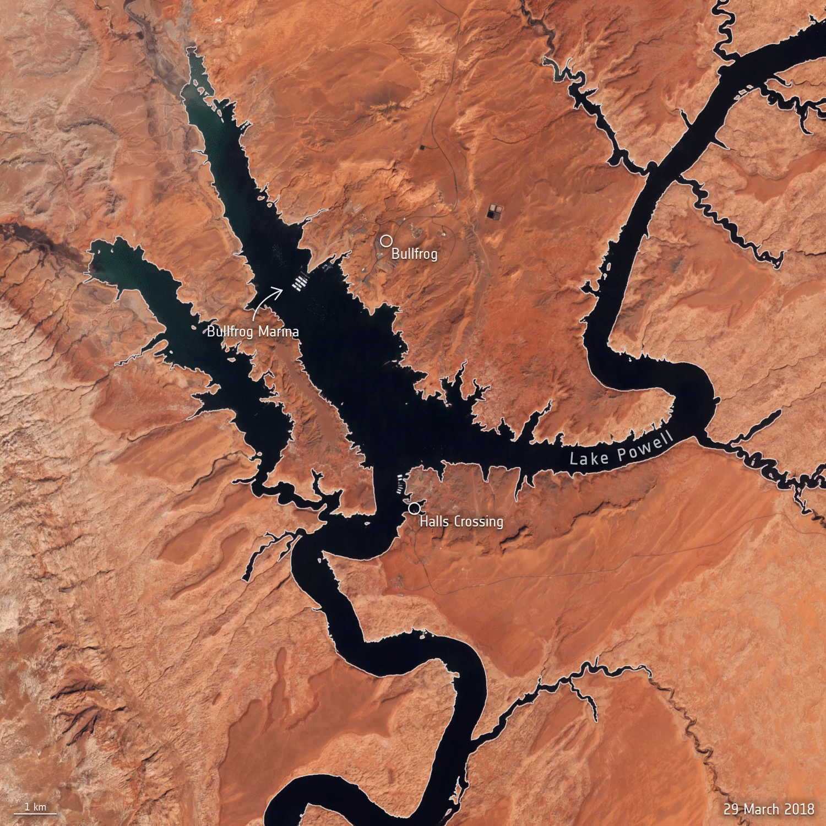
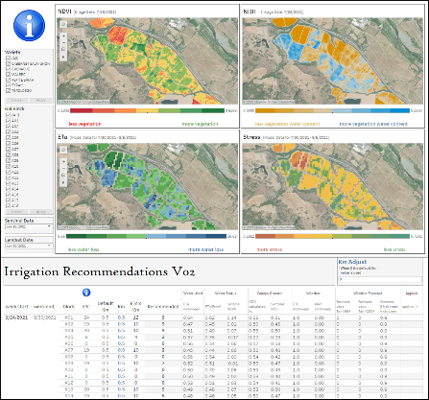
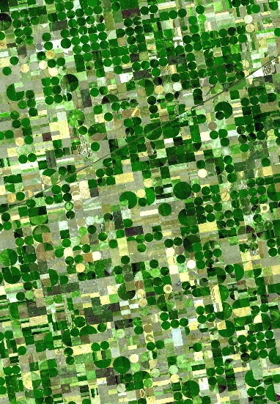
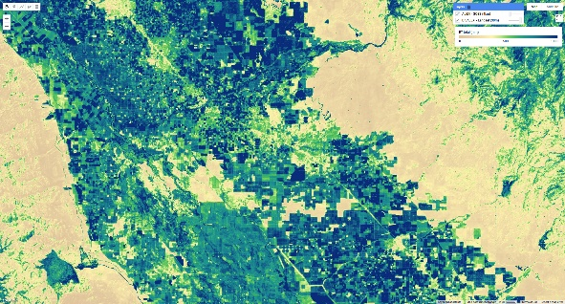

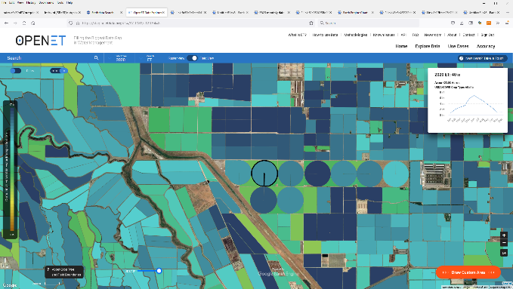

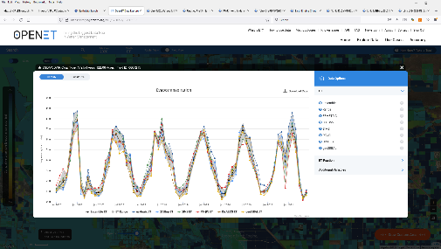
Martha Anderson
Agricultural Water-Management and Water-Use Change
Challenges
Responses
Drought + climate change
Increasing demands
Reservoirs at historic lows
Declining aquifers
Water calls
Drought preparedness plans
Legislation (e.g., CA SGMA)
Water conservation pilots
New cropping systems
Irrigation efficiencies
Information Needs
Evapotranspiration (ET) – “water expenditures”:
At scales of management (field/daily)
Shared, transparent, and trusted data source
Near real-time and easily accessible
Lake Powell – 2018 to 2022
(Sentinel 2, ESA)
OPEN ET
Filling the Biggest Data Gap in Water Management
Ensemble modeling on Google Earth Engine (etdata.org)
Landsat (ET gold standard: TIR+VSWIR), HLS, ECOSTRESS, SBG…
Co-developed with end users to ensure usability
Supports both water resource management and LCLUC (WUC) science

Slide 4
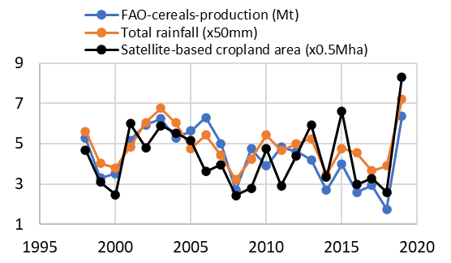
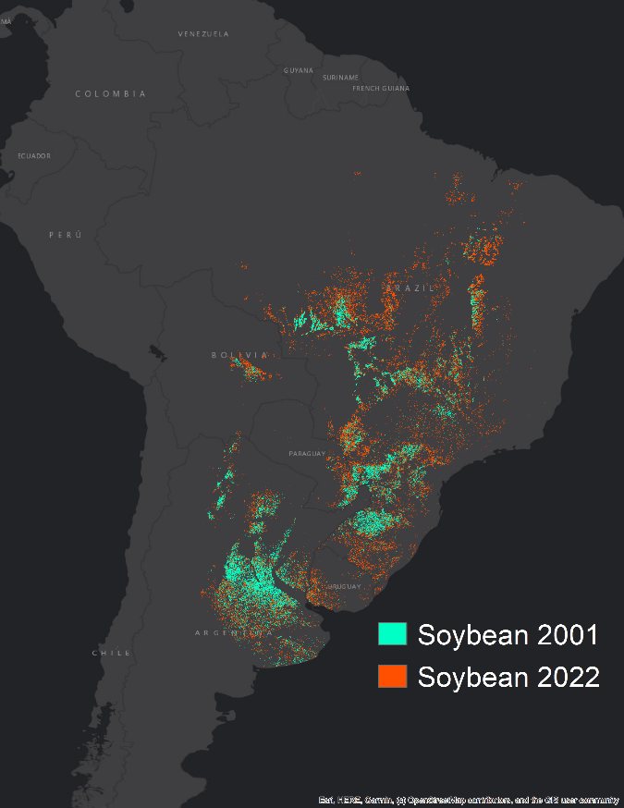
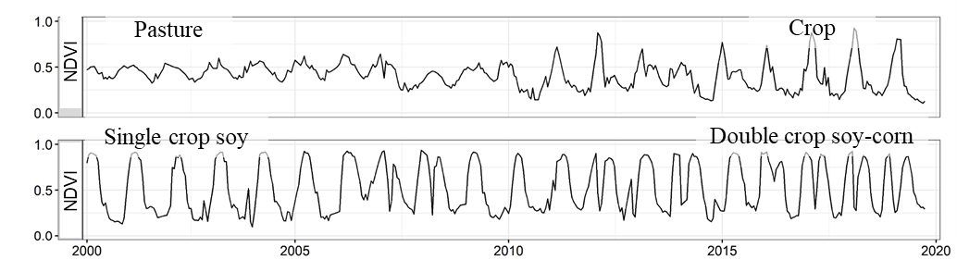
Xiao-Peng Song
Challenges in Agricultural Remote Sensing and Land-Use Change
Challenges
Accelerated expansion of cropland in the tropics at the expense of tree cover and other natural vegetation.
Extreme weather and climate events are increasing the risk of food production and insecurity.
Regional conflicts and political instability threaten food security at regional as well as global scales (e.g. the Ukraine war).
Global cropland area was 1,244 ± 63 Mha in 2019
Increased by 102 ± 45 Mha (9%) since 2000.
Potapov et al. (2022) Nat. Food
Syrian civil war began
Opportunities
Near-real-time satellite monitoring as the natural/human disasters are unfolding
Map crops at a broad scale and across time to reveal the exact pathways of land-use change (e.g. palm oil, soy).
Explore other means of increasing food production
  Optimize crop distribution and rotation
  Sustainable intensification
  …
Red: cropland reduction, Blue: cropland increase, as a result of war
Li et al. (2022) Nat. Food
Severe drought
Soy expansion in South America
Soy fields were mostly converted from previously deforested pastures.
Single-cropping soy changing to soy-corn double-cropping in Mato Grosso.
Song et al. (2021) Nat. Sustain.

